Slide 1
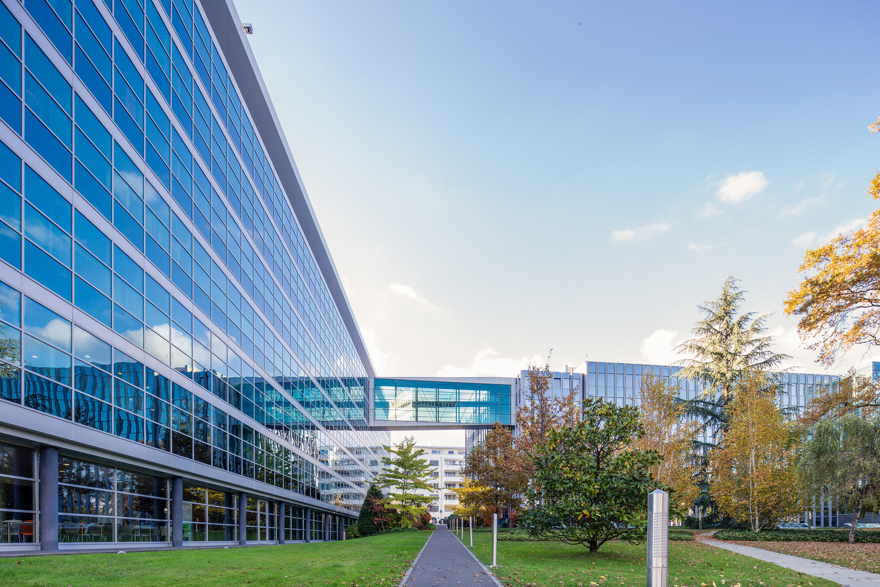


Intangible Assets Valuation
Dr. Daniel Sava
Dr. Brian More
Mathys & Squire Consulting

Slide 2
Work through academic specific examples
Dr. Brian More

Slide 3
Case study 1 – Software valuation (copyright)
Scientific software for selling to pharma and chemical industry companies
Accounts for cost of development
IP copyright – not patented; no open-source code used
The software comprises 5 modules developed in collaboration between the biotechnology department and the computing department
Use the cost to reproduce at today's prices

Slide 4
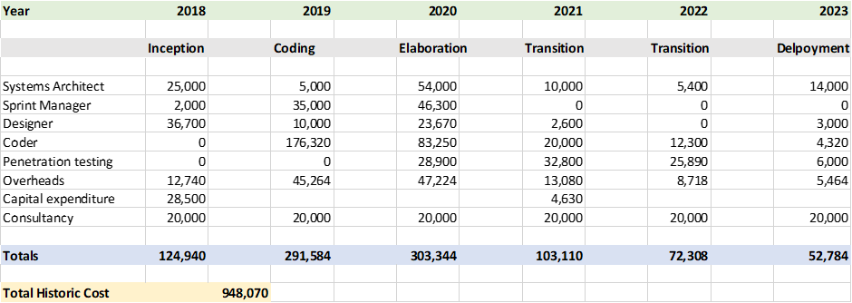
Financial Data Verified by Accounts
Accounting year end the 30th of June

Slide 5
Input Parameters for Valuation
Adjustments
Tax
Inflation rate 5% pa
Obsolescence 10% pa
Profit 10%
Opportunity cost 10%
Discount rate 15%
Valuation date 30/08/2023
Corporation Tax 25%
Tax Amortization period 15 years
Annuity 5.8473
TAB factor 0.10797943

Slide 6
Step by Step Calculations
Multiply the annual costs by the profit and opportunity cost to enhance the value = 120%
Multiply the new costs by the inflation factor
Number of days from the accounting period end to the valuation date = 61 days
Enhancement factor = 0.167 to increase the costs from June to August
For 2023 multiply by (1 + 0.05) ^ 0.167 = 1.008
For 2022 multiply by (1 + 0.05) ^ 1.167 = 1.059
Then continue back to 2018

Slide 7

Step by Step Calculations
Divide the new costs by the obsolescence factor
Number of days from the accounting period end to the valuation date = 61 days
Enhancement factor = 0.167 to increase the costs from June to August
For 2023 divide by (1 + 0.10) ^ 0.167 = 1.016
For 2022 divide by (1 + 0.10) ^ 1.167 = 1.118
Then continue back to 2018
Reproduction cost then equals the sum of the bottom line = € 953,371

Slide 8
Accounting for tax and tax amortization benefit (TAB)
Reproduction cost then equals = € 953,371
Corporation tax = 25%
Tax deducted = € 238 343
After tax reproduction cost = € 715,028
Tax amortization benefit = € 77,208
Fair Market Value of Software = € 792,236

Slide 9
Commentary on Calculations
The inflation rate is taken at 5% per annum, more accurately you would apply the inflation rate at the known yearly rate.
Obsolescence is taken at 10% per annum, this varies dependent upon the complexity of the algorithms.
The fair market value is very sensitive to the obsolescence
For an obsolescence of 20% the fair value becomes €539,752

Slide 10
Case study 2 – Teaching material (copyright)
Teaching material – new way of teaching medical students – saves Medical universities cost;
Your university medical school has developed a blended teaching software package along with online real time assessment for medical students. The software is a gamification of traditional lecture theatre training with cost savings as shown on the next slide:

Slide 11
Medical School Cost Savings 2023-2028
Lecture theatre time saved = 200 hours per annum
Marking and assessment time saved = 500 hours per annum
Blended cost of teaching staff = $ 250 per hour (includes overheads)
Blended cost of marking staff = $ 50 per hour (includes overheads)
Total cost saving = $ (200 x 250) + $ (500 x 50) = $ 75,000 per annum

Slide 12
Input Parameters for Valuation
Adjustments
Tax
Growth rate 5% pa
Terminal growth rate 1%
Discount rate 20%
Valuation date 29/08/2023
Financial year end 31/12/2023
First cash flow 31/12/2023
Corporation Tax 25%
Tax Amortization period 25 years
Annuity 4.947587
TAB factor 0.0520511

Slide 13
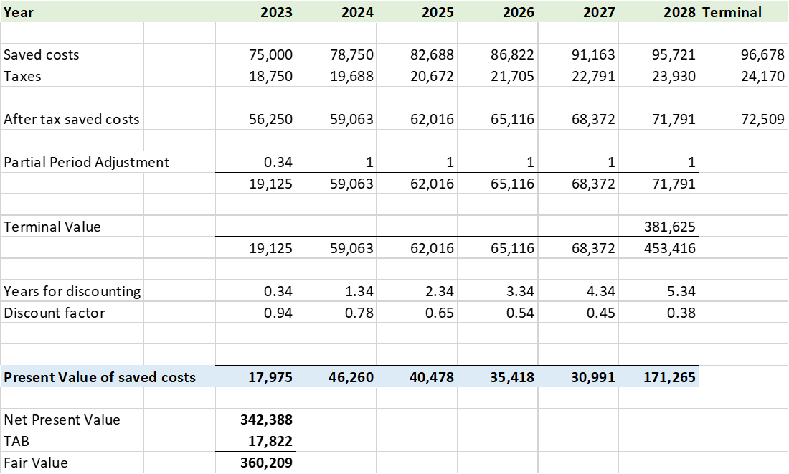
Step by Step Calculations

Slide 14
Commentary on Calculations
The discount rate is taken at 20%, this is high for a public university where the cost of capital is debt only, this figure is more like a small private university value.
For sensitivity calculations take the discount rate to 10%, then recalculate.
Result
A 48% increase in the expected lifetime value

Slide 15

Licensing Considerations
The total value of the NPV of the cost savings using the gamified teaching material = $360,000.
The licensing university would expect 25% of this as a royalty = $90,000
Or $9,000 per annum over 10 years.

Slide 16
Case study 3 – Valuation of technology (patents + know how)
Case study 3ISR report – quite clean + different types of claims
There are a few strong competitors
The team is very experienced and can deliver scale-up; done so with previous technology
No projections, not easy to get the costs of development as was done alongside other things.

Slide 17
Case study 3 – Valuation methods
What method would you choose?
Relief from Royalty – easiest to obtain data for
DCF/Greenfield can also work – more data required about EBIT, changes in working capital, investment requirements, depreciation & amortisation.

Slide 18
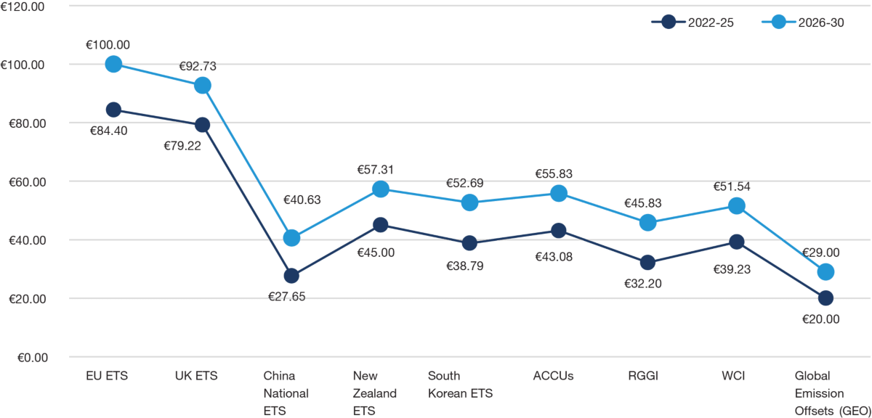
Case study 3 – Revenue modelling
Carbon market – a few established players
https://www.iea.org/energy-system/carbon-capture-utilisation-and-storage
Around – 125Mt per year by 2030 (125 million tonnes)
For our example – the technology aims for 1Mt by 2033 – Fisher Pry to model the diffusion of the technology.
Price per tonne – PwC – forecasts future carbon offset prices (graph) – assume a $60
https://www.pwc.co.uk/services/sustainability-climate-change/insights/bullish-sentiment-expected-over-next-decade-for-carbon-markets-globally-latest-trends-and-developments-in-2022.html#:~:text=The%20EU%20and%20UK%20ETS,2026%2D30%20for%20both%20schemes

Slide 19
Case study 3 – Revenue modelling
Year | 2023 | 2024 | 2025 | 2026 | 2027 | 2028 | 2029 | 2030 | 2031 | 2032 | 2033
Time | 0 | 1 | 2 | 3 | 4 | 5 | 6 | 7 | 8 | 9 | 10
Penetration | 3.23% | 7.24% | 15.45% | 29.94% | 50.00% | 70.06% | 84.55% | 92.76% | 96.77% | 98.59% | 99.39%
Removal Capacity | 32 | 72 | 154 | 299 | 500 | 701 | 846 | 928 | 968 | 986 | 994
Target removal capacity | 1,000
Shape parameter | 0.85
Timeto50% | 4
Revenue in thousands)

Slide 20
Case study 3 – Royalty rate
Year | Licensor | Licensee | IP right | Territory | Base | Royalty | Restrictions
15/04/2021 | Euacentrix LLC | Boon Industries Inc. | IP covering proprietary technology – Proprietary formula (ClO₂ + water) & make use Proprietary Equipment | Worldwide | Net Sales | 5% | Exclusive; For all application and uses
19/11/2020 | Digital Research Solutions Inc. | JANGIT Enterprises Inc. | Patent (US 10572726 (digital media document summarizer) + associated know-how | Worldwide | Net Sales | 6% | Exclusive, Solely for field of Summarization, Consolidation and educational software
04/12/2019 | Tortec Forschungsinstitut gmbh | Tortec Titan+ | Exploit the technology (List of 8 patents (Ukraine, Russia) + technologies, patents, designs, processes, formulas, know-how, technical data, etc.) to produce TORtec products. | Worldwide | Net Income | 10% | Exclusive, Perpetual, Irrevocable
21/04/2015 | SG Blocks Inc | Red Cardinal Holdings | Proprietary method and technology for construction of buildings | Worldwide | Net Sales | 10% | Non-exclusive USA, EU Exclusive – The world – (USA+EU)
01/08/2011 | Temple University | Save the world air, inc. | Patent rights (Patent portfolio – Method for Reduction of Crude oil viscosity – USA, Brazil, Canada, UK, China, Indonesia, Mexico, Nigeria, Norway, Russia, Arab Emirates- granted only in UK and Nigeria) and technical information for making, selling, using, importing Licensed product | Worldwide | Net Sales | 7% for (first $20m sales, sliding scale to 4% for >$100m | Exclusive
12/07/2010 | CEFCO Global Clean Energy, llc/CEFCO LLC | Peerless, LLC | CEFCO Process (Patent US20080250715+ know-how) in the field of “air quality control systems for post-combustion gases, including air filtration, air emissions control, carbon emission and capture and air pollutants recovery, and the production of end-products, including chemicals, fertilizers, fuels, and metals and minerals, from the products of such filtration, control, capture or recovery process.” | USA | Gross Revenue Sales | 5% | Exclusive, 10 years
09/12/2014 | Rice University | Tubz, LLC | Patent family (USA, Europe, Israel, South Korea) - Graphene-CNT Hybrid Material and Use as a Supercapacitor Electrode | Worldwide | Adjusted Gross Sales | 3% +other payments | Exclusive, Field of use (consumer electronics (including without limitation mobile electronics, mobile telephones/smartphones, tablets, and wearable electronics), nano electronic technologies, electric vehicles, energy storage, and medical devices.)

Slide 21
Case study 3 – Royalty rate
What royalty rate should we use for this valuation?
Which do you think is the closest comparable?
In my view – 5th agreement is the closest – start from 5% - consider geography, exclusivity, any other existing licences.
How would you adjust if you discover there is already a contract that gives a companies a free non-exclusive world-wide licence?
3.25% - 3.75%

Slide 22
Case study 3 – Discount rate and risk adjustment
What are the risks for this technology to reach the market?
What are the risks associated with the IP?
How can we account for the risk in the IP valuation?
Either high VC discount rate; or Rate of return of startup (20%) + risk adjustment of revenues (10% success rate)

Slide 23
Case study 3 – Other parameters
Tax rate – 25% - usually a good assumption if no information
Terminal growth rate - -7% - the patent expires in 2043
Tax amortisation period – Remaining patent lifetime
Valuation data
End of financial year

Slide 24
Case study 3 – Revenues & Inputs

Slide 25
Case study 3 – Fair value

Slide 26
Case study 3 – Sensitivity Analysis

Slide 27
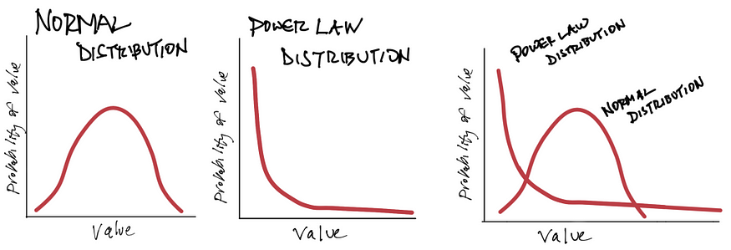
Spinouts and VC funding
Venture capital works on a Power Law model
VCs – each investment is made with the potential of returning 10-20x (the whole fund or more)
Most of the investments will fail
A few will return the invested capital or a bit more
Outliers will return most of the fund
Source: https://dougshapiro.medium.com/power-laws-in-culture-27ab6461c693

Slide 28
“A healthy intellectual property position may not guarantee a start-up technology company is going to be successful, but it is going to find it a whole lot harder to succeed if it does not have one. And crucially, it is not just the ownership of intellectual property that is important, it is the understanding that intellectual property is a key.”
Joff Wild

Slide 29
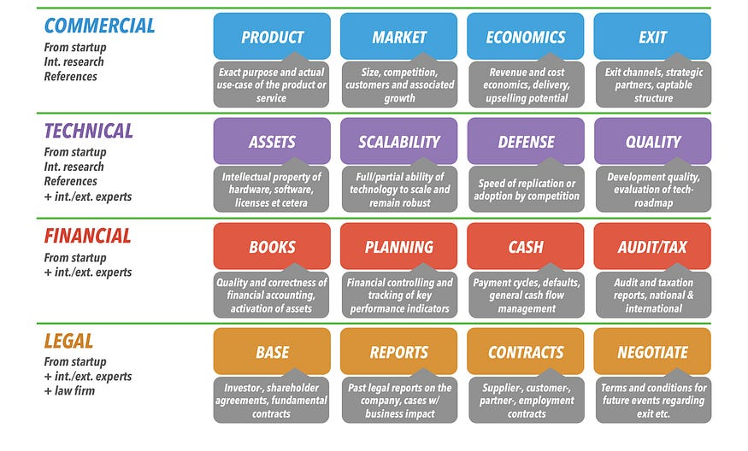
Spinouts and VC funding – due diligence

Slide 30

Spinouts and VC funding – valuation approaches
Premoney valuation = Postmoney valuation – Invested Capital
Early stages- VCs value company/not IP individually
  IP is included in the company value (main driver of value)
Pre & Post money valuation
The Art
  How much money one needs to raise? – VCs usually want 20-30% equity
  Interest from other investors (FOMO) – more leverage
  “We laugh at [venture] firms that use spreadsheets for seed and Series A deals for valuations. There’s just not enough data.” says Mendelson, co-author of the book, Venture Deals: Be Smarter Than Your Lawyer and Venture Capitalist.
Early stage – lack of historical financial data
Premoney valuation - €4m | 80%
Postmoney valuation - €5m |100%
Invested capital - €1m | 20%

Slide 31
Spinouts and VC funding – valuation approaches
3 semi-quantitative method (high degree of subjectivity) – Payne Scorecard, Berkus method, and Risk factor summation method.
Example of Payne Scorecard
2 quantitative methods – VC method; First Chicago method.
VC method

Slide 32
Spinouts and VC funding – Payne scorecard
Comparison Factor | Weight in Valuation
Strength of entrepreneur & Team | 0-30%
Size of the opportunity | 0-25%
Product/Technology | 0-15%
Competitive environment | 0-10%
Marketing/Sales/Partnerships | 0-10%
Need for additional investment | 0-5%
Other factors | 0-5%
Develop for seed companies in the range of $1m - $2.5m – Premoney valuation.
Decide on comparison factor for potential company
Compare the factors with a benchmark company for which the Premoney valuation is known
Add factors and multiply with benchmark pre-money valuation
Source: William Payne, The Definitive Guide to Raising Money from Angels; Antonella Puca, Early Stage Valuation: A Fair Value Perspective

Slide 33
Spinouts and VC funding – Payne scorecard
Comparison Factor | Target company | Benchmark | Comparison | Factor
Strength of entrepreneur & Team | 30% | 25% | 120% | 0.36
Size of the opportunity | 25% | 25% | 100% | 0.25
Product/Technology | 15% | 20% | 75% | 0.1125
Competitive environment | 10% | 10% | 100% | 0.1
Marketing/Sales/Partnerships | 10% | 12.5% | 80% | 0.08
Need for additional investment | 5% | 5% | 100% | 0.05
Other factors (great traction) | 5% | 2.5% | 200% | 0.1
Total factor – 1.0525; Benchmark Premoney valuation - $2m
Target Premoney valuation - $ 2.105m

Slide 34

Spinouts and VC funding – VC method
Estimating – Postmoney valuation & ownership % - as a function of desired risk adjusted return & capital to invest
Postmoney valuation = Valuation at exit/(1+Target Return)^{Time to exit}
Example
€1m to invest; Required return 40%
Value at exit - €30m; Time to exit – 6 years
Target Total value to paid in capital (TVPI or Investment multiple) - (1+Target Return)^{Time to exit} – 7.53
Postmoney valuation - €30m/7.53 – approx. €4m

Slide 35
Thank you for your attention!
DSava@mathys-squire.com
BMore@mathys-squire.com
© Mathys & Squire Consulting, 2023
2023

