Slide 1
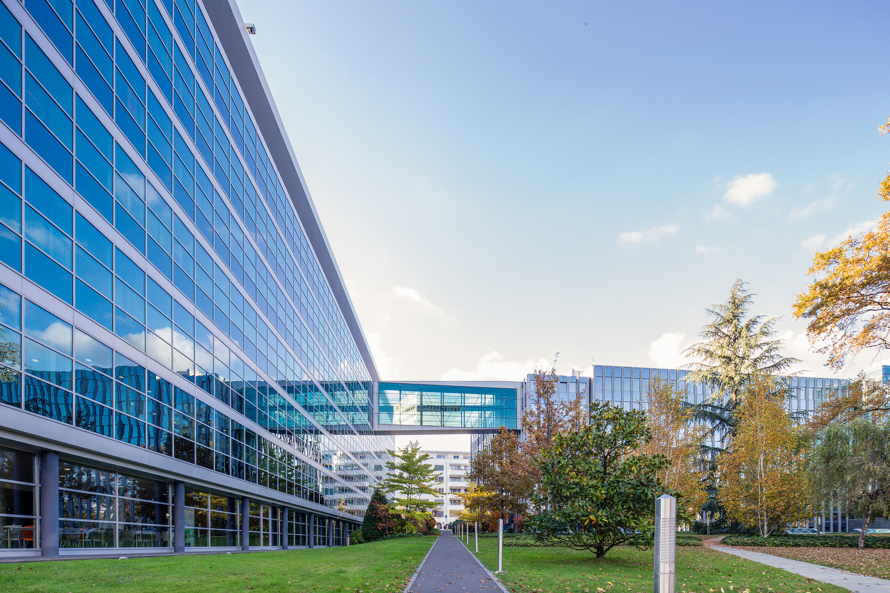


Intangible Assets Valuation
Dr. Daniel Sava
Dr. Brian More
Mathys & Squire Consulting

Slide 2
Contents
Introduction
Fundamentals of Intangible Assets Valuation
Methodologies and their limitations
Advanced Income approach methods & key parameters
Work through academic specific examples
Q&A; Wrap-up

Slide 3

Dr. Daniel Sava
IP commercialization professional
PhD in Chemistry (Materials Science, Life Sciences)
Financial Modelling Valuation Analyst (FMVA®)

Slide 4

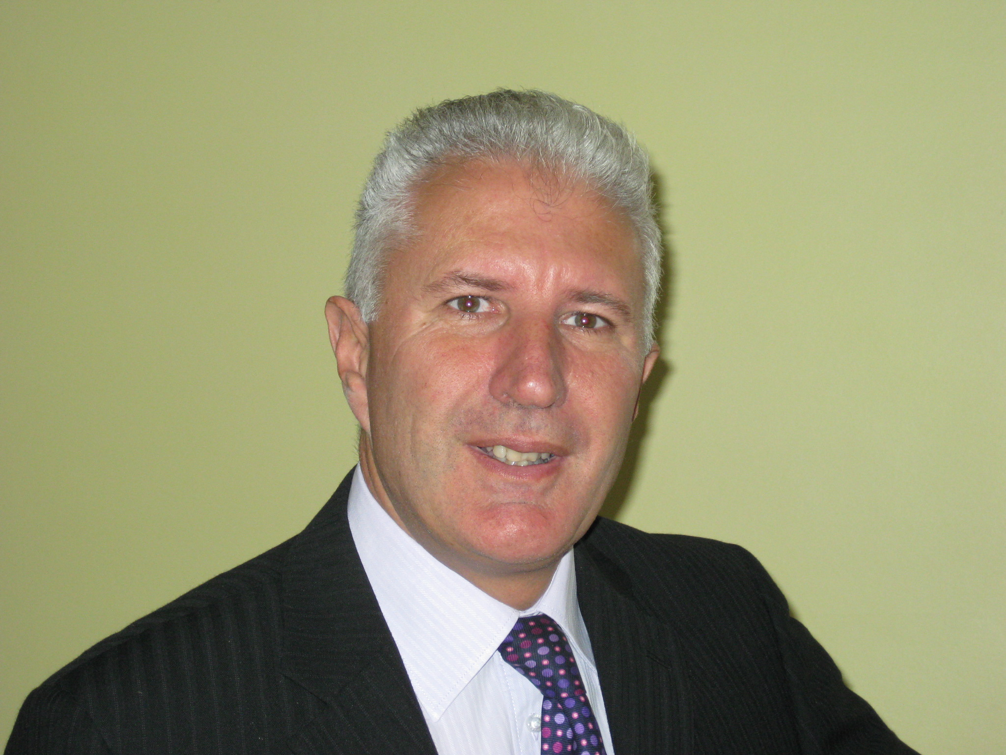
Dr. Brian More
IP commercialization professional
PhD in nuclear physics (nuclear structure)
MBA in Technology Transfer and Innovation

Slide 5
Introduction
Objective – Clear and key considerations for valuation of IP in an academic/technology development environment;
Broad audience – different levels of IP valuation understanding
Discussion! – Always interrupt for questions

Slide 6
Fundamentals of Intangible Assets Valuation
Dr. Daniel Sava

Slide 7

Why?
Understanding the monetary value of the intangible asset (intellectual property) at a specific time.
Notes:
Before starting

Slide 8
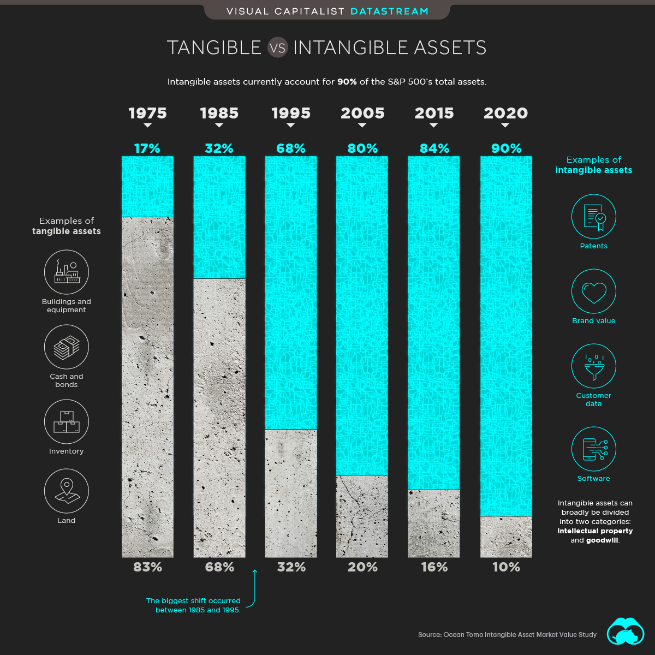
Why?
Notes:
Before starting

Slide 9

When?
When do you want your IP/IA valued?

Slide 10


When?
Transactional
Transaction pricing – license, sale, purchase
Financing – fundraising, collateral based
Tax requirements
Liquidation/Re-organisation
Litigation
Notational
Strategic planning
Insurance purposes
Management information purposes
Identification of commercialisation opportunities

Slide 11
What?
Accounting standards - International Financial Reporting Standards (IFRS) & Generally Accepted Accounting Principles (GAAP)
Intangible assets – IFRS – International Accounting Standards (IAS) 38 – “An intangible asset is an identifiable non-monetary asset without physical substance. Such an asset is identifiable when it is separable, or when it arises from contractual or other legal rights. Separable assets can be sold, transferred, licensed, etc.”
Intangible assets – US GAAP – Accounting Standards Codification (ASC) 350 – “Intangible assets are assets (not including financial assets) that lack physical substance.”

Slide 12

What?
What are the usual types of assets you want valued?

Slide 13
What?
Registered/unregistered IP
Patents
Trademarks
Designs
Copyright
Trade secrets/know-how
Other intangibles
Contract intangibles
Customer intangibles
Data processing intangibles
Human capital intangibles
Marketing intangibles
Goodwill

Slide 14



Valuation process – Data & Results
Inputs (Why, when, what, financials, etc.)
$1.42m ($1.13m – $1.74m)

Slide 15
Valuation process – Data & Results
Purpose of the valuation
IP analysis
Data collection and Market analysis
Valuation modelling
Valuation reporting
License/Spin-out
Strategic decision
IP transfer
IP based financing

Slide 16
Valuation process – Data & Results
Purpose of the valuation
IP analysis
Data collection and Market analysis
Valuation modelling
Valuation reporting
IP ownership
IP related agreements (NDAs, MTAs, Collaboration Agreements, etc.)
Cross check IP information – databases – legal status; fees, remaining life-time
IP prosecution and litigation (if any) history
IP protection and respective products; Competitors & IP landscape

Slide 17
Valuation process – Data & Results
Purpose of the valuation
IP analysis
Data collection and Market analysis
Valuation modelling
Valuation reporting
What is the Unique Selling Point (USP)/Value proposition of the IP?
What is the competitive advantage?
What is the size of the market?
What is the regulatory landscape?
Pricing, adoption, etc.

Slide 18
Valuation process – Data & Results
Purpose of the valuation
IP analysis
Data collection and Market analysis
Valuation modelling
Valuation reporting
Analyse all available financial reports
Revenue modelling (adoption, pricing, growth rates, etc.)
Discount rate, royalty rate, financial margins (EBIT, ΔWC, etc,), tax rate.
Timing of Cash Flows and valuation
Scenarios and sensitivity

Slide 19
Valuation process – Data & Results
Purpose of the valuation
IP analysis
Data collection and Market analysis
Valuation modelling
Valuation reporting
Integrate all information
Check for cohesive story and assumptions
Check calculations – especially units

Slide 20
Due diligence
Check all information as close as possible to the source!
Interviews with clients/academics
Interviews with people within the industry of the IP
IP checks – read through agreements; information public databases, etc.
Habit to challenge the information (devil’s advocate role) – ask for sources

Slide 21



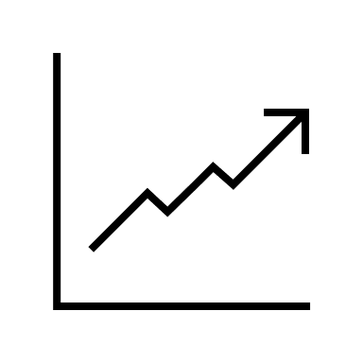

Valuation approaches
Business valuation techniques
Asset Approach (fair market value of net assets) – cost approach
Intrinsic Value (Income Approach) – Discounted Cash Flows (DCF)
Relative Value (Market Approach) – Public company comparable/Precedent transactions

Slide 22
Valuation methods
Cost approach (asset approach)
Cost to reproduce
Cost to replace
Market approach (sales comparison approach)
Use comparable IP transactions
Income approach
Future potential income

Slide 23
Methodologies and their limits
Dr. Daniel Sava

Slide 24
Cost approach methods
Cost to reproduce (Cost to develop)
Estimated cost to make an exact duplicate or replica of the IP at current prices (date of the valuation)
Cost to replace (Cost of reasonable alternatives)
Estimated cost to make an equivalent utility asset of the IP at current prices (date of the valuation)

Slide 25
Cost to reproduce
Minimum value of patent right = Cost of developing technology + Patenting legal costs
Price of patent right = Minimum value of patent right + Reasonable profit margin + Entrepreneur’s/Owner’s incentive (opportunity cost)

Slide 26
Cost to replace
Maximum price an acquirer would pay for the IP asset = cost of obtaining a reasonable IP right alternative

Slide 27
Cost approaches – key considerations
Data available for analysis – components of cost (Material, Labor, Overhead, Developer’s profit, Opportunity Cost/Entrepreneurial incentive)
At current prices – bringing everything to valuation date’s prices
  Adjust for inflation
  Adjust for obsolescence
    Physical obsolescence
    Functional obsolescence
    Technological obsolescence
    Economic obsolescence

Slide 28
Cost approaches – limitations
Disregards the creativity/innovation of the IP
Hard to properly quantify all the time and advancement effects
Does not take into account the future (earning) potential of the IP

Slide 29
Cost approach - example

Slide 30
Market approach methods
Value of IP – derived – comparable IP transactions (same industry, same IP characteristics (size of portfolio, geography, IP landscape), market and competitor dynamics, etc.)
Sales transaction method – Multiple approach (similar to business valuation)
Licensing transaction – Royalty rate comparables – used in Relief from Royalty method (a mixture of market approach with income approach)

Slide 31
Market approach limitations
No “liquid” market for IP transaction (no equivalent of stock market for IP)
Each piece of IP is unique – remaining life and stage of IP, size, competitive market and IP landscape
Portfolio effect (rarely does a piece of IP transact on its own)
Survivorship bias

Slide 32
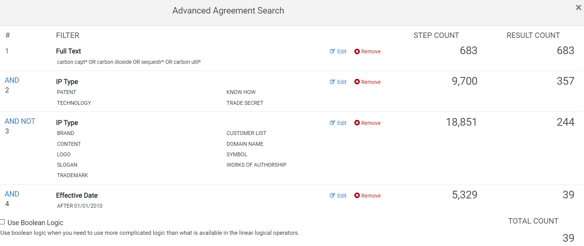
Market approach methods – Royalty rate benchmark
Carbon capture technology (patent portfolio) – with no patents yet granted

Slide 33
Market approach methods – Royalty rate benchmark
Year | Licensor | Licensee | IP right | Territory | Base | Royalty | Restrictions
15/04/2021 | Euacentrix LLC | Boon Industries Inc. | IP covering proprietary technology – Proprietary formula (ClO₂ + water) & make use Proprietary Equipment | Worldwide | Net Sales | 5% | Exclusive; For all application and uses
19/11/2020 | Digital Research Solutions Inc. | JANGIT Enterprises Inc. | Patent (US 10572726 (digital media document summarizer) + associated know-how | Worldwide | Net Sales | 6% | Exclusive, Solely for field of Summarization, Consolidation and educational software
04/12/2019 | Tortec Forschungsinstitut gmbh | Tortec Titan+ | Exploit the technology (List of 8 patents (Ukraine, Russia) + technologies, patents, designs, processes, formulas, know-how, technical data, etc.) to produce TORtec products. | Worldwide | Net Income | 10% | Exclusive, Perpetual, Irrevocable
21/04/2015 | SG Blocks Inc | Red Cardinal Holdings | Proprietary method and technology for construction of buildings | Worldwide | Net Sales | 10% | Non-exclusive USA, EU Exclusive – The world – (USA+EU)
01/08/2011 | Temple University | Save the world air, inc. | Patent rights (Patent portfolio – Method for Reduction of Crude oil viscosity – USA, Brazil, Canada, UK, China, Indonesia, Mexico, Nigeria, Norway, Russia, Arab Emirates- granted only in UK and Nigeria) and technical information for making, selling, using, importing Licensed product | Worldwide | Net Sales | 7% for (first $20m sales, sliding scale to 4% for >$100m | Exclusive
12/07/2010 | CEFCO Global Clean Energy, llc/CEFCO LLC | Peerless, LLC | CEFCO Process (Patent US20080250715+ know-how) in the field of “air quality control systems for post-combustion gases, including air filtration, air emissions control, carbon emission and capture and air pollutants recovery, and the production of end-products, including chemicals, fertilizers, fuels, and metals and minerals, from the products of such filtration, control, capture or recovery process.” | USA | Gross Revenue Sales | 5% | Exclusive, 10 years
09/12/2014 | Rice University | Tubz, LLC | Patent family (USA, Europe, Israel, South Korea) - Graphene-CNT Hybrid Material and Use as a Supercapacitor Electrode | Worldwide | Adjusted Gross Sales | 3% +other payments | Exclusive, Field of use (consumer electronics (including without limitation mobile electronics, mobile telephones/smartphones, tablets, and wearable electronics), nano electronic technologies, electric vehicles, energy storage, and medical devices.)
Notes:
Careful – ktMINE says Net sales for Tortec

Slide 34
Income approach methods
Determine the value of the IP – present value of the future income (cash flow, cost saving)
Direct methods
Discounted cash flow – (cost savings/price premium (product vs generic))
Relief from Royalty (Royalty Savings)
Premium profit/With or without (Comparative Income differential; Incremental Cashflow)
Others – Greenfield,
Indirect methods
Residual – Multi-period excess earnings
Residual – Profit split method

Slide 35
Income approach methods - example
Example DCF - cost saving or premium profit. – Trade secret (process) – indefinite lifetime
Example for relief from royalty – Patent portfolio – with remaining lifetime 15 years
Example for multi period excess earnings – Creative work (Game) – with remaining lifetime (life of author + 70 years)

Slide 36
Income approach methods – DCF – cost savings

Slide 37
Income approach methods – Relief from Royalty

Slide 38
Income approach methods – Multi period excess earnings

Slide 39
Which method should I choose?
 | Relief from Royalty | MPEE | With or without | Greenfield | DCF (cost saving/price premium) | Cost method
Brand/ Trademark | ✓ |  | ✓ |  | ✓
Trade secret/ Know-how | ✓ | ✓ |  |  | ✓
Patents/ Technology/Database/ Mask works | ✓ | ✓ |  |  | ✓
Software | ✓ | ✓ |  |  | ✓ | ✓
Copyright (teaching material/ artistic work /procedures) Designs | ✓ | ✓ |  | ✓ |  | ✓
License/Contract |  |  | ✓ | ✓

Slide 40
Not an exact science – Scenarios & Sensitivity analysis
DCF cost savings
Relief from Royalty
MPEE
MPEE

Slide 41
Advanced Income Approach methods & Key parameters
Dr. Daniel Sava; Dr. Brian More

Slide 42
Advanced Income Methods
Standard income methods
do not take into account market flexibility/uncertainty
Purpose of advanced methods
does take into account market uncertainty
helps with strategic decisions

Slide 43
rNPV
rNPV – risk adjusted Net Present Value
Extension of the DCF method – accounting for risk/probability of success

Slide 44
rNPV – simple example
Project – InvenTech
Still in development – requires $50k investment today
1 year – 50% success rate; further $300k required to launch on market
After launch Revenues are Y2 - $150k Y3 $250k Y4 - $450k Y5 - $250k Y6 – $200k; Cash flow is 40% of Revenues.
Discount rate 15%
Notes:
Success rate – passing the development stage and getting ready for market

Slide 45
rNPV – simple example
Year | 0 | 1 | 2 | 3 | 4 | 5 | 6
Revenue | $0 | $0 | $150,000 | $250,000 | $450,000 | $250,000 | $200,000
Net CF | -$50,000 | -$300,000 | $60,000 | $100,000 | $180,000 | $100,000 | $80,000
Success factor | 100% | 50% | 50% | 50% | 50% | 50% | 50%
Risk adjusted CF | -$50,000 | -$150,000 | $30,000 | $50,000 | $90,000 | $50,000 | $40,000
Discount | 100% | 87% | 76% | 66% | 57% | 50% | 43%
Risk adjusted present CF | -$50,000 | -$130,435 | $22,684 | $32,876 | $51,458 | $24,859 | $17,293
rNPV | -$31,265
Notes:
Success rate – passing the development stage and getting ready for market

Slide 46
rNPV – decision tree
Development of technology – not pre-defined
In reality - many decision points in taking a project to market
InvenTech – instead of the 50% chance of success;
30% chance – great results; (better revenues by 50%)
40% - abandon
30% - more development (another $75k required) – which results 67% - good results, 33% abandon

Slide 47
rNPV – decision tree
Year | 1 | 2 | 3 | 4 | 5 | 6
Revenue | $0 | $225,000 | $375,000 | $675,000 | $375,000 | $300,000
Net CF | -$300,000 | $90,000 | $150,000 | $270,000 | $150,000 | $120,000
Discount | 100% | 87% | 76% | 66% | 57% | 50%
Present CF | -$300,000 | $78,261 | $113,422 | $177,529 | $85,763 | $59,661
NPV1 | $214,636
Great results
NPV1
30%
Year | 2 | 3 | 4 | 5 | 6 | 7
Revenue | $0 | $150,000 | $250,000 | $450,000 | $250,000 | $200,000
Net CF | -$300,000 | $60,000 | $100,000 | $180,000 | $100,000 | $80,000
Discount | 100% | 87% | 76% | 66% | 57% | 50%
Present CF | -$300,000 | $52,174 | $75,614 | $118,353 | $57,175 | $39,774
NPV2 | $43,091
Good results
NPV2
Initial R&D
Further R&D ($75k)
67%
30%
40%
33%
Abandon
Abandon
Y0
Y1
Y2

Slide 48
rNPV – decision tree
Year | 1 | 2
Revenue | $0 | $0
Net CF | -$75,000 | $43,091
Success factor | 100% | 67%
Risk adjusted CF | -$75,000 | $28,871
Discount | 100% | 87%
Risk adjusted present CF | -$75,000 | $25,105
NPV | -$49,895
Great results
$214,636
NPV1
30%
Good results
NPV2
$43,091
Initial R&D
Further R&D ($75k)
67%
30%
40%
33%
Abandon
$0
Abandon
$0
Y0
Y1
Y2

Slide 49
rNPV – decision tree
Great results
$214,636
NPV1
30%
rNPV = -$50,000 + (30%× $214,636)×0.87 = $5922
Initial R&D
30%
-$49,895
$0
40%
rNPV = -$50,000 + (30%× ($214,636-49,895)×0.87 = -$7,024
Abandon
$0
Y0
Y1
Y2

Slide 50
rNPV – decision tree vs simple risk adjustment
Year | 0 | 1 | 2 | 3 | 4 | 5 | 6
Revenue | $0 | $0 | $225,000 | $375,000 | $675,000 | $375,000 | $300,000
Net CF | -$50,000 | -$300,000 | $90,000 | $150,000 | $270,000 | $150,000 | $120,000
Success factor | 100% | 30% | 30% | 30% | 30% | 30% | 30%
Risk adjusted CF | -$50,000 | -$90,000 | $27,000 | $45,000 | $81,000 | $45,000 | $36,000
Discount | 100% | 87% | 76% | 66% | 57% | 50% | 43%
Risk adjusted present CF | -$50,000 | -$78,261 | $20,416 | $29,588 | $46,312 | $22,373 | $15,564
NPV1 | $5,992
rNPV = -$50,000 + (30%× $214,636)×0.87 = $5992
Y0

Slide 51
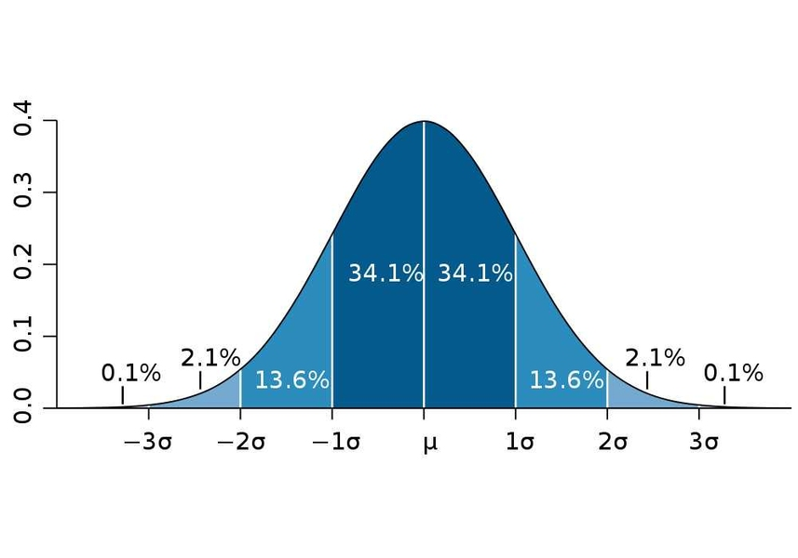
Monte Carlo
For traditional DCFs – people use scenarios – worst case, average case, best case (assumptions for each case)
Monte Carlo – simulate the probability of a range of case
Example – Simulate a normal distribution for number of units sold, price of product, discount rate and royalty rate (based on mean & std. deviation)
© MIT edu

Slide 52
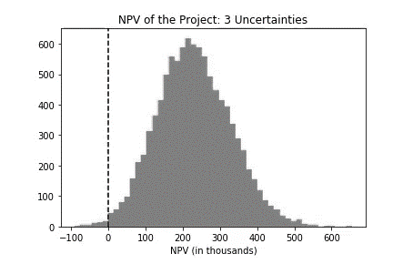
Monte Carlo
Result a distribution of NPV (or Fair Values) for the IP.

Slide 53
Real options
A real option gives the owner the right, but not the obligation to do something;
From finance – Call option (Option to buy asset at an agreed price); Put option (Option to sell an asset at an agreed price)
Different options – option to defer, option to expand or contract, option to abandon or licence, option to switch, option to stage investments, options to grow.
For IP valuation – option to abandon once a project is not profitable anymore is the most used.

Slide 54
Real options
From a mathematical point of view – 4 methods to value an option:
Formula
Trees
Simulations
Finite differences
IP valuation – Trees (binomial) and Formula (Black Scholes) – the most used.

Slide 55
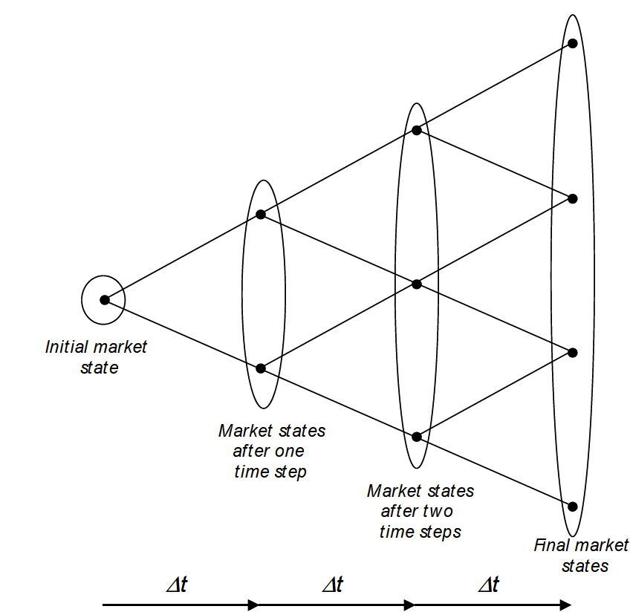
Real options – binomial tree
Similar to decision trees – Binomial tree
Main use – valuation of Life Sciences Projects
Changes of Revenues(Cashflows)
Each node – 2 possibilities
Main assumption – Volatility
Steps up down – calculate based on volatility and time interval
Valuation in Life Sciences – A Practical Guide -Boris Bogdan, Ralph Villiger

Slide 56
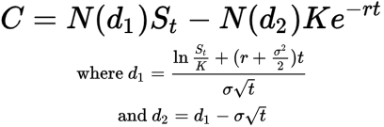
Real options – Black Scholes formula
Black Scholes formula
C = call option price
N = Cumulative distribution functions of the normal distribution (Area under the curve)
S_{t} = spot price of an asset (Current underlying price asset – Present value of cashflows)
K = strike price (exercise price – Cost of development)
r = risk-free interest rate
t = time to maturity (how long to get to market)
σ = volatility of the asset

Slide 57
Key parameters
Revenue modelling
Discount rate
Royalty rate
Success rates
Others

Slide 58
Revenue modelling
One of the greatest impact on the final valuation results – Starting base
Market/Industry analysis
Corresponding product & geography – IP
Competitive landscape – market share
Value proposition/Unique selling point (USP) - Pricing

Slide 59
Revenue modelling
Basic modelling – linear growth rate
Year | 2023 | 2024 | 2025 | 2026 | 2027 | 2028 | 2029 | 2030 | 2031 | 2032
Revenue | $1,000,000 | $1,100,000 | $1,210,000 | $1,331,000 | $1,464,100 | $1,610,510 | $1,771,561 | $1,948,717 | $2,143,589 | $2,357,948
Total addressable market | $10,000,000
Market share | 10%
Growth rate | 10%

Slide 60
Revenue modelling
Basic modelling – comparable growth rates
Growth rates |  | 55% | 48% | 41% | 37% | 33% | 25% | 20% | 15% | 10%
Year | 2023 | 2024 | 2025 | 2026 | 2027 | 2028 | 2029 | 2030 | 2031 | 2032
Revenue | $200,000 | $310,000 | $458,800 | $646,908 | $886,264 | $1,178,731 | $1,473,414 | $1,768,097 | $2,033,311 | $2,236,642
Total addressable market | $10,000,000
Market share | 2%

Slide 61
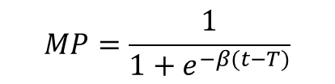
Revenue modelling
More realistic approach – Fisher – Pry model – diffusion of new technologies
Year | 2023 | 2024 | 2025 | 2026 | 2027 | 2028 | 2029 | 2030 | 2031 | 2032
Time (t) | 0 | 1 | 2 | 3 | 4 | 5 | 6 | 7 | 8 | 9
Market Penetration (MP) | 11.92% | 18.24% | 26.89% | 37.75% | 50.00% | 62.25% | 73.11% | 81.76% | 88.08% | 92.41%
Revenue | $1,192,029 | $1,824,255 | $2,689,414 | $3,775,407 | $5,000,000 | $6,224,593 | $7,310,586 | $8,175,745 | $8,807,971 | $9,241,418
Target market size (SOM) | $10,000,000
Shape parameter (β) | 0.50
Time to 50% (T) | 4
$$MP=\frac{1}{1+e^{−β(t−T)}}$$
Logistic curve

Slide 62
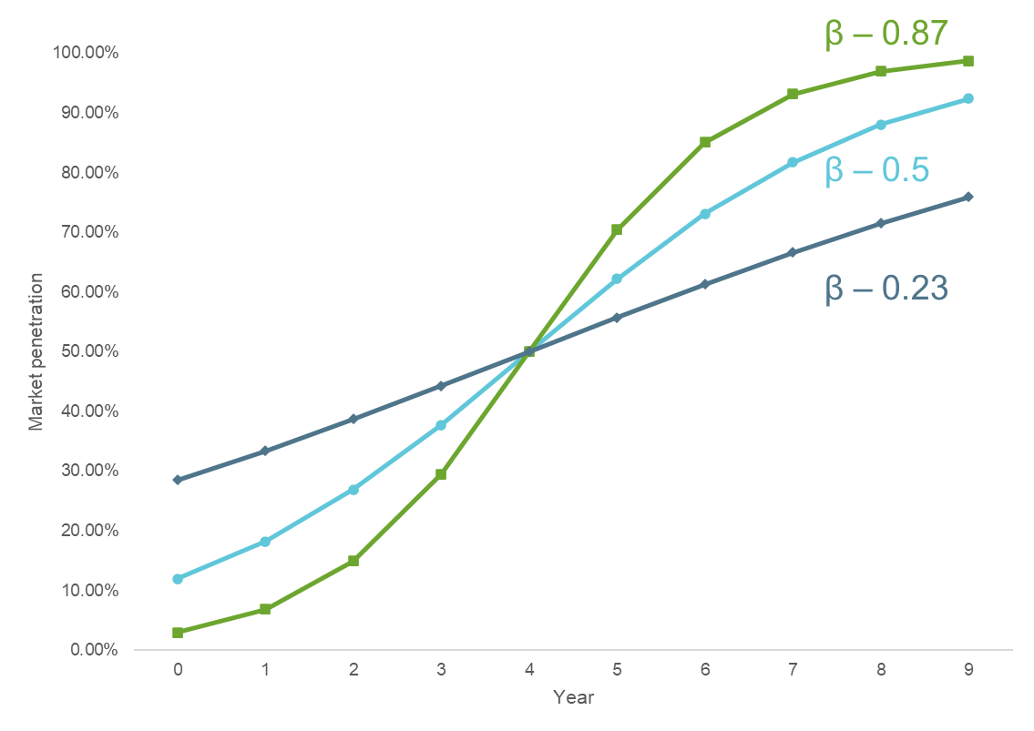
Revenue modelling
The larger β – the steeper the curve.
Ideally – model β and T – based on numbers within the industry

Slide 63
Discount rate
Discount rate – rate factor with which future cash flows are discounted to a present value.
$100 today > $100 in one year > $100 in two years, etc. (Time value of money)

Slide 64
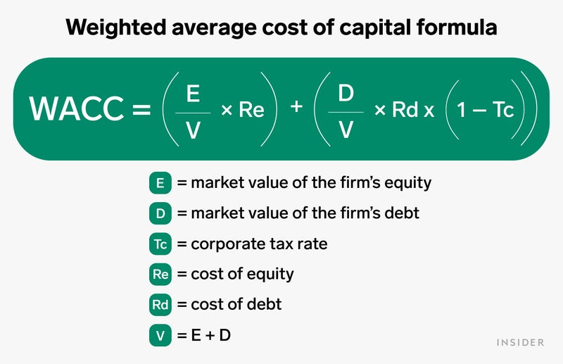
Discount rate
Companies can raise money through debt (borrowing) or through equity (selling shares)
Investors – want a return for their money
Return for debt < return for equity - Debt is paid first & the remainder goes to shareholders
Weighted average cost of capital (WACC)
https://www.businessinsider.com/personal-finance/weighted-average-cost-of-capital

Slide 65

Discount rate
For IP assets – Investment – shareholders or potential shareholders
What is their required return? What is the cost of equity?
Risk vs Reward
The riskier the IP – the higher the Reward required

Slide 66
Discount rate – theoretical models
Capital Asset Pricing Model (CAPM) – R_{e} = r_{f} + β (r_{m} – r_{f}) = r_{f} + β r_{p}
R_{e} – cost of equity; r_{f} – risk free rate (US treasuries, UK gilts rates)
r_{m} – market required rate of return; r_{p} – market risk premium
β – measure of volatility – movement of a stock compared to the stock market as a whole
Advantageous – databases with all parameters
Better suited for bigger companies with diversified IP assets

Slide 67
Discount rate – theoretical models
Build up method – R_{e} = r_{f} + r_{p} + r_{i} + r_{s} + r_{c} + r_{cp}
r_{i} – industry premium, r_{s} – size premium, r_{c} – country premium, r_{cp} – company risk
Advantageous – databases with all parameters
Better suited for bigger companies with diversified IP assets

Slide 68
Discount rate – IP – early stage
IP valuations discount rate
Not a diversified portfolio (single asset/product - more risk)
High likelihood of failure
Market/Industry/Regulatory landscapes matter
Investment in IP – very similar to early-stage Venture Capital Investment

Slide 69
Discount rate – IP
Venture Capital Rates of Return
Intellectual property – Valuation, Exploitation, and Infringement Damages – Russell L. Parr – 5th edition 2018
Startup – companies less than 1 year old; First stage – Prototypes developed, scaling up risk high;
Second stage – Product finalised and company growing; Third stage – Companies approaching maturity
Stage of development | Required rate of return (%)
Startup | 50 - 70
First stage (early development) | 40 - 60
Second Stage (expansion) | 30 - 50
Third Stage | 20 - 35

Slide 70
Discount rate – IP
Venture Capital Rates of Return - (1+TR)^{T} = (1+r)^{T}/(1-p)
TR = [(1+r)^{T}/(1-p)]^{(1/T)} – 1; TR – target return; r- required return; p – probability of failure; T- time to exit
For r = 25%
 | 10% | 20.0% | 30.0% | 40.0% | 50.0% | 60.0% | 70.0% | 80.0% | 90.0%
1 | 39% | 56% | 79% | 108% | 150% | 213% | 317% | 525% | 1150%
2 | 32% | 40% | 49% | 61% | 77% | 98% | 128% | 180% | 295%
3 | 29% | 35% | 41% | 48% | 57% | 70% | 87% | 114% | 169%
4 | 28% | 32% | 37% | 42% | 49% | 57% | 69% | 87% | 122%
5 | 28% | 31% | 34% | 38% | 44% | 50% | 59% | 72% | 98%
6 | 27% | 30% | 33% | 36% | 40% | 46% | 53% | 63% | 83%
7 | 27% | 29% | 32% | 34% | 38% | 42% | 48% | 57% | 74%
8 | 27% | 29% | 31% | 33% | 36% | 40% | 45% | 53% | 67%
9 | 26% | 28% | 30% | 32% | 35% | 38% | 43% | 49% | 61%

Slide 71


Royalty rate
Royalty rate – Licensor (owner of IP) – granting rights to Licensee (using the IP)
Licensing agreement – many considerations
Licensed rights (details of IP)
Scope of licence (geographies, markets, field of use)
Exclusivity (exclusive, sole, non-exclusive)
Financial terms (up-front payments, milestone payments, running royalties, royalty base, equity compensation, audit clauses, etc.)

Slide 72
Royalty rate
Non-exclusive license Geography Restricted field of use | Non-exclusive license Geography Fields of use | Sole license Geography Fields of use | Sole License Geography Fields of use | Exclusive license Restricted geography Restricted field of use | Exclusive license Worldwide Restricted field of use | Exclusive license Restricted geography For all fields of use | Exclusive license Worldwide For all fields of use
Royalty rate
Smaller Royalty Rate
Higher Royalty Rate

Slide 73
Royalty rate determination
Rule of thumb – 25% of profit (or 5% Net Sales for businesses with 20% profit margin)
Benchmarking – similar transactions or industry averages
Profit differential analysis (profit with and without access to the IP)
Profit split - Analysis of contributions for allocation of profit – royalty rate (ideal)

Slide 74
Royalty rate
Agreements need to be analysed in detail (very time consuming)
  Granted rights
  Geography; Field of Use
  Royalty Base (Gross sales, Net sales, EBITDA, Net Profit, etc.)
  Related parties vs. Arm’s length negotiation
  Industry, types of companies, etc.

Slide 75
Royalty rate determination
Industry | Average | Median | Max | Min | Count
Chemicals | 4.7% | 4.3% | 25.0% | 0.1% | 78
Internet (incl software) | 11.8% | 8.8% | 50.0% | 0.3% | 88
Telecom (excl Media) | 4.9% | 4.5% | 15.5% | 0.4% | 73
Consumer Goods, Retail & Leisure | 5.5% | 5.0% | 28.0% | 0.1% | 98
Media & Entertainment | 9.1% | 5.0% | 50.0% | 2.0% | 25
Food Processing | 3.2% | 2.8% | 10.0% | 0.3% | 38
Medical/Health Products | 6.1% | 5.0% | 77.0% | 0.1% | 376
Pharma & Biotech | 7.0% | 5.0% | 50.0% | 0.0% | 458
Energy & Environment | 5.0% | 5.0% | 20.0% | 1.0% | 107
Machines/Tools | 5.2% | 4.5% | 25.0% | 0.5% | 90
Automotive | 4.3% | 3.5% | 15.0% | 0.5% | 59
Electrical & Electronics | 4.2% | 4.0% | 15.0% | 0.5% | 139
Semiconductors | 4.3% | 3.0% | 30.0% | 0.0% | 75
Computers & Office Equip | 5.3% | 4.0% | 25.0% | 0.2% | 73
Software | 11.5% | 6.8% | 70.0% | 0.0% | 147
Industry Summary | 6.40% | 4.80% |  |  | 1,924
derived from Royalty Source

Slide 76
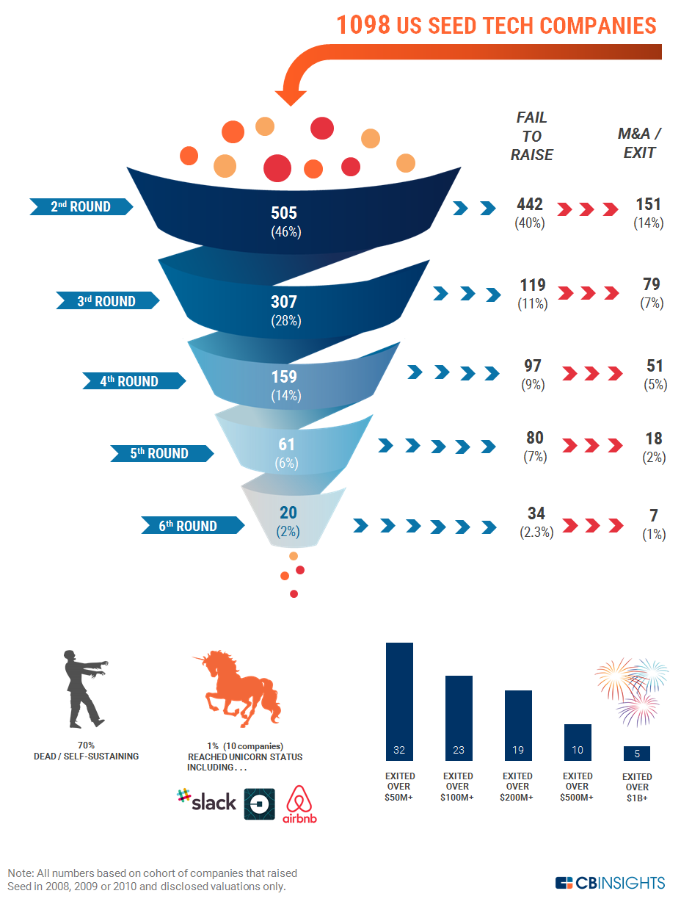
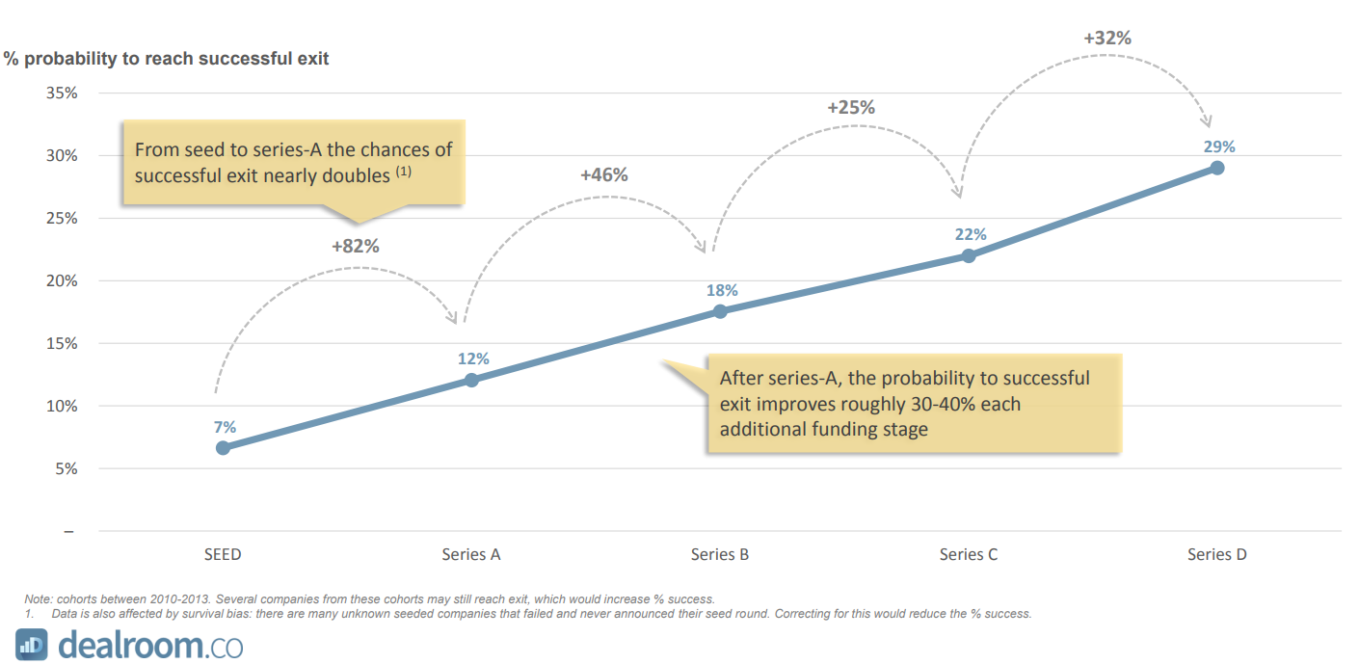
Success rate
Seed stage – low probability of success

Slide 77
Success rate
Disease Group | Stage 1 | Stage 2 | Stage 3 | Approval | Cumulative
Arthritis/Pain | 76.90% | 38.10% | 78.10% | 89.10% | 20.40%
CNS | 66.20% | 45.60% | 61.80% | 77.90% | 14.50%
CV | 62.70% | 43.30% | 76.30% | 84.40% | 17.50%
GIT | 66.80% | 49.10% | 71.00% | 85.90% | 20.00%
Immunology | 64.80% | 44.60% | 65.20% | 81.60% | 15.40%
Infections | 70.80% | 51.20% | 79.90% | 96.90% | 28.10%
Metabolism | 47.80% | 52.00% | 78.90% | 92.80% | 18.20%
Oncology | 64.40% | 41.80% | 65.40% | 89.70% | 15.80%
Ophthalmology | 66.00% | 39.00% | 64.00% | 92.00% | 15.20%
Respiratory | 63.40% | 41.10% | 59.90% | 76.90% | 12.00%
Urology | 50.00% | 38.00% | 67.00% | 79.00% | 10.10%
Women’s Health | 39.00% | 42.00% | 48.00% | 59.00% | 4.60%
Pharma/
Biotech
Success rates
Valuation in Life Sciences – A Practical Guide -Boris Bogdan, Ralph Villiger

Slide 78
Other factors
Valuation date & End of financial year – Adjustments for partial period and cashflows – informs the assumptions;
Tax rate & Tax amortisation benefit
Contributory Asset Charges
EBIT margin
Changes in WC margin

Slide 79
Work through academic specific examples
Dr. Brian More

Slide 80
Case study 1 – Valuation of technology (patents + know how)
Carbon capture technology – patent at PCT stage (priority date – Jan 2022) + know-how
ISR report – quite clean + different types of claims
There are a few strong competitors
The team is very experienced and can deliver scale-up; done so with previous technology
No projections, not easy to get the costs of development as was done alongside other things.

Slide 81
Case study 1 – Valuation methods
What method would you choose?
Relief from Royalty – easiest to obtain data for
DCF/Greenfield can also work – more data required about EBIT, changes in working capital, investment requirements, depreciation & amortisation.

Slide 82
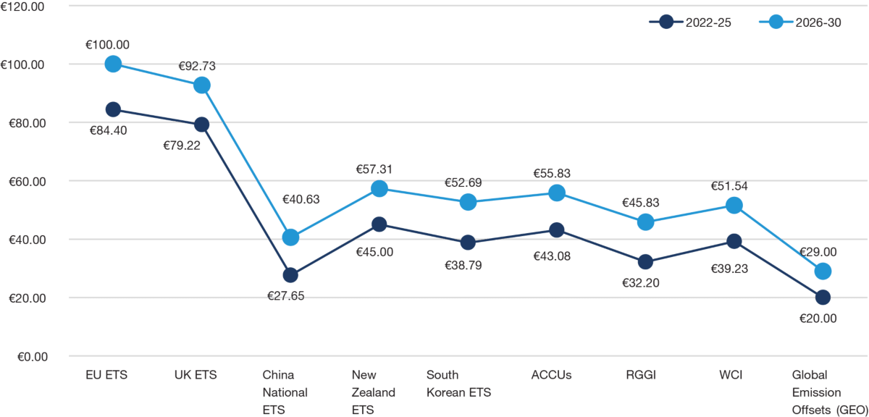
Case study 1 – Revenue modelling
Carbon market – a few established players
https://www.iea.org/energy-system/carbon-capture-utilisation-and-storage
Around – 125Mt per year by 2030 (125 million tonnes)
For our example – the technology aims for 1Mt by 2033 – Fisher Pry to model the diffusion of the technology.
Price per tonne – PwC – forecasts future carbon offset prices (graph) – assume a $60
https://www.pwc.co.uk/services/sustainability-climate-change/insights/bullish-sentiment-expected-over-next-decade-for-carbon-markets-globally-latest-trends-and-developments-in-2022.html#:~:text=The%20EU%20and%20UK%20ETS,2026%2D30%20for%20both%20schemes

Slide 83
Case study 1 – Revenue modelling
Year | 2023 | 2024 | 2025 | 2026 | 2027 | 2028 | 2029 | 2030 | 2031 | 2032 | 2033
Time | 0 | 1 | 2 | 3 | 4 | 5 | 6 | 7 | 8 | 9 | 10
Penetration | 3.23% | 7.24% | 15.45% | 29.94% | 50.00% | 70.06% | 84.55% | 92.76% | 96.77% | 98.59% | 99.39%
Removal Capacity | 32 | 72 | 154 | 299 | 500 | 701 | 846 | 928 | 968 | 986 | 994
Target removal capacity | 1,000
Shape parameter | 0.85
Timeto50% | 4
Revenue in thousands)

Slide 84
Case study 1 – Royalty rate
Year | Licensor | Licensee | IP right | Territory | Base | Royalty | Restrictions
15/04/2021 | Euacentrix LLC | Boon Industries Inc. | IP covering proprietary technology – Proprietary formula (ClO₂ + water) & make use Proprietary Equipment | Worldwide | Net Sales | 5% | Exclusive; For all application and uses
19/11/2020 | Digital Research Solutions Inc. | JANGIT Enterprises Inc. | Patent (US 10572726 (digital media document summarizer) + associated know-how | Worldwide | Net Sales | 6% | Exclusive, Solely for field of Summarization, Consolidation and educational software
04/12/2019 | Tortec Forschungsinstitut gmbh | Tortec Titan+ | Exploit the technology (List of 8 patents (Ukraine, Russia) + technologies, patents, designs, processes, formulas, know-how, technical data, etc.) to produce TORtec products. | Worldwide | Net Income | 10% | Exclusive, Perpetual, Irrevocable
21/04/2015 | SG Blocks Inc | Red Cardinal Holdings | Proprietary method and technology for construction of buildings | Worldwide | Net Sales | 10% | Non-exclusive USA, EU Exclusive – The world – (USA+EU)
01/08/2011 | Temple University | Save the world air, inc. | Patent rights (Patent portfolio – Method for Reduction of Crude oil viscosity – USA, Brazil, Canada, UK, China, Indonesia, Mexico, Nigeria, Norway, Russia, Arab Emirates- granted only in UK and Nigeria) and technical information for making, selling, using, importing Licensed product | Worldwide | Net Sales | 7% for (first $20m sales, sliding scale to 4% for >$100m | Exclusive
12/07/2010 | CEFCO Global Clean Energy, llc/CEFCO LLC | Peerless, LLC | CEFCO Process (Patent US20080250715+ know-how) in the field of “air quality control systems for post-combustion gases, including air filtration, air emissions control, carbon emission and capture and air pollutants recovery, and the production of end-products, including chemicals, fertilizers, fuels, and metals and minerals, from the products of such filtration, control, capture or recovery process.” | USA | Gross Revenue Sales | 5% | Exclusive, 10 years
09/12/2014 | Rice University | Tubz, LLC | Patent family (USA, Europe, Israel, South Korea) - Graphene-CNT Hybrid Material and Use as a Supercapacitor Electrode | Worldwide | Adjusted Gross Sales | 3% +other payments | Exclusive, Field of use (consumer electronics (including without limitation mobile electronics, mobile telephones/smartphones, tablets, and wearable electronics), nano electronic technologies, electric vehicles, energy storage, and medical devices.)

Slide 85
Case study 1 – Royalty rate
What royalty rate should we use for this valuation?
Which do you think is the closest comparable?
In my view – 5th agreement is the closest – start from 5% - consider geography, exclusivity, any other existing licences.
How would you adjust if you discover there is already a contract that gives a companies a free non-exclusive world-wide licence?
3.25% - 3.75%

Slide 86
Case study 1 – Discount rate and risk adjustment
What are the risks for this technology to reach the market?
What are the risks associated with the IP?
How can we account for the risk in the IP valuation?
Either high VC discount rate; or Rate of return of startup (20%) + risk adjustment of revenues (10% success rate)

Slide 87
Case study 1 – Other parameters
Tax rate – 25% - usually a good assumption if no information
Terminal growth rate - -7% - the patent expires in 2043
Tax amortisation period – Remaining patent lifetime
Valuation data
End of financial year

Slide 88
Case study 1 – Revenues & Inputs

Slide 89
Case study 1 – Fair value

Slide 90
Case study 1 – Sensitivity Analysis

Slide 91
Case study 2 – Software valuation (copyright)
Scientific software for selling to pharma and chemical industry companies
Accounts for cost of development
IP copyright – not patented; no open-source code used
The software comprises 5 modules developed in collaboration between the biotechnology department and the computing department
Use the cost to reproduce at today's prices

Slide 92
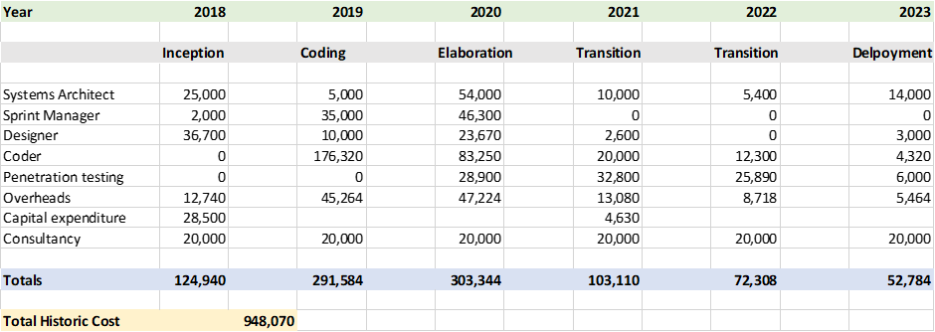
Financial Data Verified by Accounts
Accounting year end the 30th of June

Slide 93
Input Parameters for Valuation
Adjustments
Tax
Inflation rate 5% pa
Obsolescence 10% pa
Profit 10%
Opportunity cost 10%
Discount rate 15%
Valuation date 30/08/2023
Corporation Tax 25%
Tax Amortization period 15 years
Annuity 5.8473
TAB factor 0.10797943

Slide 94
Step by Step Calculations
Multiply the annual costs by the profit and opportunity cost to enhance the value = 120%
Multiply the new costs by the inflation factor
Number of days from the accounting period end to the valuation date = 61 days
Enhancement factor = 0.167 to increase the costs from June to August
For 2023 multiply by (1 + 0.05) ^ 0.167 = 1.008
For 2022 multiply by (1 + 0.05) ^ 1.167 = 1.059
Then continue back to 2018

Slide 95

Step by Step Calculations
Divide the new costs by the obsolescence factor
Number of days from the accounting period end to the valuation date = 61 days
Enhancement factor = 0.167 to increase the costs from June to August
For 2023 divide by (1 + 0.10) ^ 0.167 = 1.016
For 2022 divide by (1 + 0.10) ^ 1.167 = 1.118
Then continue back to 2018
Reproduction cost then equals the sum of the bottom line = € 953,371

Slide 96
Accounting for tax and tax amortization benefit (TAB)
Reproduction cost then equals = € 953,371
Corporation tax = 25%
Tax deducted = € 238 343
After tax reproduction cost = € 715,028
Tax amortization benefit = € 77,208
Fair Market Value of Software = € 792,236

Slide 97
Commentary on Calculations
The inflation rate is taken at 5% per annum, more accurately you would apply the inflation rate at the known yearly rate.
Obsolescence is taken at 10% per annum, this varies dependent upon the complexity of the algorithms.
The fair market value is very sensitive to the obsolescence
For an obsolescence of 20% the fair value becomes €539,752

Slide 98
Case study 3 – Teaching material (copyright)
Teaching material – new way of teaching medical students – saves Medical universities cost;
Your university medical school has developed a blended teaching software package along with online real time assessment for medical students. The software is a gamification of traditional lecture theatre training with cost savings as shown on the next slide:

Slide 99
Medical School Cost Savings 2023-2028
Lecture theatre time saved = 200 hours per annum
Marking and assessment time saved = 500 hours per annum
Blended cost of teaching staff = $ 250 per hour (includes overheads)
Blended cost of marking staff = $ 50 per hour (includes overheads)
Total cost saving = $ (200 x 250) + $ (500 x 50) = $ 75,000 per annum

Slide 100
Input Parameters for Valuation
Adjustments
Tax
Growth rate 5% pa
Terminal growth rate 1%
Discount rate 20%
Valuation date 29/08/2023
Financial year end 31/12/2023
First cash flow 31/12/2023
Corporation Tax 25%
Tax Amortization period 25 years
Annuity 4.947587
TAB factor 0.0520511

Slide 101
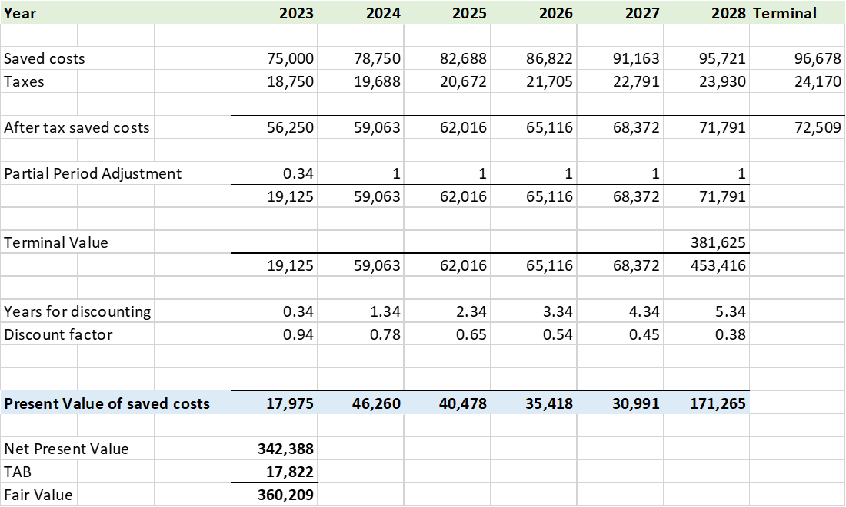
Step by Step Calculations

Slide 102
Commentary on Calculations
The discount rate is taken at 20%, this is high for a public university where the cost of capital is debt only, this figure is more like a small private university value.
For sensitivity calculations take the discount rate to 10%, then recalculate.
Result
A 48% increase in the expected lifetime value

Slide 103

Licensing Considerations
The total value of the NPV of the cost savings using the gamified teaching material = $360,000.
The licensing university would expect 25% of this as a royalty = $90,000
Or $9,000 per annum over 10 years.

Slide 104
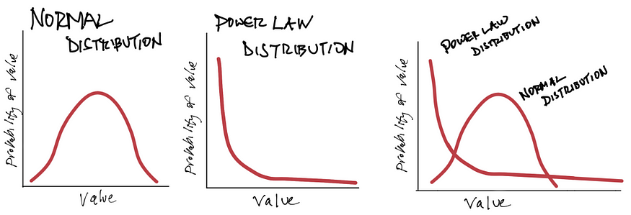
Spinouts and VC funding
Venture capital works on a Power Law model
VCs – each investment is made with the potential of returning 10-20x (the whole fund or more)
Most of the investments will fail
A few will return the invested capital or a bit more
Outliers will return most of the fund
Source: https://dougshapiro.medium.com/power-laws-in-culture-27ab6461c693

Slide 105
“A healthy intellectual property position may not guarantee a start-up technology company is going to be successful, but it is going to find it a whole lot harder to succeed if it does not have one. And crucially, it is not just the ownership of intellectual property that is important, it is the understanding that intellectual property is a key.”
Joff Wild

Slide 106
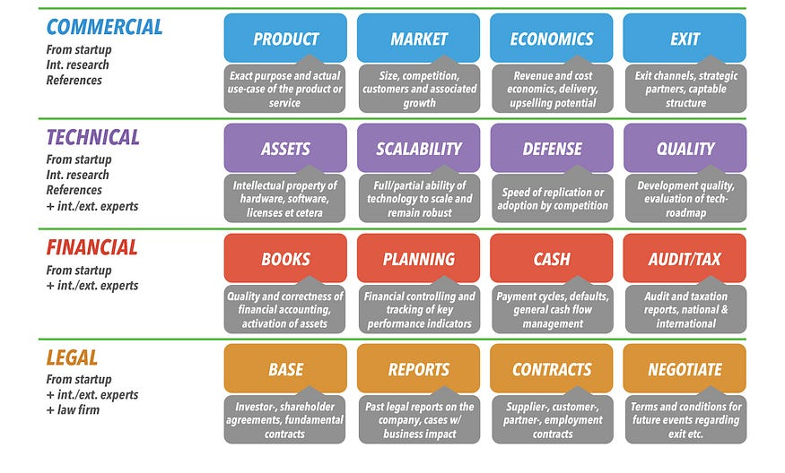
Spinouts and VC funding – due diligence

Slide 107

Spinouts and VC funding – valuation approaches
Premoney valuation = Postmoney valuation – Invested Capital
Early stages- VCs value company/not IP individually
  IP is included in the company value (main driver of value)
Pre & Post money valuation
The Art
  How much money one needs to raise? – VCs usually want 20-30% equity
  Interest from other investors (FOMO) – more leverage
  “We laugh at [venture] firms that use spreadsheets for seed and Series A deals for valuations. There’s just not enough data.” says Mendelson, co-author of the book, Venture Deals: Be Smarter Than Your Lawyer and Venture Capitalist.
Early stage – lack of historical financial data
Premoney valuation - €4m | 80%
Postmoney valuation - €5m |100%
Invested capital - €1m | 20%

Slide 108
Spinouts and VC funding – valuation approaches
3 semi-quantitative method (high degree of subjectivity) – Payne Scorecard, Berkus method, and Risk factor summation method.
Example of Payne Scorecard
2 quantitative methods – VC method; First Chicago method.
VC method

Slide 109
Spinouts and VC funding – Payne scorecard
Comparison Factor | Weight in Valuation
Strength of entrepreneur & Team | 0-30%
Size of the opportunity | 0-25%
Product/Technology | 0-15%
Competitive environment | 0-10%
Marketing/Sales/Partnerships | 0-10%
Need for additional investment | 0-5%
Other factors | 0-5%
Develop for seed companies in the range of $1m - $2.5m – Premoney valuation.
Decide on comparison factor for potential company
Compare the factors with a benchmark company for which the Premoney valuation is known
Add factors and multiply with benchmark pre-money valuation
Source: William Payne, The Definitive Guide to Raising Money from Angels; Antonella Puca, Early Stage Valuation: A Fair Value Perspective

Slide 110
Spinouts and VC funding – Payne scorecard
Comparison Factor | Target company | Benchmark | Comparison | Factor
Strength of entrepreneur & Team | 30% | 25% | 120% | 0.36
Size of the opportunity | 25% | 25% | 100% | 0.25
Product/Technology | 15% | 20% | 75% | 0.1125
Competitive environment | 10% | 10% | 100% | 0.1
Marketing/Sales/Partnerships | 10% | 12.5% | 80% | 0.08
Need for additional investment | 5% | 5% | 100% | 0.05
Other factors (great traction) | 5% | 2.5% | 200% | 0.1
Total factor – 1.0525; Benchmark Premoney valuation - $2m
Target Premoney valuation - $ 2.105m

Slide 111

Spinouts and VC funding – VC method
Estimating – Postmoney valuation & ownership % - as a function of desired risk adjusted return & capital to invest
Postmoney valuation = Valuation at exit/(1+Target Return)^{Time to exit}
Example
€1m to invest; Required return 40%
Value at exit - €30m; Time to exit – 6 years
Target Total value to paid in capital (TVPI or Investment multiple) - (1+Target Return)^{Time to exit} – 7.53
Postmoney valuation - €30m/7.53 – approx. €4m

Slide 112
Thank you for your attention!
DSava@mathys-squire.com
BMore@mathys-squire.com
© Mathys & Squire Consulting, 2023
2023

