Slide 1
“The Center for Commercialisation and Transfer of Tehcnology” under the Intellectual Property Agency of the Republic of Azerbaijan”
Faig Alizada
Deputy Director of the Center

Slide 2
Content
Strategy of the country for the development of innovation ecosystem and tehcnoparks.
1.1. General strategy, main Decrees and Orders of the President.
1.3. Creation strategy of the CCTT, iternal capabilities and conceptual model of CCTT.
Main activities of the CCTT and plans.
2.1. Organisational-technical works, formation and expantion of internal capabilities of the Center;
2.2. Creation of different databases;
2.3. Creation of databases of patents, Valuation methodology (determination of limitations and criterias), initial valutaion of patents;
2.4. Establishment of TCOs within Universities and support for the creation of technoparks within Universities;
International and local cooperations.
3.1. International Organisations;
3.2. Local entities;
Cooperation of WIPO, EAPO and IPA on Texhnoparks
4.1. Legislative acts regulating activities of Technoparks;
4.2. Plans regarding supporting the formation of Technoparks in Azerbaijan;
4.3. Current status of existing Technoparks in Azerbaijan.

Slide 3
1.1. Strategy of the country for the development of innovation ecosystem and tehcnoparks.
Reforms on state level;
Important legal acts passed in the field of innovation;
Decree “on the approval of strategic road maps for the national economy and the main sectors of the economy”;
Decree on “the Social-Economic Development Strategy of the Republic of Azerbaijan for 2022-2026”;
Decree "on ensuring coordination in the field of innovative development in the Republic of Azerbaijan".
Main directions of reforms in the sphere of innovations and directions of the works conducted by the IP Agency of Azerbaijan

Slide 4
2.1. Creation strategy of the CCTT & conceptual model
Innovative development requires a coherent, joint and systematic solution to the issues of intellectual property, technology commercialization and innovation support.
For this reason the head of the country set the task of establishing CCTT in front of the Agency. CCTT has already been established and its founder is the Agency and it is established in the form of a public legal entity.
CCTT - is an organization focused on the transfer of the results of scientific research carried out in public and private organizations for commercial and non-commercial use, as well as on obtaining income from these results.
The strategy of creation of CCTT is at the intersection of desires, external conditions and internal opportunities.
01
What are the environmental opportunities and barriers?
02
How will the capabilities of the center be formed?
03
What does the organization aim for? (Activity Directions)
04
Who will be the target group (beneficiaries), what will be the products?
© K.Imanov

Slide 5
2.2. Iternal capabilities
Recuitment of educated and knowledgeable employees;
Preparation of motivation policy for the employees;
Trainings on Project Management, Negotiation skills etc.
Establishment of proper organizational structure by taking into account capabilities of the IP Agency and financial risks;
Proper Organizational Structure
Human resources and training of the staff
Formation of products for commercialization and tech transfer;
Products can be classified according to industrial fields or operations of the Center;
Creation of official web address;
Provision of all equipment and software for the efficient operation of the Center (registry of inventions/inventors, registry of potentional buyers/beneficiaries, project management tool etc.);
Equipments, hardware and software
Products
CCTT
Formation of proper and profitable target groups/beneficiaries;
Legal document forms
Preparation of proper documentation forms by taking into account all legal risks (Agreement templates, valuation methodology, risk analysis and marketing methodologies, business plan template etc);
Target qroup/Beneficiaries
Proper financing of the Center, financial modelling, proper financial management and proper funding of the projects;
According to the Charter of CCTT, the property of organization consists of the charter capital, other property and funds allocated by the agency, income generated from its operation, donations, grants, investments and other sources;
Financing
Collborations
Collaboration with Universities, Scientific Research Centers/Institutions, inventors, state-owned enterprises etc.

Slide 6
2.3. Main activities of the CCTT and its plans.
Activities of the Center;
Main works has been doing by the Center:
Organisational-technical works, formation and expantion of the internal capabilities of the Center;
Creation of different databases; (Higher Educational Institutions, SRSs, Industrial parks, Technoparks);
Creation of database of patents, Evaluation of patetns;
Establishment of TCOs within Universities and support for the creation of technoparks within Universities
Conducting awraness compaings and sessions about activity of the Center, as well as estblishment of TCOs and Tehcnoprks and organizing exhibitions for inventions and involving inventors thereto.

Slide 7
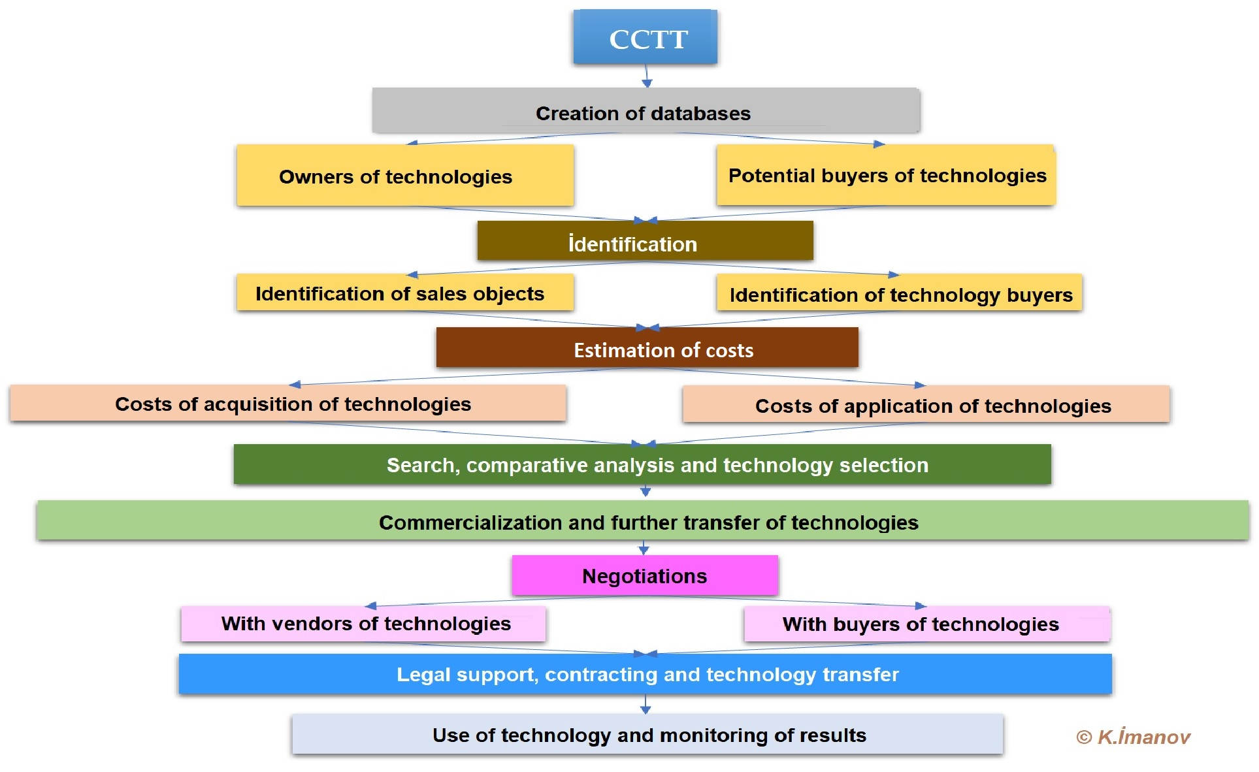
2.4. Conceptul model of CCTT

Slide 8
2.5. Creation of information databases and resources
37 entities, enterprise and structural units;
8 incubation and acceleration centers;
28 TTOs, departments, technoparks- within the Ministry of Science & Education;
12 instituts - operating within the ANAS;
42 NGOs;
3 High Tehnology Parks;
7 İndustrial parks.
43 Higher Educational Institutions (32 public, 11 private);
10 different funds and other institutions and their support mechanisms;
etc.

Slide 9
2.6. Meetings with patent owners
Re patents obtained during 2019-2021: | Re patents obtained in 2022: | Total:
264 - Total amount of patents 118 - Inventions; 111 - Utility models; 35 - Industrial designs; 77 - The number of rightholders who were met in person and by various technical means. | 149 - Total amount of patents 108 - Inventions; 31- Utility models; 10 - Industrial designs; 42 - The number of rightholders who were met in person and by various technical means (35 on invention, 7 on utility model); | 413 - Total amount of patents 226 - Inventions; 142 - Utility models; 45 - Industrial designs; 119 - The number of rightholders who were met in person and by various technical means.

Slide 10
2.7. Creation of a single database of patents
The total database includes 413 patents;
The database mainly includes patents related to the last years of 2019-2022;
Several patents are date back to 2012, 2014 and 2015;
Evaluations were conducted only on 107 patents in the first stage (92 inventions, 15 utility models);
Selected patents are planned to be placed in the first stage on the website of the Agency and will be integrated into the software in the future.

Slide 11
2.8. Creation of the methodogy on valuation of IP objects
Initial draft of the assesment metedology has been prepared;
The assessment methodology is based on (i) Legal, (ii) technology, (iii) market and (iv) finance aspects of the invention;
Metodology indicators consist of (i) limitiations & (ii) criteria;
The assesment is conducted based on the answers given to questions re limitations and criteria;
The decision making process is conducted by the Working group and SB of the Center. If necessary we involve field experts.

Slide 12
2.9. Results of assesment (current situation)
107 patents included in the database were evaluated based on the methodology. As a result of the assesment, the followings were identified:
2 patents have business plans;
6 patents have not been extended & 3 of them removed from the list
Most of the patents were registered in last 4 years.;
90-95% of the owners - interested in commercialization & exhibition;
3 patents have international registration.
83 patents - Have got samples;

Slide 13
2.10. Passed decisions based on the Metodology
20 patents - business plan can be written for commercialization purposes;
7 patents - decision to assist them in preparation of sample and testing.
62 patents - WAITING decision for collecting necessary data and re-assesment;
17 patent holders - Beside to waiting decision, consulting and supporting services can be provided;
30 patent holders- Provided preliminary advice;
8 patents - Removed from the list (3 of them because they were not be extended, 4 because they were not interested, 2 because they were interested in giving only 4% and 10%).

Slide 14
2.11. Establishment of CTOs within Universities
Since August 2022, negotiations have been held with various higher education institutions and scientific research institutes regarding various directions of cooperation. In general:
19 - Negotiations were conducted with 19 higher education institutions (total);
9 - An initial agreement was reached on the organization of official meetings with 9 higher education institutions;
For the purpose of establishing TCO at higher educational institutions:
Memorandum and
Contract sample has been prepared.
We are now in the process of creation of TCO within Sumgait State University.

Slide 15
3.1. Work done in the field of international cooperation
WIPO - Correspondence and participation in meetings, events, seminars ;
Türkpatent - about the "Technofest Azerbaijan" festival, geographical indications
Negotiations were held with the CLDP program of the American Chamber of Commerce, meetings were held in visual and video conference formats, experience was exchanged;
Eurasian Patent Organization - Correspondence and participation in events (EAPO)
In accordance with the "Action Plan on cooperation between the innovation infrastructure of the Republic of Azerbaijan and the Skolkovo Foundation in 2022-2023", a work plan was prepared in the relevant directions

Slide 16
3.2. Collaborations with local institutions
Ministry of Economy, Small and Medium Business Development Agency, Economic Zones Development Agency etc..
Intensive meetings were held with the Ministry of Education and Higher Education Institutions under its jurisdiction, and work is being carried out in the following directions:
(i) establishment of IP chairs;
(ii) establishment of TKOs;
(iii) support for the registration of IFNs of inventors and participation in exhibitions;
(iv) Holding informational meetings, conferences, seminars
First of all - Baku State University; Sumgait State University; Baku Engineering University; University of Architecture and Construction; University of Economics.
Azerbaijan National Academy of Sciences and Ministry of Digital Development and Transport

Slide 17
4.1. WIPO-EAPO-IPA cooperation regarding technoparks
Legislation regulating the activity of technoparks
There is not a separate law on tehcnoparks;
Model Regulation;
Charters of the Agency and CCTT;
Legislation in the field of Intellectual Property etc.
Opportunities created for residents of technoparks
Grants;
Subsidies;
Discounted loans;
Tax benefits;
Discounts on fees.

Slide 18
4.2. WIPO-EAPO-IPA cooperation regarding technoparks
Intended reforms
Improvement of the normative legal framework - adoption of the Laws "On Invention"; "Support for Innovative Activity"; making relevant changes to the Law "On Sciense", etc.
Development of human resources - starting to teach the IPR as a subject at universities, organizing joint trainings for technoparks by WIPO-EAPO-IPA
Training of experts in the field of national and international patent search, providing access to international and EAPO search systems, etc.
Increasing financial support - creation of venture capital and relevant structures and development of a working scheme with investors, providing initial capital to Inventor and Technoparks and approving co-financing subsidy programs with these services
Other support measures for the commercialization of Intellectual Property objects created in technoparks

Slide 19
4.3. WIPO-EAPO-IPA cooperation regarding technoparks
The following 4 universities operating under the Ministry of Education have a technology park or are in the process of establishing a technology park
Baku Engineering University;
Azerbaijan State University of Architecture and Construction;
Sumgait State University;
Azerbaijan State Economic University.

Slide 20
THANK YOU!
“The Center for Commercialisation and Transfer of Tehcnology” under the Intellectual Property agency of the Republic of Azerbaijan”

