Slide 1
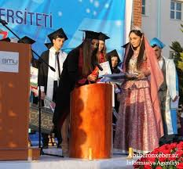
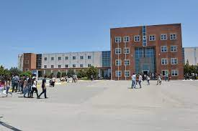
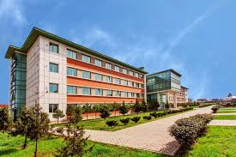
2022 @ Khirdalan city, Azerbaijan
www.beu.edu.az www.iro.beu.edu.az
2022 @ Khirdalan city, Azerbaijan

Slide 2
H I S T O R Y O F T H E U N I V E R S I T Y
Baku Engineering University (BEU) is one of the prestigious public/state higher education institutions that functions under the Ministry of Education. BEU was established on the 8th of November, 2016, with the status of the Public Legal Entity on the base of one private university which was established in 1993.
BEU prepares engineers on all levels of higher education, executes programmes of higher and additional education in this sphere, and conducts fundamental and applied science researchers.
The establishment of the university aims to improve the teaching of engineering technologies and prepare highly-qualified personnel for the industry.
According to the current level of development of the Azerbaijani economy, the university aims to prepare specialists with the ability to work with innovative technologies and organize production processes. BEU operates in a big campus and it is located in Khirdalan city in the Republic of Azerbaijan. The total area of the campus is 200000 m2 (20 ha). Khirdalan city is situated between Baku city and Sumgait city. The official postal address of BEU: is Hasan Aliyev str. 120, Khirdalan city, AZ-0102, Azerbaijan
2022 @ Khirdalan city, Azerbaijan
www.beu.edu.az www.iro.beu.edu.az

Slide 3
FACULTI ES O F THE UNI VERSI TY
There are four faculties and they prepare specialties in
25 directions at Baku Engineering University:
Engineering Faculty;
Architecture and Construction Faculty;
Economics and Administrative Faculty;
Education Faculty.
2022 @ Khirdalan city, Azerbaijan
www.beu.edu.az www.iro.beu.edu.az

Slide 4
THE SPECIALTIES OF THE FACULTIES
Engineering Faculty:
Computer Engineering (in Azerbaijan & English language);
Information Technologies (in Azerbaijan & English language);
Machine Engineering (in Azerbaijan & English language);
Mechanical Engineering (in Azerbaijan & English language);
Industrial Engineering (in Azerbaijan & English language);
Electric and Electronics Engineering (in Azerbaijan & English language);
Information Security (in Azerbaijan language);
8. Energetics Engineering (in Azerbaijan language);
9. Transport construction engineering(in Azerbaijan language);
Process Automation Engineering (in Azerbaijan language);
Radio and Telecommunications Engineering (in Azerbaijan language);
Logistics and Transport Technologies Engineering (in Azerbaijan & Russian language).
Transport service (by transport modes) (in Azerbaijan language).
2022 @ Khirdalan city, Azerbaijan
For more information https://beu.edu.az/en/faculty/engineering/
www.beu.edu.az www.iro.beu.edu.az

Slide 5
THE SPECIALTIES OF THE FACULTIES
Architecture and Construction Faculty:
Architecture (in Azerbaijan & English language);
Civil Engineering (in Azerbaijan & English language);
Design (in Azerbaijan & English language);
Urban Planning (in Azerbaijan language & English language);
Ecological Engineering (in Azerbaijan & English language);
Industrial Engineering (in Azerbaijan & English language);
Chemical Engineering (in Azerbaijan & English language);
Transport Construction Engineering (in Azerbaijan language).
For more information https://beu.edu.az/en/faculty/architecture/
2022 @ Khirdalan city, Azerbaijan
www.beu.edu.az www.iro.beu.edu.az

Slide 6
THE SPECIALTIES OF THE FACULTIES
Economics and Administrative Faculty:
Economy - (in Azerbaijan);
Public Administration - (in Azerbaijan);
Business Administration - (in Azerbaijan);
Accounting and audit - (in Azerbaijan);
Finance - (in Azerbaijan)
For more information https://beu.edu.az/en/faculty/economics/
PS.: The undergraduate programme of BEU is accredited by the Chartered Institute of Management Accountants (CIMA) as well as some specialities of Economics and Administrative Faculty of BEU use the curriculum of the Association of Chartered Certified Accountants (ACCA).
2022 @ Khirdalan city, Azerbaijan
www.beu.edu.az www.iro.beu.edu.az

Slide 7
THE SPECIALTIES OF THE FACULTIES
Education Faculty:
Mathematics and Informatics Teacher Education (in English language);
Mathematics Teacher Education (in English language);
Physics Teacher Education (in English language);
Chemistry Teacher Education (in English language);
Biology Teacher Education (in English language).
2022 @ Khirdalan city, Azerbaijan
For more information https://beu.edu.az/en/faculty/pedagogy/
www.beu.edu.az www.iro.beu.edu.az

Slide 8
BEU provides Master, MBA and PhD education as well.
2022 @ Khirdalan city, Azerbaijan
www.beu.edu.az www.iro.beu.edu.az
For more information https://beu.edu.az/en/page/elmi-tedqiqat-6

Slide 9
BEU provides PhD education
in below directions:
Machines, equipment and processes
Theory of Mechanics and Mechanisms
Deformable solids mechanics
Dynamics, robustness of machines, devices and apparatus
Theoretical bases of heat engineering
Petrochemicals
Systematic analysis, management and information processing
Organization and management of enterprises
Field economy
2022 @ Khirdalan city, Azerbaijan
www.beu.edu.az
www.iro.beu.edu.az

Slide 10
DIFFERENT EDUCATIONAL AND RESEARCH LABORATORIES
OF BAKU ENGINEERING UNIVERSITY (BEU)
BEU has a lot of educational and research laboratories. We are going to inform you and show some pictures of BEU laboratories.
There are some laboratories at the Chemical Engineering Department of BEU that were sponsored by BP Azerbaijan company. They are divided into 4 audiences: General and Analytical Chemistry, Organic Chemistry, Physical Chemistry, and Chemical Engineering. After gaining theoretical knowledge from chemistry courses, the students are engaged in practical activities, and this trend continues in the classes, including analytical chemistry, organic chemistry, physical chemistry, and fluid mechanics.
Experiments are conducted in the General Chemistry Lab in accordance with the General Chemistry subjects. It should be noted that in accordance with safety regulations, access to the lab is possible in white coats and protective glasses. The laboratory is designed to teach the basic principles and concepts of general chemistry. Moreover, the laboratory empowers students to collect and analyze data, prepare a practice report, and use books. During the course, the students are taught safety rules and precise research techniques in the lab. All the experiments in this field are carried out in practice as students learn the properties of inorganic substances and their transformations as part of the general chemistry course, after that, the students conduct their reactions in the laboratory. The laboratory has the necessary equipment and labware for training.
2022 @ Khirdalan city, Azerbaijan
www.beu.edu.az www.iro.beu.edu.az

Slide 11
DIFFERENT EDUCATIONAL AND RESEARCH LABORATORIES
OF BAKU ENGINEERING UNIVERSITY (BEU)
The focus of the analytical chemistry and instrumental analysis course is to conduct chemical analyzes and calculations. In analytical chemistry laboratories, students conduct titrimetric methods, and gravimetric analysis, and familiarize themselves with the principles of operation of devices such as spectrophotometers, flame photometers, and viscometers for self-determination. The carl-Fisher machine carried out the analysis of oil and similar organic substances containing small amounts of water and is used for accurate measurement of water is also taught in an analytical chemistry course. The centrifuges used to dissolve heterogeneous compounds are available in the analytical chemistry laboratory as in other laboratories and are actively used in teaching. The analytical chemistry laboratory is also equipped with a distillation apparatus, taking into account the need for a large amount of distilled water to teach chemistry. Moreover, the laboratory has a pH meter for determining the pH of the substance, electrical conductivity, and high-precision scales, while suction cups, dryers, high-temperature stoves, water baths, heaters and magnetic mixers for experiments with gas. Students use these devices under the supervision of lecturers and laboratory assistants. Synthesis reactions, acid-base titration, enthalpy and thermal output, cation determination, as well as determination of density of vitamin C with titration audiometric determination of copper and other experiments, are carried out in this laboratory.
In the Organic Chemistry Lab, students learn both synthesis techniques and transformations, as well as work on the research work conducted. There are also facilities used for separating substances in the labs, which are equipped with the equipment required for the most advanced synthesis. The purity, melting and boiling temperatures of the synthesized substances can be studied in the laboratory.
2022 @ Khirdalan city, Azerbaijan
www.beu.edu.az www.iro.beu.edu.az

Slide 12
PHYSICS LABORATORY
THERE ARE DIFFERENT EDUCATIONAL AND RESEARCH LABORATORIES AT BAKU ENGINEERING UNIVERSITY
2022 @ Khirdalan city, Azerbaijan
For more information about the activity of the International Relations and Projects Management Department please visit the website: www.iro.beu.edu.az/en and facebook page: www.facebook.com/iro.beu.edu.az
www.beu.edu.az www.iro.beu.edu.az

Slide 13
BIOLOGICAL LABORATORY
THERE ARE DIFFERENT EDUCATIONAL AND RESEARCH LABORATORIES AT BAKU ENGINEERING UNIVERSITY
2022 @ Khirdalan city, Azerbaijan
For more information about the activity of the International Relations and Projects Management Department please visit the website: www.iro.beu.edu.az/en and facebook page: www.facebook.com/iro.beu.edu.az
www.beu.edu.az www.iro.beu.edu.az

Slide 14
COMPUTER LABORATORY
THERE ARE DIFFERENT EDUCATIONAL AND RESEARCH LABORATORIES AT BAKU ENGINEERING UNIVERSITY
2022 @ Khirdalan city, Azerbaijan
For more information about the activity of the International Relations and Projects Management Department please visit the website: www.iro.beu.edu.az/en and facebook page: www.facebook.com/iro.beu.edu.az
www.beu.edu.az www.iro.beu.edu.az

Slide 15
AUTOMATIC CONTROL LABORATORY
THERE ARE DIFFERENT EDUCATIONAL AND RESEARCH LABORATORIES AT BAKU ENGINEERING UNIVERSITY
2022 @ Khirdalan city, Azerbaijan
For more information about the activity of the International Relations and Projects Management Department please visit the website: www.iro.beu.edu.az/en and facebook page: www.facebook.com/iro.beu.edu.az
www.beu.edu.az www.iro.beu.edu.az

Slide 16
MECHANICAL ENGINEERING LABORATORY
THERE ARE DIFFERENT EDUCATIONAL AND RESEARCH LABORATORIES AT BAKU ENGINEERING UNIVERSITY
2022 @ Khirdalan city, Azerbaijan
For more information about the activity of the International Relations and Projects Management Department please visit the website: www.iro.beu.edu.az/en and facebook page: www.facebook.com/iro.beu.edu.az
www.beu.edu.az www.iro.beu.edu.az

Slide 17
ENERGETIC LABORATORY
THERE ARE DIFFERENT EDUCATIONAL AND RESEARCH LABORATORIES AT BAKU ENGINEERING UNIVERSITY
2022 @ Khirdalan city, Azerbaijan
For more information about the activity of the International Relations and Projects Management Department please visit the website: www.iro.beu.edu.az/en and facebook page: www.facebook.com/iro.beu.edu.az
www.beu.edu.az www.iro.beu.edu.az

Slide 18
ARCHITECTURE AND CONSTRUCTION ENGINEERING LABORATORY
THERE ARE DIFFERENT EDUCATIONAL AND RESEARCH LABORATORIES AT BAKU ENGINEERING UNIVERSITY
2022 @ Khirdalan city, Azerbaijan
For more information about the activity of the International Relations and Projects Management Department please visit the website: www.iro.beu.edu.az/en and facebook page: www.facebook.com/iro.beu.edu.az
www.beu.edu.az www.iro.beu.edu.az

Slide 19
"MOBILE APPLICATIONS AND GAME DESIGN" LABORATORY WAS ESTABLISHED WITHIN “MAGNUS” ERASMUS+ KA2 PROJECT WHICH IT WAS FINANCED BY THE ERASMUS+ PROGRAM OF EUROPEAN UNION
THERE ARE DIFFERENT EDUCATIONAL AND RESEARCH LABORATORIES AT BAKU ENGINEERING UNIVERSITY
2022 @ Khirdalan city, Azerbaijan
For more information about the activity of the International Relations and Projects Management Department please visit the website: www.iro.beu.edu.az/en and facebook page: www.facebook.com/iro.beu.edu.az
www.beu.edu.az www.iro.beu.edu.az

Slide 20
BEU TECHNOPARK
of Baku Engineering University (BEU)
Mission of BEU Technopark:
-Coordinating Baku Engineering University (BEU) with
relevant industries and companies;
-Supporting and mentoring the students' start-up projects and their businesses;
-Consulting to reach financial sources for implementation
new useful projects for the students and teachers;
-Coordinate scientific and research activities of BEU teachers and researchers as well as support to commercialization and transferring the results of their research work into the industry;
-Develop international relations and expand cooperation with all relevant local and international stakeholders of BEU Technopark;
-Supporting to produce the advanced and innovative products through scientific research works;
-Supporting the sustainable development of the economy including the non-oil sector in Azerbaijan;
-Involvement in learning and production of advanced technological updates rapidly developing in the world
2022 @ Khirdalan city, Azerbaijan
www.beu.edu.az www.iro.beu.edu.az

Slide 21
The main function of the BEU Technopark is to promote the establishment of companies based on innovation and scientific research, and in this process to ensure the interests of the BMU.
To provide or support access to venture capitalists and investors
Supports communication, network, media and etc
Professional training and mentoring services
Incubation services at BEU Technopark
Support with office and other work opportunities in a specially allocated space within the university
Academic (expert and research; laboratory, etc.) supports
ECOSYSTEM
GOVERMENT
Promotions and supports
Baku Engineering University
INDUSTRY İnvestors & Entrepreneurs

Slide 22
Formulation of entrepreneurial University model
The strategic development plan of BEU Technopark, the development of BMU according to the Entrepreneurial University model is taken as the main line.
Innovation ecosystem of Azerbaijan
Diversification of the economy Small and medium business development
Education system of Azerbaijan
Developing an environment of entrepreneurship and innovation in the educational system
Baku Engineering University
Developing BEU in an entrepreneurial university model
Main directions:
Development of teaching and research environment based on the development of high technologies;
Development of a teaching and research environment that supports the development of the startup environment;
Various "boot-camps", seminars, "demo" days, entrepreneurship classes, coding courses, organization of competitions, etc.

Slide 23
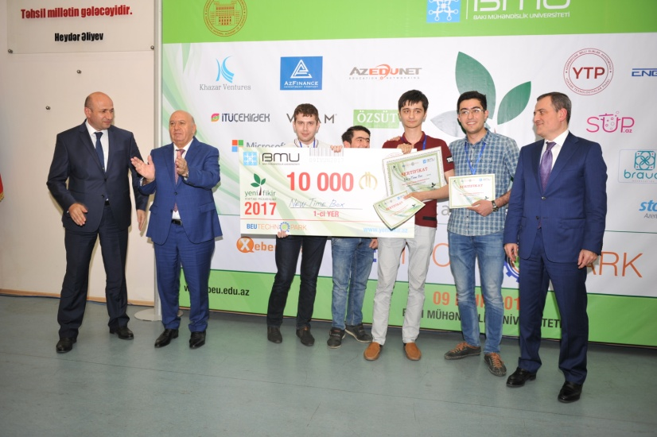
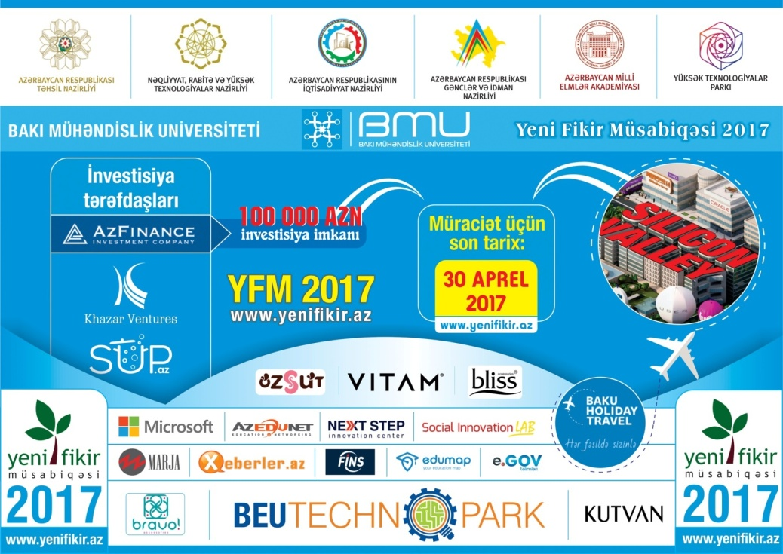
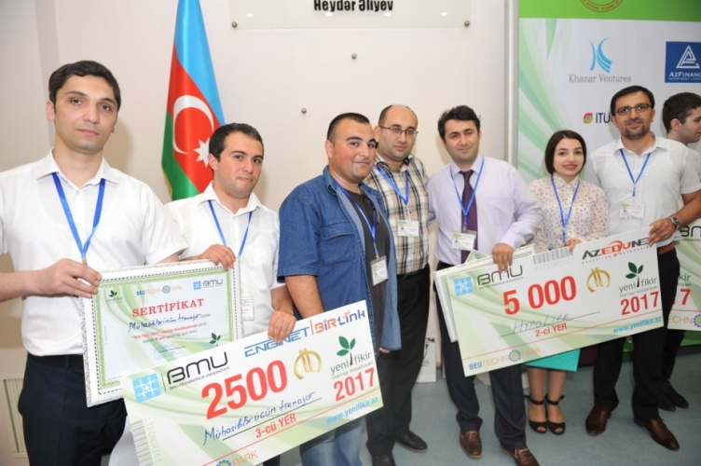
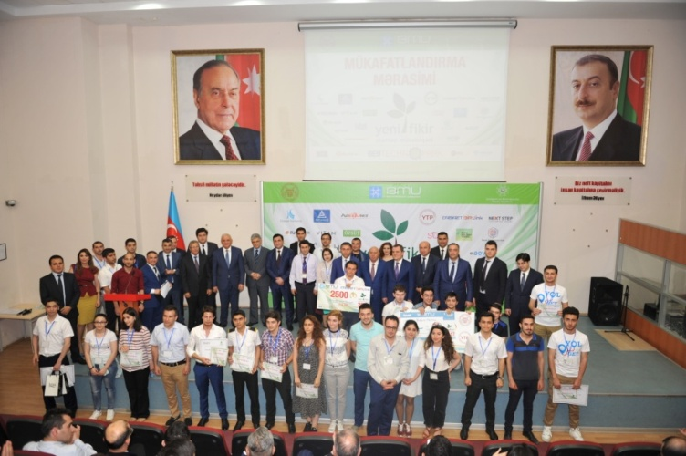
New Idea startup competition
New Idea startup competition is one of the biggest projects of BEU Technopark.977 startups have applied to the Competition held 6 times so far. Incubation services were provided to 100 projects, and seed investment was provided to 40 projects.

Slide 24
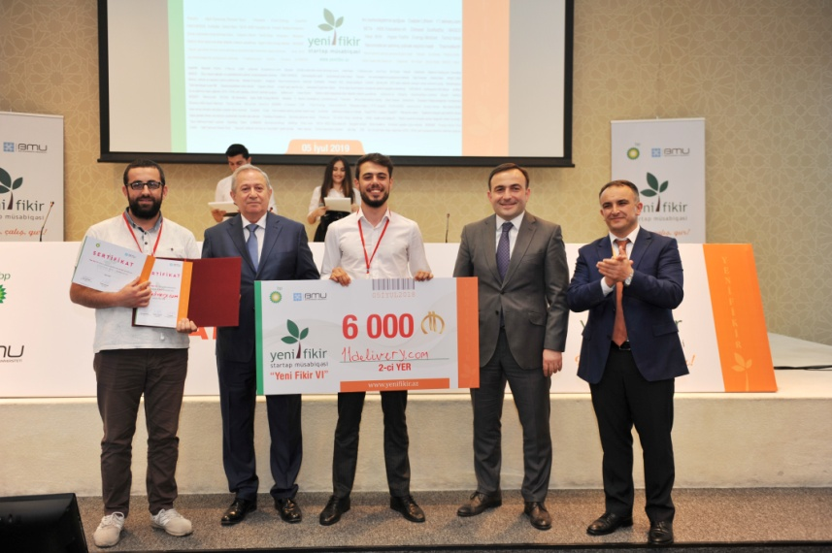
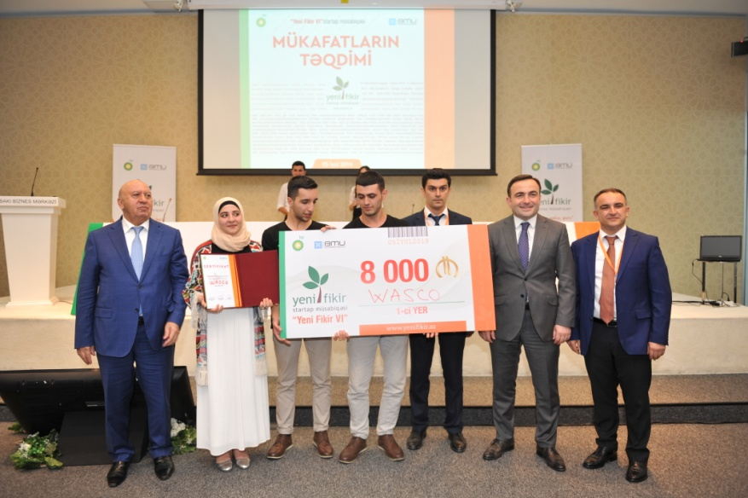
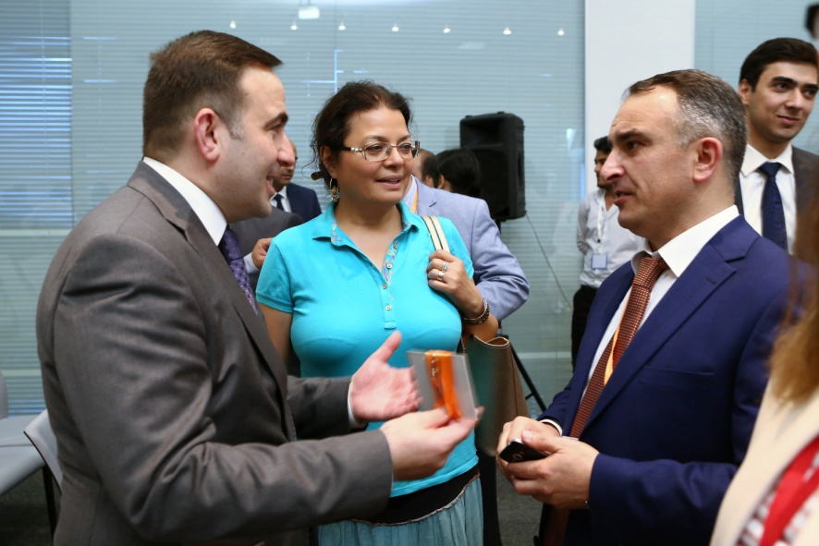
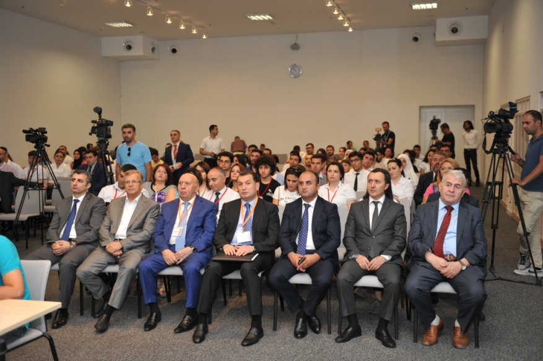
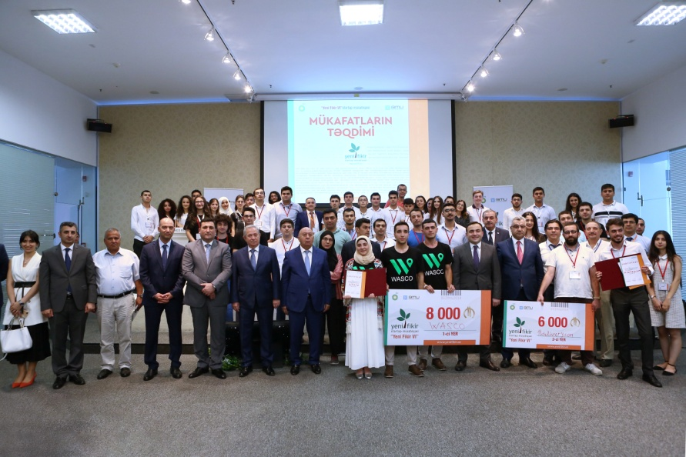
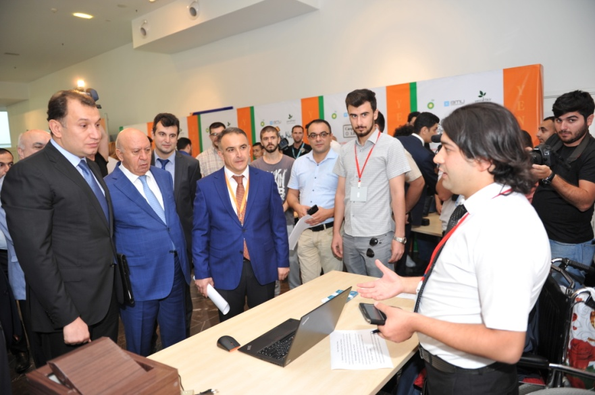
New Idea startup competition

Slide 25
Training and mentoring services Online registration of projects
With professional jury
Evaluation of projects Training and mentoring services
With BEU and other stakeholders
Organization of incubation and acceleration services
With all the actors of the innovation ecosystem
Organization of Demo and Awarding event
www.yenifikir.az
Action line of New Idea startup competition

Slide 26
BEU participates in different international programs and projects: Therefore, we attach great importance to international cooperation. We will be happy to cooperate with the colleague here.
2022 @ Khirdalan city, Azerbaijan
For more information about the activity of the International Relations and Projects Management Department please visit the website: www.iro.beu.edu.az/en and facebook page: www.facebook.com/iro.beu.edu.az
www.beu.edu.az www.iro.beu.edu.az

Slide 27
Assoc. Prof. Isa Gasimov
Baku Engineering University
Founder&Project Manager "New Idea" Startup Competition
Mobile: +994 55 7680245 email: iqasimov@beu.edu.az
URL: www.beu.edu.az www.yenifikir.az
2022 @ Khirdalan city, Azerbaijan
Address: Hasan Aliyev str. 120, Khirdalan city, AZ-0102, Azerbaijan
www.beu.edu.az www.iro.beu.edu.az

