Slide 1
ARMENIA
NATION OF INNOVATION
New Perspectives in Global Value Chain

Slide 2
PREFERRED DESTINATION
FOR MULTINATIONALS, SUCCESSFUL INVESTMENTS & ACQUISITIONS
Catering R&D needs of the large corporations with our innovative and creative workforce

Slide 3
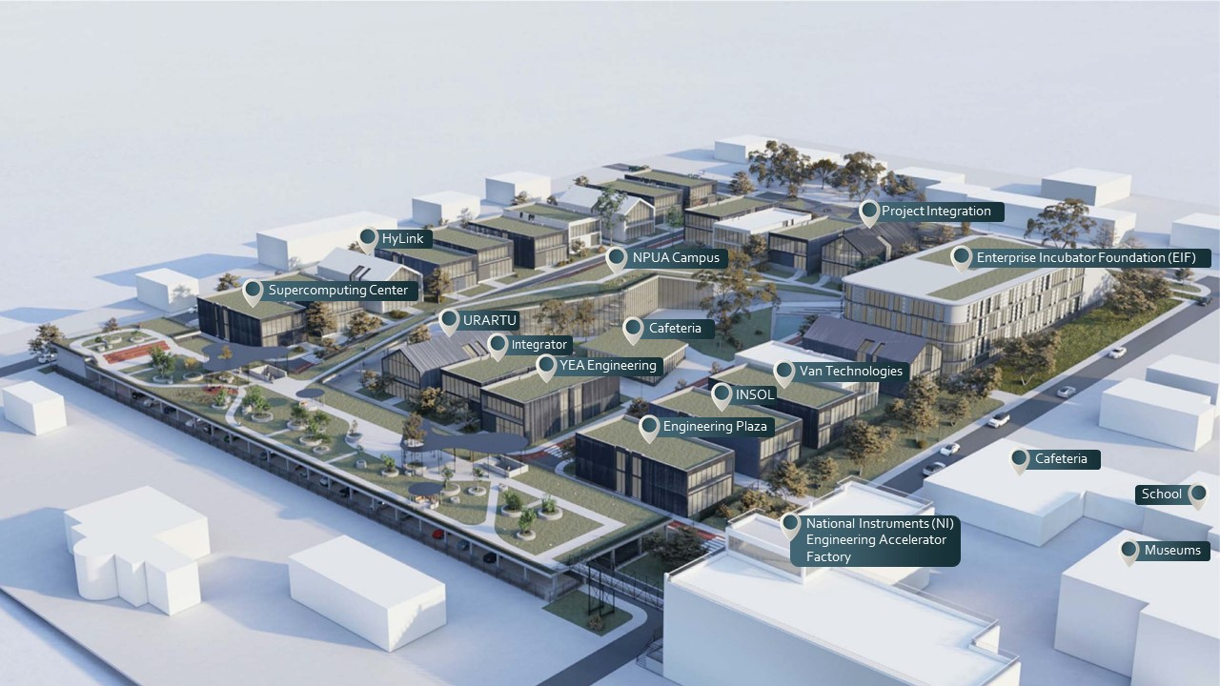
ENGINEERING
CITY
SCIENCE & RESEARCH
EDUCATIONAL MODELS
INFRA
STRUCTURE
RESIDENTS & TENANTS
Creation of the Armenian National SuperComputing Center in Engineering City

Slide 6
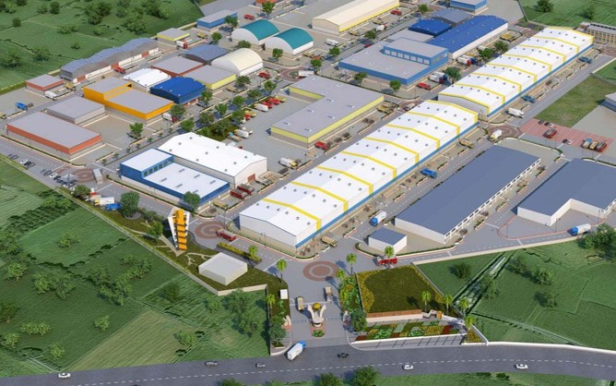
SCIENCE & RESEARCH
EDUCATIONAL MODELS
INFRA
STRUCTURE
FACTORY
CITY
Develop manufacturing capacity for high-tech engineering companies in Armenia
Position Armenia as a location for high-tech manufacturing
Attract international engineering and manufacturing companies to Armenia
Create jobs for professionals with secondary vocational education
•High-Margin Products
•Customized Production
•Smart Manufacturing – Industry 4.0

Slide 7
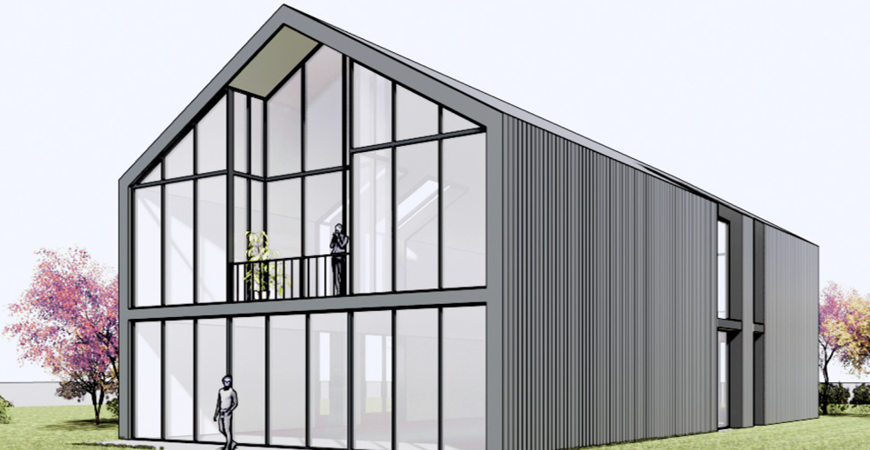
SCIENCE & RESEARCH
EDUCATIONAL MODELS
INFRA
STRUCTURE
ARMENIAN NATIONAL SUPERCOMPUTING CENTER
strengthening academia, industry and public sector cooperation
20
30
200
topics to be assisted in 2022
research topics to be conducted in 2022
to complete scientific and engineering training sessions in 2022
Supercomputer applications
Educational and research infrastructure
High productivity and Data analysis technologies

Slide 8
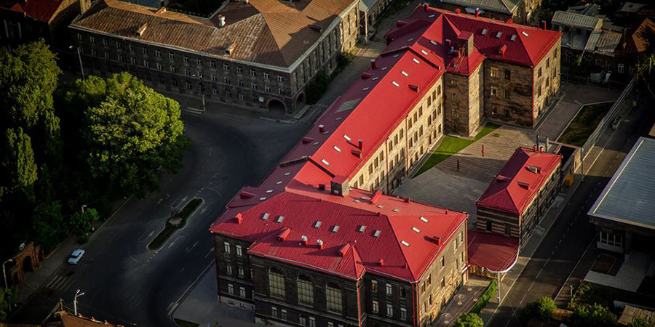
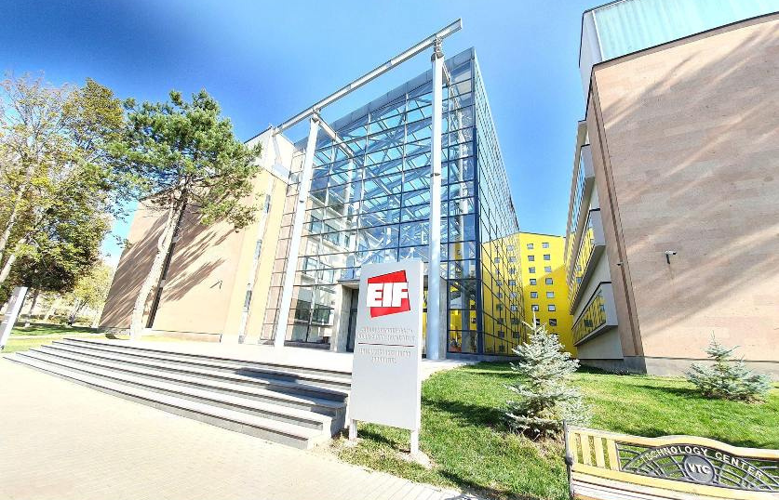
STRONG PRESENCE IN ARMENIAN REGIONS
Gyumri Technology Center
Vanadzor Technology Center
Kapan Mobile Lab
IT Trainings in all the regions of Armenia

Slide 9
EDUCATIONAL MODELS
STARTUPS
ACCELERATION
INCUBATION
INFRASTRUCTURE
GYUMRI
TECHNOLOGY
CENTER
31
resident companies
Establishment of a creative hub with cross-disciplinary labs
Sustainable design and mobility
Atelier for meta systems
Sensorial engineering
1000
students trained annually

Slide 10
EDUCATIONAL MODELS
STARTUPS
ACCELERATION
INCUBATION
INFRASTRUCTURE
VANADZOR TECHNOLOGY
CENTER
25
resident companies
500
students trained annually
Engineering Labs & Services

Slide 11
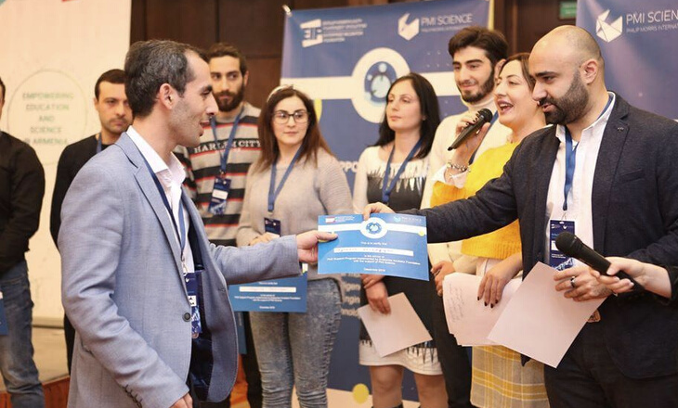
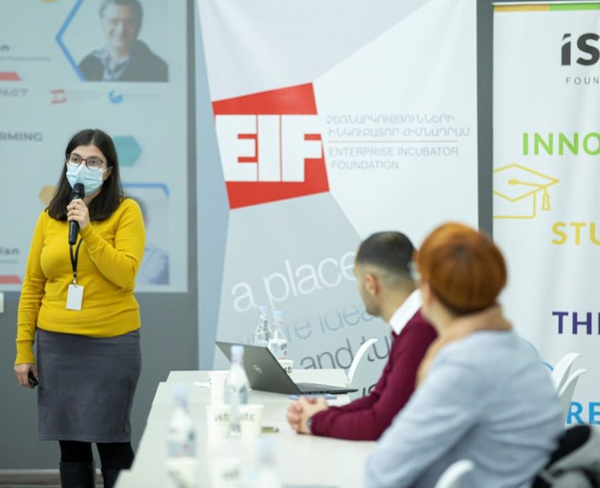
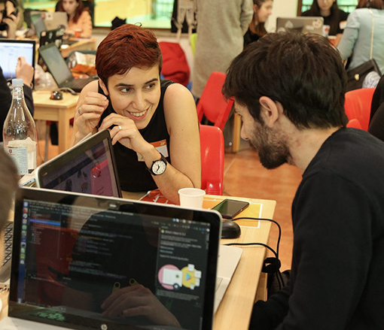
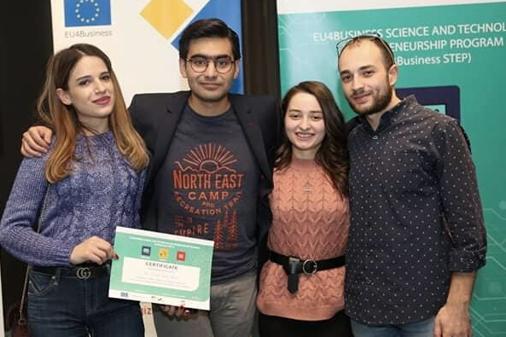
STRONG EXPERIENCE IN STARTUP ECOSYSTEM DEVELOPMENT

Slide 12
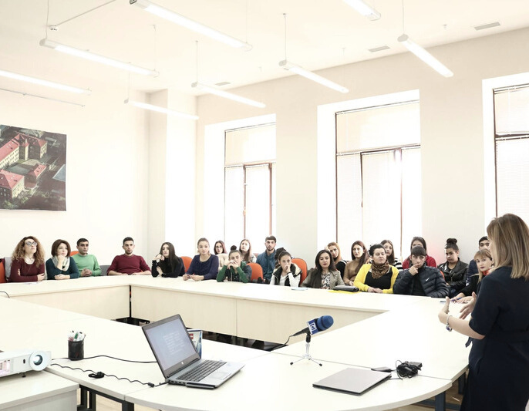
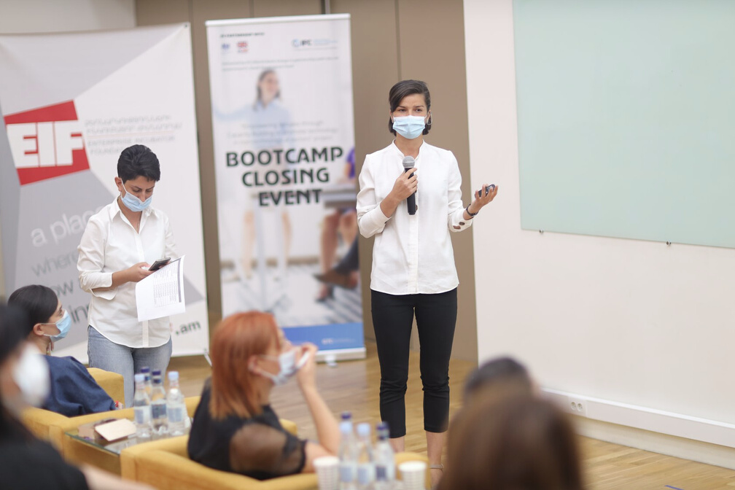
IMPLEMENTATION OF
INCUBATION, ACCELERATION AND GRANT PROGRAMS
Idea Grants - Science and Technology Entrepreneurship Program
Innovation Matching Grants
Regional Matching Grants
Research & Faculty grants
Empowering Females through Capacity Building
Climate Change Tech Accelerator

Slide 13
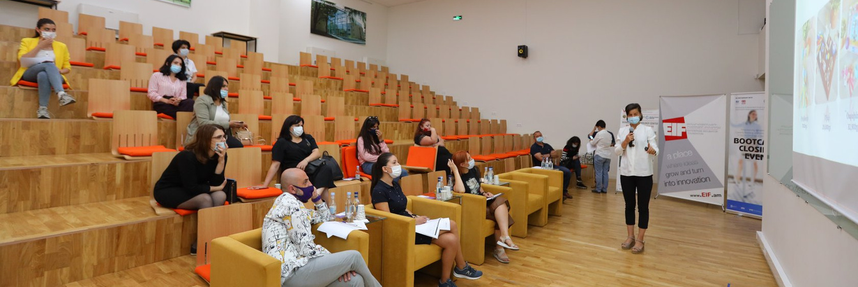
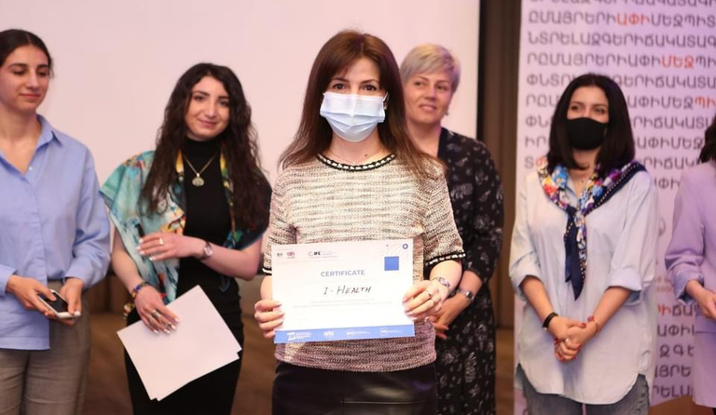
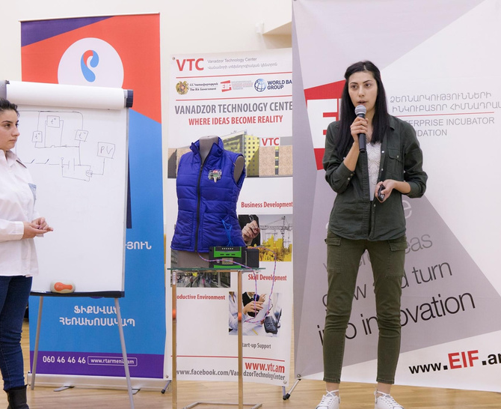
EMPOWERING FEMALES
THROUGH CAPACITY BUILDING
TO PROMOTE TECHNOLOGY IN
NON-TECH SECTORS
Intensive Bootcamp
350
female entrepreneurs from Armenian regions and Yerevan
Acceleration Program
200
female owned firms from Armenian regions and Yerevan
Sectors
Agriculture
High Tech
Manufacturing
Health
Creative Industries
Tourism

Slide 14
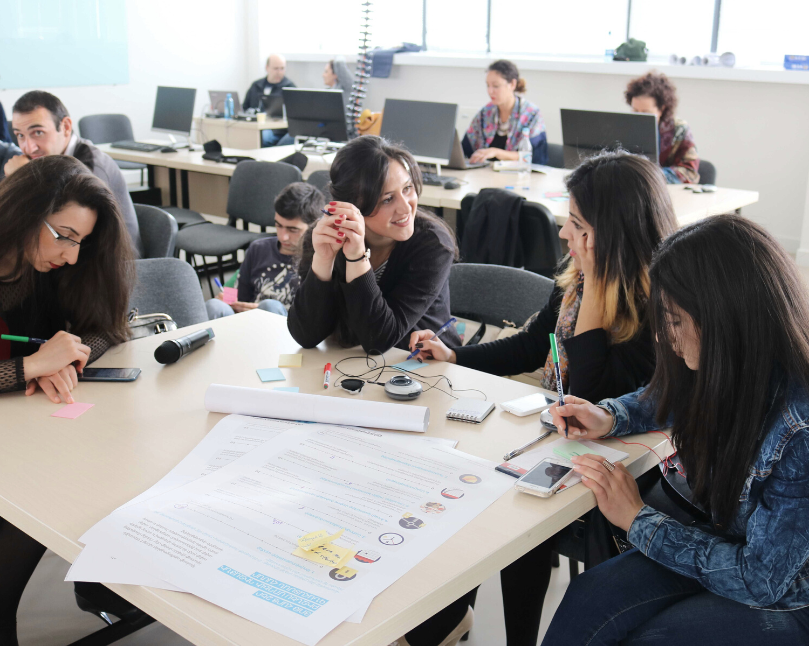
EDUCATION AND SKILL DEVELOPMENT
Armenian National Engineering Labs (ANEL)
Joint master programs and & PhD grants in Data science and Systems Engineering with US universities
Armenian Indian Technology Center (AITC)
Microsoft Innovations Center (MIC)
Innovative Solutions and Technologies Center (ISTC)
Gyumri and Vanadzor Technology Centers (GTC & VTC)
Mobile Regional Laboratories (mLAB)

Slide 15
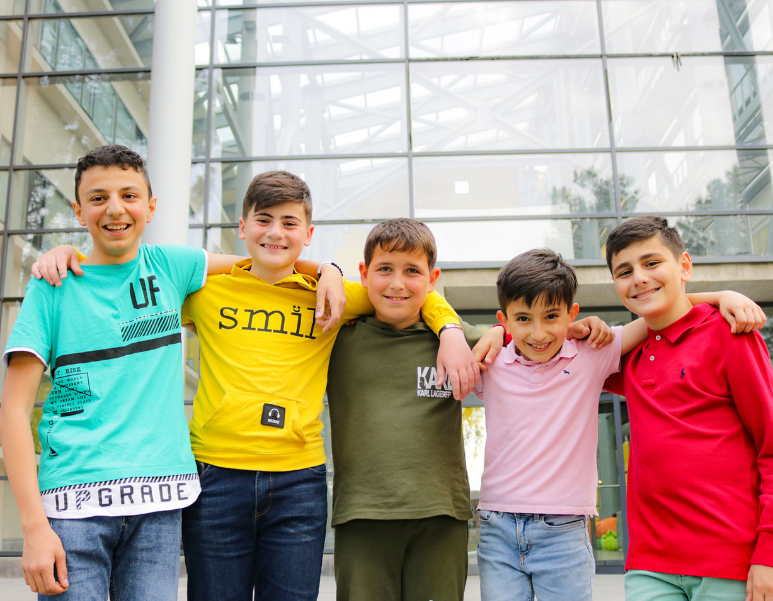
EDUCATIONAL MODELS
INFRASTRUCTURE
PARTNERSHIPS
ARMENIA
WORKFORCE
DEVELOPMENT
ACTIVITY
cultivating potential
5
years
duration
10,000
15-29 y.o. trained in ICT/high-tech, Agriculture, Tourism & hospitality sectors
7,500
employed

Slide 16
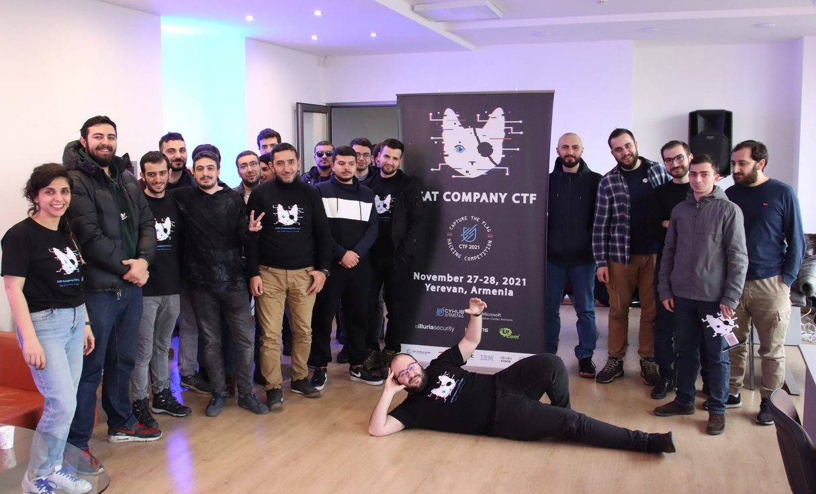
MIC &
CYBERSECURITY HUB
EDUCATIONAL MODELS
STARTUPS
ACCELERATION
INCUBATION
HIGHLIGHT EVENTS
9
427
new curricula developed
successfully completed training sessions
Main Cybersecurity Hub & ecosystem builder in Armenia
Capacity building in Cybersecurity
Development of Cybersecurity intensive bootcamp curriculum for
high-school students & certification programs for professionals (upskiling)
Development of MOOCs open source cybersecurity training courses in Armenian
1st Cybersecurity incubation Program in Armenia with the involvement of top international mentors & experts
Provision of Cybersecurity services

Slide 17
Thank you
info@eif.am
eif.am
Enterprise Incubator Foundation
21/1 Bagrevand Street,
Engineering City
Yerevan 0062, Republic of Armenia

