Slide 1

WIPO Guide and Survey on Technology Transfer (TTO)
staff and researchers’ views
on Technology Transfer (TT)

Slide 2
The Context
One of the impediments for TT and commercialization is the limited number of incentives for researchers and TTO staff
A survey was designed and administered to provide support data to the Guide
WIPO produced the Guide “Incentives in Technology Transfer – How to Encourage, Recognize and Reward Faculty Researchers and TTO Staff”

Slide 3
WIPO Guide on Incentives is written for:
WIPO Guide - Looking for responses for slow changes in entrepreneurial ecology at universities and R&D. Lack of incentives for the central stakeholders: researchers and TT staff.
Governments and policy makers
to improve national policies
University leaders
to improve institutional policies and practices in their institution
University researchers and TT staff
to support “bottom up” processes m for receiving recognition and rewards
Trainers
to develop training programs on incentives or institutional IP policies
Notes:
Thank you Olga, Andrea and Claudia for this introduction and also for your valuable contributions to the Survey and the Guide. It is my pleasure to present you an overview of the content of the WIPO Guide on Incentives for Researchers and TT Staff and explain some examples of incentives that can be put in place.
We created this Guide because many of our member states still struggle to successfully translate academic research into commercially viable processes and technology. We believe this can be attributed partially to a lack of incentives for the central stakeholders, namely the faculty researchers and the TT staff.
The main purpose of the WIPO Guide is therefore to provide an overview of the wide range of possible incentives, each with its own pros and cons.
The Guide is intended for a broad audience.
Governments : who want to improve the TT policies and practices in their country. The Guide showcases different national incentives and legislative provisions that aim to motivate applied scholarly activity and impact on society.
University leaders : the Guide will provide them with good practices on how to build a researcher incentives program, and how to select and implement the most adequate incentives, specific to the university’s particular circumstances.
Researchers and TT staff: who are interested in knowing what measures and conditions exist for receiving recognition and rewards for their TT efforts and performance.
Trainers: who are in search of a solid basis to develop a training program on incentives and/or institutional IP policies. Case studies and experiences from various institutions/countries will allow comparison of different approaches.
*****
Universities and research institutions are being asked to play a central role in our knowledge-centered economy by the technology transfer of their discoveries and inventions. We can see that, in response to this challenge, innovation ecologies at and around universities are starting to change. But in many cases, the change has been slow and limited. We, and many others, believe this can be attributed partially to a lack of incentives for the central stakeholder, namely the faculty researcher.
We created this Guide because many of our member states still struggle to successfullytranslate academic research into commercially viable processes and technology. The entrepreneurial ecology at and around universities has been changing a lot in the past years. But in many cases, the change has been slow and limited. We believe this can be attributed partially to a lack of incentives for the central stakeholder, namely the faculty researcher.

Slide 4
Typology
Non-financial incentives
Career advancement
Financial incentives
Notes:
In the Guide, incentives are divided into three groups:
Non-financial incentives
Career advancement incentives
Financial incentives
Within each of these groups, the incentives may be for general engagement, or for specific activities in TT.

Slide 5
Non-financial incentives | Career advancement | Financial incentives
Recognition | Promotion criteria | To encourage licensing
Flexible working conditions | Other policies targeting career advancement – like mobility | To encourage spin-outs
Support for TT |  | To encourage KE
Additional funds
Right to publish
Returning IP to the inventor
Notes:
This is an overview of the different incentives that are explained in the Guide. I wont have the time to deal with all of them in detail, but will give some examples of each of the three categories.
***
Non-financial incentives
These incentives typically involve praise and honour received for an achievement (‘kudos’); they often involve the recognition, praise and public promotion of an activity; they can be from within the University, or from external organisations. They can include incentives to engage in technology transfer and to consider socially responsible technology transfer (e.g. access to medicines). The non-financial incentives often reflect the culture of the university and the messages leadership wishes to promote about the role of TT in the university.
Career advancement incentives
These incentives are part of the recruitment into a university, promotion and retention within a university. What incentives may encourage a researcher to join a university, to stay at a university, and to gain promotion within a university? To what extent is engagement in technology transfer activities taken into account in promotion and recruitment opportunities?
Financial incentives
The most common financial incentives are researchers receiving a share of licensing income and researchers becoming shareholders in successful spin-out companies.
These are the direct appeal to researchers to get involved in technology transfer and to receive a share of the financial returns.
There can also be financial incentives to encourage general researcher engagement in knowledge exchange - research contracts and consulting for example.
***
Note: Under non-financial incentives, this ppt only deals with the first 4 incentives, not with Right to Publish and Returning IP.
Returning IP to the inventor
The path to commercialization begins when an invention is disclosed to the TTO. Critical assessments determine whether the technology has a market, a market need, and whether it can be patented or otherwise IP-protected. In some cases, those assessments return too many negatives: there may be insufficient interest among licensees or investors, difficulty scaling up, competition and regulatory risks, and a slew of other issues that, despite the TTO's best efforts, prove too difficult to overcome. Rather than letting the case files collect dust, the intellectual property can and, in many cases, should be returned to the inventor. However, there are some difficulties. For starters, Restrictions. and rights need to be clarified due to the large number of players and factors to consider. There's also the important relationship with the inventor to maintain and even strengthen. To communicate why the IP is being released, what led to the decision, and what the rights of the University, funding sources, and faculty are in relation to the innovation.
Protecting researchers’ right to publish
It is crucial to Researchers the ability to publish the outcomes of a research cooperation with industry and thus it is a very important factor and incentive to contribute to technology transfer if this capability is granted.
Many institutions will negotiate schemes that let the Researcher to publish when they collaborate with industry after appropriate engagement with the industry partner to guarantee that no sensitive information is disclosed, and that any IP is properly secured. The length of the confidentiality obligations is typically between three and five years, but much will depend on the nature of the project, the amount of time needed for additional development before commercialization (for example, pharmaceuticals may need more time), and the type of intellectual property (for example, whether the research is expected to result in a patent, in trade secrets, and a know-how license it is anticipated then it may not be possible to negotiate publication rights. This may be a serious issue: as an example, US universities will generally not agree to do research that must be kept secret. U.S. standard for publication includes a process of review performed by the company only for potential inventions not identified by University or inclusion of company confidential information. The review period is typically 60 days, and no more than an additional 60-day delay is allowed to the company to request changes or to file patent applications.
Universities and TTOs can support Researchers needs in their relation with companies by making it very clear that it is a Researcher’s choice to delay or withhold a publication for any reason, providing very clear, accessible information via the TTO of how patenting and publication can be complementary, and where issues will arise, not signing up to any agreements with third parties that delay publication for more than a few months and inform all Researchers involved in a delay - always of no more than a few months.

Slide 6
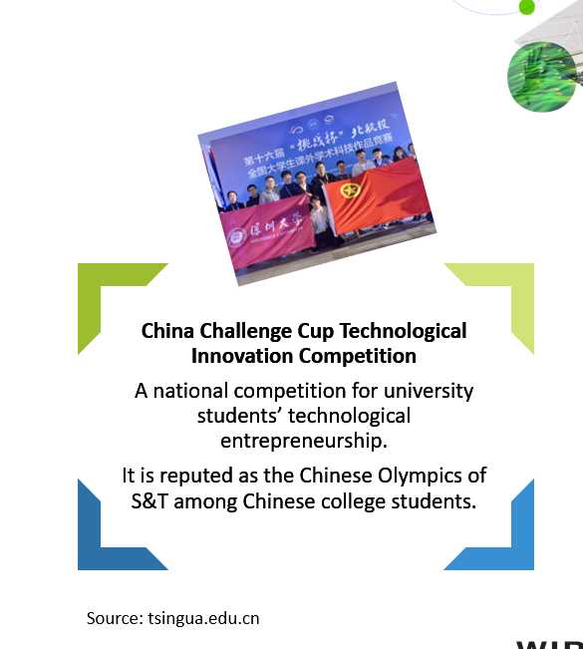
Recognition
This is a very personal incentive to respond to internal motivation of the staff – researchers, TTO or students
Direct praise in speeches, reports, etc.
Success stories
Prizes and awards
Incentives for students
Recognition schemes can be granted
At national level
At institutional level
Professional Associations

Slide 7
Flexible Employment Conditions
University of Mississippi Faculty Consulting Policy
Consulting is permitted provided the faculty member's full-time obligation to the University is met. The maximum nb of consulting days is 39 days/academic year or 52 days/calendar year for 12-month appointees. Faculty members should resolve any questions and/or ambiguities with their department chairperson or dean before the fact, so that the University community is not injured by their actions. Faculty members have an obligation to report fully the level of their consulting activities when asked to do so.
Sabbaticals and mobility schemes
  Spin offs
  Working with industry
  Upgrading competences
Teaching and admin reductions
Time allocation for consulting
Source: https://www.research.olemiss.edu/sites/default/files/ACA_FG_300_005.pdf
Notes:
Another non-financial incentive is Flexible employment conditions. Researchers value flexibility regardless of how it is defined.
Sabbatical leave (either paid or un-paid) is particularly useful for inventors intending to develop a spinout, but it may also be useful in order to enable researchers to work in-house with industry (secondments) or to concentrate on patenting and licensing. The Guide provides good practices for granting such sabbatical leaves.
Flexibility can also be a reduction of academic or administrative work for those faculty members with high research output (e.g. The Reykjavic University Research Policy).
And yet another example of flexible employment conditions is allowing researchers to spend some of their time consulting for other organizations in addition to their full-time employment at the university. As you know, though consulting opportunities can make faculty better scholars and teachers, it can potentially divert faculty from their primary activities; and both conflicts of interest and conflicts of commitment may arise. The Guide therefore provides examples of consulting policies that set forth time limits and other conditions that are intended to strike a fair balance between consulting and the obligations of the faculty within the university.
The EXAMPLE of such consulting policy shown here on my slide is the one of the University of Mississippi, that limits the nr of days of consulting and puts in place an obligation to report.
*****
Flexible conditions can include:
Sabbaticals and mobility schemes. Sabbatical leave (either paid or un-paid) is particularly useful for inventors intending to develop a spinout, but it may also be useful in order to enable researchers to work in-house with industry (secondments) or to concentrate on patenting and licensing. When granting sabbatical leave to some researchers, the department/unit will incur staff losses. Universities may wish to envisage that a compensation be made also to the unit, for example in the form of additional resources to replace the absent staff, or a share in the commercialization proceeds. In addition, when in sabbatical leave, researchers value most the possibility of returning, while keeping the same position and salary. Universities may wish to consider granting such possibility for a limited time (e.g. 3 to 5 years).
Teaching and admin reductions. Allowing researchers to buy out teaching and administrative time during their working hours, to devote exclusively to enterprise development. In this situation, the Researcher remains a full-time employee.
Time allocation for consulting and other outside professional activities. Allowing researchers to spend some of their time consulting for other organizations in addition to their full-time employment at the University. Though consulting opportunities can make faculty better scholars and teachers, the nature of the consulting process has in it the potential for diversion of faculty from their primary activities. Both conflicts of interest and conflicts of commitment may arise. The Guide provides examples of consulting policies that set forth time limits and other conditions that are intended to strike a fair balance between consulting and the obligations of the faculty within the university.
Consulting: the rules are different in the UK and the US (elaborate)
****
Though consulting opportunities can make faculty better scholars and teachers, the nature of the consulting process has in it the potential for diversion of faculty from their primary activities. Both conflicts of interest and conflicts of commitment may arise where faculty researchers compromise their professional standards or allow an outside activity to interfere with their obligations to students, colleagues or the primary missions of the university. Therefore, there needs to be a limit on the time that a faculty researcher may spend in consulting (“one day per week” consulting is commonly permitted). Universities typically have consulting policies and conflict of interest policies to set forth time and other limits that are intended to strike a fair balance between consulting and the obligations of the faculty within the university and serve to safeguard the interests of both parties
University of Mississippi Faculty Consulting Policy : https://www.research.olemiss.edu/sites/default/files/ACA_FG_300_005.pdf

Slide 8
Providing Support to Researchers for TT
Number of researchers do not engage in TT due to the lack of support for IP commercialization
Entrepreneurship coaching and mentoring
Business plan competitions, networking
TTO support for spinout creation
Development of business concept or preliminary business plan
IP due diligence
Market assessment and technology positioning
Introduction to financial community and guidance on fundraising
Notes:
3. Providing support to Researchers for technology transfer
Researchers will be incentivized to participate in TT activities if the TTO can offer them a professional and encouraging environment. The maturity of the ecosystem and the available resources will dictate the type and the amount of support that a university TTO offers to its researchers.
The Guide provides a couple of examples of how different TTOs, in different countries, have composed their package of services. For example ………
****
Amount of support: For example, for spinout formation, in uniquely mature ecosystems, such as Silicon Valley, a company may be formed with support from the many actors surrounding a university (such as very-early-stage investment firms, law firms, accounting firms, business advisors). But in the less mature ecosystems in which the majority of universities reside, a university may need to support the academic inventors through all the stages of company formation, development and investment. For instance, the university may provide real estate for the company to start and grow; legal services to help with incorporation; access to university core facilities, etc.
Entrepreneurship training, coaching and mentoring;
Education in patenting;
Incubators, business plan competitions, networking;
Travel funds to participate in practitioner conferences and meetings .
Specific TTO support for spinout creation
Development of business concept or preliminary business plan;
IP due diligence (including internal disclosure , ownership, freedom to operate);
Market assessment and technology positioning;
Introduction to financial community (venture capital/angels, PoC funds and seed funding public calls) and guidance on fundraising, helping to prepare communication materials, pitch decks, applications for public calls, etc.

Slide 9
Access to Additional Funds
Realising Our Potential Awards (ROPA), UK
Academic researchers with existing industry funding can apply for a sum to spend on any research activity they wanted.
“It provides responsive-mode funding for them to carry out undirected, curiosity-driven research of their own choosing.”
Research funds
PoC funds
Translational funds
Notes:
The last example I’d like to share is the provision of additional funds. Researchers spend a considerable amount of time on examining avenues for funding their research. So any incentives that provide funding for additional R&D activities will be welcomed and can influence their behaviour. As a matter of fact, surveys have shown that such additional funds are one of the most desired incentives.
Now, these additional funds provide of course money, but we included them under the non-financial incentives because they are not direct to the individual.
Additional fund incentives can originate from a variety of sources: governments, private funders, donations, crowdfunding, universities, international funding, etc.
A first type of such incentive is an Additional Research Funds
It is possible to design an incentive for researchers who are already engaged in TT activities to receive funds to carry out additional research as a reward. These rewards would be financed from the university’s central resources, for example the income received from technology transfer activities.
EXAMPLE of such fund at national level: Realising Our Potential Awards (ROPA), United Kingdom
In 1994, the UK government operated the ROPA scheme to encourage academic researchers to collaborate with industry and reward those already collaborating with industry. An academic with existing industry funding could apply for a relatively small sum to spend on any research activity he or she wanted. It thus provided responsive-mode funding for researchers to carry out curiosity-driven research of their own choosing. The scheme has been widely welcomed both by industry and by academics

Slide 10
Additionnal Funds – PoC – Help to Bridge the Gap – Source, Size and Criteria
Feasibility Fund, University of Tartu (Estonia)
In order to strengthen the flow from basic research to market, PoC funding was first created in 2019 and within three years UT has provided the funding of 900 K for 31 projects in the University of Tartu.
About half of the researchers who apply for the spin-off program have received the PoC funding. This proves that the PoC together with the UT spin-off program is a successful approach for commercialization of science based ideas and technology..
National Research Foundation (NRF) Central Gap Fund, Singapore.
Provides a national-level platform to resource impactful projects and encourage collaboration across public research performers and industry.
Provides funding support for projects of quantum up to S$2M (inclusive of 30% Overheads) for a period of up to 2 years.
Source: auckland.ac.nz
Source: tsingua.edu.cn
Notes:
Proof-of-concept, translational funds
The Guide also provides numerous inspiring examples of PoC and translational funding schemes to bridge the 'valley of death' funding gap in early stage projects. There is no 'one size fits all' approach for such PoC structures. Sources of funding, funding size, and eligibility criteria vary greatly.
An example of an institutional PoC fund is the Feasibility Fund from the U of Tartu
An example of a national PoC fund is the National Research Foundation (NRF) Central Gap Fund (“Central Gap”) in Singapore.
****
Singapore: The scheme provides a national-level platform to resource impactful projects and encourage collaboration across public research performers and/or industry. Publicly-funded research performers and government-linked entities are eligible for Central Gap.

Slide 11
Career Advancement Incentives
Notes:
Then we come to the career advancement incentives.
Merit, tenure, promotion, and career advancement criteria are important tools to affect an innovation-driven cultural change at the university.
****
Some institutions, such as MIT, Cambridge, University of Tehran, Hebrew University, have an innovation-driven academic culture that has already made global impact through its spinouts and technology transfer. For such institutions, change in career advancement criteria may not be necessary. However, there are many universities where this innovation-driven cultural change is yet to happen, is happening at a slow rate, or spans only a small fraction of the faculty. For such institutions, merit, tenure, and career advancement criteria are important tools to affect change.
****
Entrepreneurial Universities
Stanford, MIT or Cornell,
Cornell is promoting entrepreneurs like they are apostles and enterpreneurship like it is a religion
Asia: See https://edurank.org/business/entrepreneurship/as/

Slide 12
Promotion and Career Advancement Criteria
Examples of criteria for promotion include:
Number of publications of applied research
Nr. of invention disclosures submitted to TTO
Number of patent applications filed
Number of patents granted
Number of licenses executed
Actual licensing revenue received
Collaborations with industry (collaborative research, consulting), etc.
Number of companies started
Knowledge of innovation and commercialization imparted to students
Industry reports, white papers and other “non-academic” outputs
Networking effort with non-academics, incl. memberships of the board of directors of companies, social enterprises and NGOs
Consistent policies are lacking
Misalignment between mission and promotion
2 steps:
- Define which TT undertakings will be included.
Set out equivalence criteria for various research outcomes and TT outcomes
Notes:
What we have seen here is that there is a certain MISALIGMENT : Even while many universities are pushing for outcomes from their TTOs, very few universities explicitly state that promotion awards are given for commercialization activity. But in recent years, a rising number of universities are addressing this divide and start to include faculty patenting and commercialization activities in their promotion guidelines.
We have also observed that there doesn’t seem to be much consistency – There are different calls from universities, associations, and coalitions to incorporate TT activities in career advancement but none of these initiatives has yet led to the development of widely‐adopted measurements.
3. And the challenge for developing effective amendments to the University promotion system typically comprises two steps:
First, accurately defining which TT undertakings will be included in the criteria for faculty career progression. Little research has been done on what the ideal criteria ought to look like. In general, this would depend on the channel and nature of TT activity on one hand, and on the local context on the other.
Examples of criteria that have been recognized include: …
The second step is to set out equivalence criteria for various TT outcomes. There is no general rule that may underlie such equivalences, as these need to be set at a departmental and University level, depending on contextual factors. For example, consider the act of filing patents. If promotion committees are measuring impact, the university policies need to make sure that just filing patents is not sufficient without action to capitalize on that IP registration. Thus, for example, invention disclosures may have relatively little value, patent applications slightly more, and licensed patents will be highly valued, especially those that produce royalties.
The Guide provides some international good practices for the inclusive recognition of innovation & entrepreneurship impact within promotion and career advancement guidelines.
****
MISALIGMENT : In many universities there still is a fundamental misalignment between TT activities and incentives to faculty researchers in terms of merit raises, tenure, and career advancement. Even while many universities are pushing for outcomes from their TTOs, very few universities explicitly state that promotion awards are given for commercialization activity. A rising number of universities are recognizing and addressing this divide and start to include faculty patenting and commercialization activities in their promotion and tenure guidelines.
NO CONSISTENT POLICIES – There are different initiatives and calls from universities, associations, and coalitions to incorporate TT activities in career advancement but there doesn’t seem to be much consistency. None of these initiatives has yet led to the development of widely‐adopted measurements.

Slide 13
Revenue Sharing: Examples of National law provisions
Brazil Law [Innovation Act]
”Creator is ensured min 5% and max 1/3 of the income earned by institution resulting from TT and licensing”
USA Law
[Bayh Dole Act]
Inventors must share
ZAF Law [Innovation Act]
First million rand of revenues: min 20% of gross revenues accruing to the institution
Serbia Law
No guidance on how much to share
Each institution develops its own policy
Balance must be used for education and research
Thereafter, min 30 % of net revenues accruing to the institution
Inventors must receive min 50% of the profit from commercialization of IPRs
Notes:
LAWS
Several countries have adopted legislation providing for minimum benefit-sharing arrangements.

Slide 14
Founder-Researcher Equity
U Edinburg
Size of founders is decided case-by-case but typically the university’s share would be equal to the share of the academic founders.
Imperial College (UK)
Founders Choice Program:
KU Leuven (Bel)
% split for the researcher is pre-defined. Researcher receives 40% equity.
Gives researchers the choice how much help they want from the TTO, and the amount of founding equity they’ll get accordingly.
Many universities give academic founders equity
  For their know-how
  For consulting time
The rules and reward structures vary between universities and between countries
  In some countries, academic researchers cannot own shares in spin-outs
Notes:
Many universities give the academic founders equity in the spin-out. If the researcher is shareholder, he/she can hope for personal gain through dividends or added value in capital in case of stock market flotation or acquisition by a large company.
The rules governing the equity ownership, and reward structures of spinouts vary a lot between universities and between countries.
In some countries, academic researchers cannot own shares in spin-outs.
The Guide provides examples of different approaches take in terms of initial equity-split.
In some cases, for example in the University of Edinburgh, the size of the founders is decided case-by-case but typically the University’s own share would be equal to that of the academic founders.
In some cases, the percentage split for the researcher is pre-specified, such as in KU Leuven, Belgium, where the individual researcher would receive a 40% equity share
Another interesting example is the Founders Choice Program from the Imperial College, which is a customized equity incentive.
.
Many questions will arise when creating equity incentives for researchers :
What is the approach to take in terms of initial equity-split? There are many discussions about how many shares the founding researchers should receive at the start. Universities do not always have a fix formula for the distribution of initial equity. The inventor’s share is usually decided on a case-by-case basis. Factors that may play a role in the decision are: the roles of the individual researchers in the company; the amount of help the founders will get from the TTO; the terms of the license agreement; the terms and conditions of third party funders of the research that led to the technology; the chance of the spin-out company and investors to grow value; and the extent to which the university will be able to make follow-on investments, so that it can maintain its shareholding.
How to deal with dilution issues? At a later stage, as the company grows, the spin-out can also give more equity to the researchers, under various share option plans. The license agreement will include the negotiated financial terms (royalties, etc.) and also the share of equity in the company for the university.

Slide 15
Survey on Technology Transfer (TTO)
staff and researchers’ views
on Technology Transfer (TT)

Slide 16
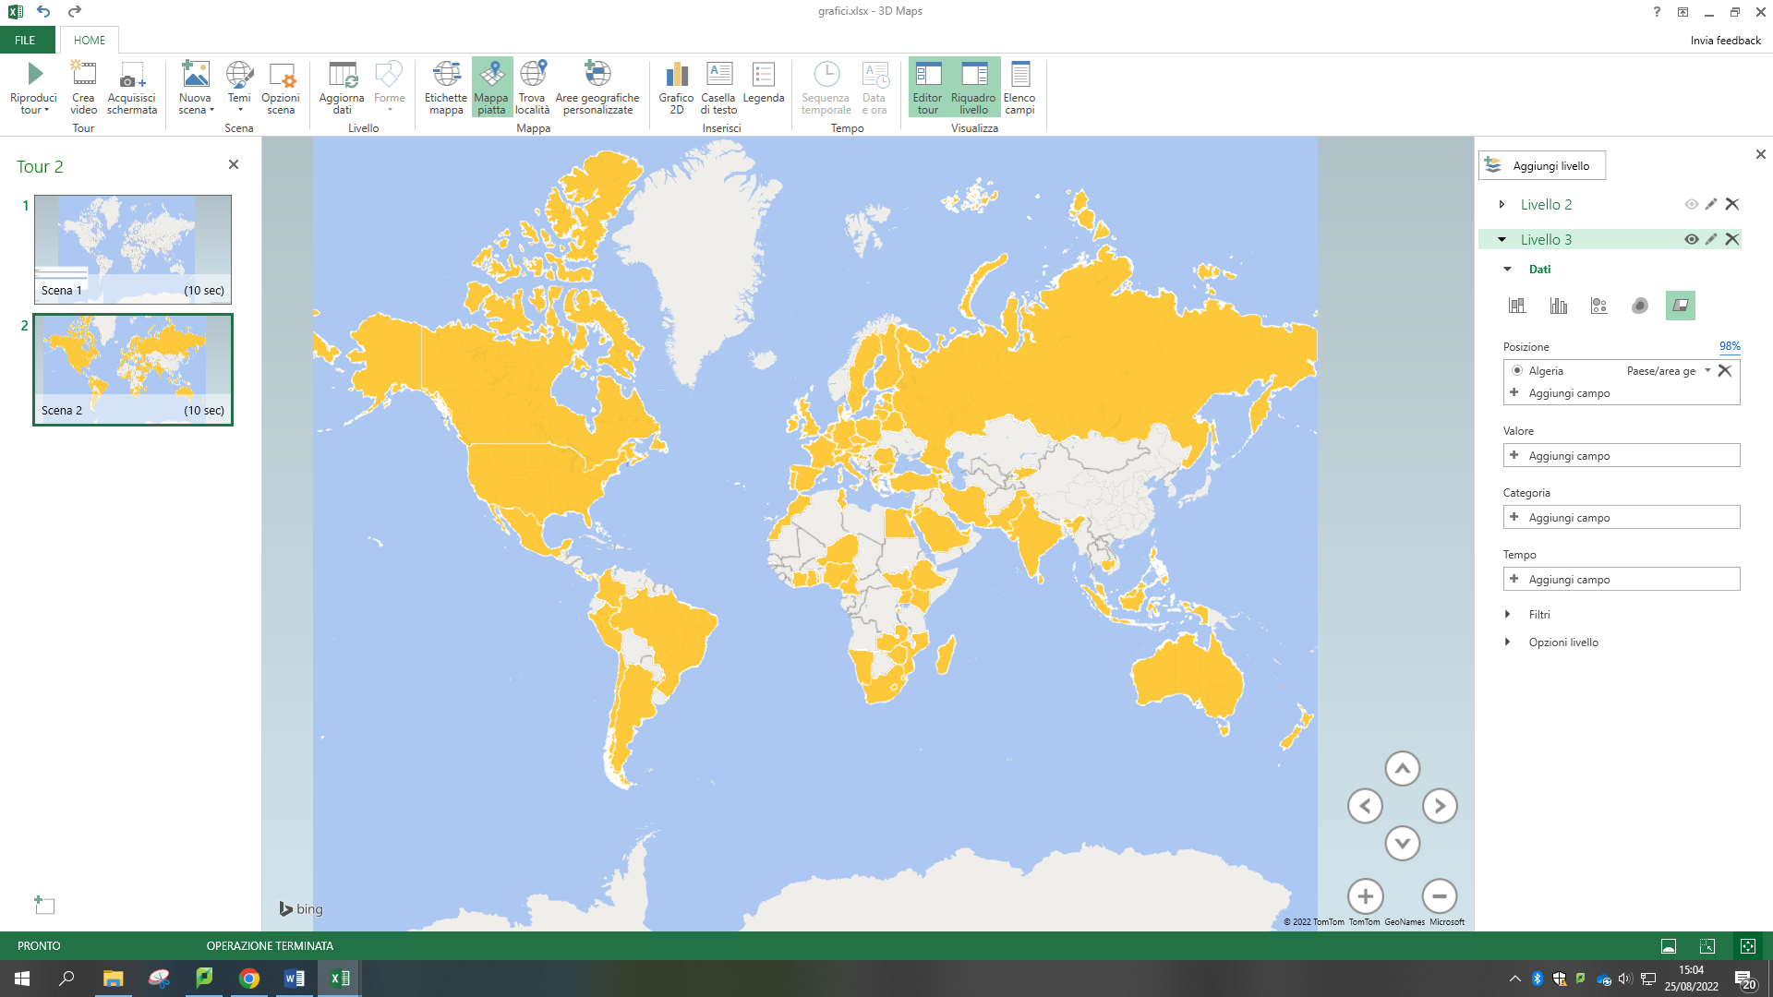
We interviewed 755 participants from 88 countries and 5 continents – TTO head of Units, TTO staff and researchers

Slide 17
Participation in the survey
755 participants from 88 countries

Slide 18
Objectives of the Survey
To provide input on improvement of TTOs practices:
the situation (i.e. too few patents, too few spinouts, scarce researchers’ involvement with industry, insufficient invention reporting);
the problem (what kind of incentive is lacking for researchers from the TTO’s perspective);
the potential improvement measures (with reference to researchers’ motivations, i.e. improve university’s entrepreneurial culture; increase researchers’ internal motivations towards TT; increase researchers’ recognition for their TT activities); and
TTO Staff – motivation and job satisfaction
Researchers - to identify the factors that are more strongly associated with researchers’ engagement in TT activities.

Slide 19
Motivations and barriers for researchers and TTO staff
Internal motivation: engagement in or attraction to an activity for the sake of enacting the activity, such that there is no known external incentive for said activity
External motivation: motivation that develops from a source other than the individual
Contextual factors: context elements that influence the motivations and are part of the environment in which the individual operates

Slide 20
Main reason to engage in technology transfer for researchers and TTO staff
Positive impact on society or to contribute to technological development for both researchers and TTO staff.
All the continents, with the only exception of researchers in Asia, where the most frequent motivation is the desire to get recognition for their work.
This analysis does not include Australia due to the limited number of responses received from this continent.

Slide 21

I engage in Technology Transfer because…
Europe
Researchers & TTO Staff
“I want to have a positive impact
on society”
Asia
Researchers - “It allows me to get recognition for my work”
TTO Staff - “I want to have a positive impact on society”
America
Researchers - “I want to contribute to technological development”
TTO Staff - “I want to have a positive impact on society”
Africa
Researchers & TTO Staff
“I want to have a positive impact
on society”

Slide 22
Why do researchers get engaged with TTOs?
Valuable intellectual experience
Challenging and exciting activity
Network of relationships with industry
Insights on industry trends
Contribution to technological development
External motivations
Encouragement from TTO to get involved in TT
Structured and effective ecosystem for TT
Internal rules that encourage researchers to get involved in TT
Clear communication on the importance of TT
Strong support for the third mission
Services that facilitate TT
Strong entrepreneurial culture
Possibility to start a different career
Visibility for further TT activities
Recognition for one’s work
Access to funding for research
Monetary rewards
Access to in-kind resources
Promotions
Internal motivations
Contextual factors

Slide 23
What role does researchers motivation play in the success of TT?
IP development and protection
First-phase TT
(research agreements, consulting, disclosure, patenting)
Internal motivations:
Possibility to get insights on industry trends
External motivations are less relevant than internal ones
Valorization
Second-phase TT
(licensing, spinout development, joint ventures, open innovation)
Contextual factors:
Structured and effective ecosystem for TT
Clear communication on the importance of TT
Engagement with TTO

Slide 24
Perspectives of researchers and TTO staff
The researchers' opinions
differ significantly from the opinions of both the employees of TTO and the heads of TTO departments

Slide 25
TTO Staff
For TTO staff, stronger motivations lead to stronger satisfaction with working in a TTO.
TT is a challenging, exciting and intellectually valuable experience
It allows to get insights on industry trends (among internal motivations), and that it
Makes it possible to get recognition for one’s work (among external motivations).
Internal motivation always higher than external, and in balance with satisfaction to work in TTO.
Although the desire to contribute to technological development and to have a positive impact on society are primary drivers for TTO staff , they appear to be relatively less relevant as predictors of job satisfaction.

Slide 26
Researchers: diversity and inclusion factors
Female respondents tend to be more motivated than male ones by the desire to check the validity and practical application of their research, but also by the possibility to get recognition for their work or to be considered for promotions as a consequence of their TT activity.
Younger respondents are more motivated than older ones by the desire to increase their network of professional relationships with industry, and by the possibility to receive promotions or monetary rewards and to start a different career.
Similar associations are observed for researchers with fixed-term contract permanent contracts : they are more strongly motivated by the possibility to increase their network of professional relationships with industry, to get recognition for their work and to start a different career ; further, they show a stronger interest for getting insights on industry trends .
No effects of prior experience outside academia were observed on motivations.

Slide 27
Gender of researchers: diversity & inclusion
Level of agreement (range 0-5)

Slide 28
Age of researchers: diversity & inclusion
Level of agreement (range 0-5)

Slide 29
Motivation of TTO staff
20.3%
Internal motivations
Insights on industry trends
Challenging and exciting activity
Valuable intellectual experience
Job
satisfaction
External motivations
Recognition for one’s work
Visibility for further TT activities
18.0%

Slide 30
The main difficulties researchers face in creation of spinouts – why they resist
Fear of not being able to provide stable funding for spinout company
Lack of financial skills
Lack of business skills
Governments play a key role in developing specific strategies, tools and incentives that can be used to:
Increase the motivation of researchers;
Ensure respect for diversity and inclusion;
Enable TTOs to guide researchers effectively.
Lack of technical-scientific skills
Fear that the spinouts may become an obstacle for academic career
Fear of not being recognized by Institution
Lack of intellectual property support and/or of clear national legislation for academic spinouts

Slide 31
Lesson Learned from the Survey
Desire to have an Impact
Researchers are researchers: easier for them to commit in the first phase of TT (patenting, idea generation) than the second one (commercialization, etc.)
Despite sharing the same motivations: researchers' opinions differ significantly from TTO staff and TTO heads on enhancement of the research value
Governments and top management play a key role in developing specific strategies, tools and incentives

Slide 32
Academic collaboration and TT require New Culture with clear vision what the impact is and how to measure it;
Governments have a key role in creating an enabling eco systems, with TT clear policies, adapted infrastructure and sustainable funding for TT activities;
Changes may be slow on the national / regional level, but institutionally measures can be more effectively adopted – NOW;
Top management’s support is essential;
There is a need for alignment between institutional business model and IP Inst.Policy, so that IP will be considered as the tool for reaching business objectives.

Slide 33

Thank you for your attention!
2022
Unsplash

