Slide 1
FIRST PRE-SEED ACCELERATOR IN SERBIA
With support of:

Slide 2
We strive to create an environment where startup founders can focus on idea validation and building amazing products.

Slide 3
We will expand your know-how and support you in turning your idea into successful business.
With Raising starts program startups benefit from:
- financial support up to CHF 20,000 with no equity!
- trainings and mentors
- networking and modern maker space
- IP support in collaboration with Swiss IPI
It's time for your idea to shine!
up to100
COMPANIES
3
CITIES

Slide 4
HOW IT WORKS:
STAGE 1
WORKSHOPS
MENTORSHIP
IP SUPPORT
PEER-TO-PEER EVENTS
ACCESS TO STPB COMMUNITY
STAGE 2
WORKSHOPS (ADVANCED TOPICS)
MENTORSHIP
FUNDING UP TO 20K CHF NO EQIUTY
IP SUPPORT
NETWORKING

Slide 5
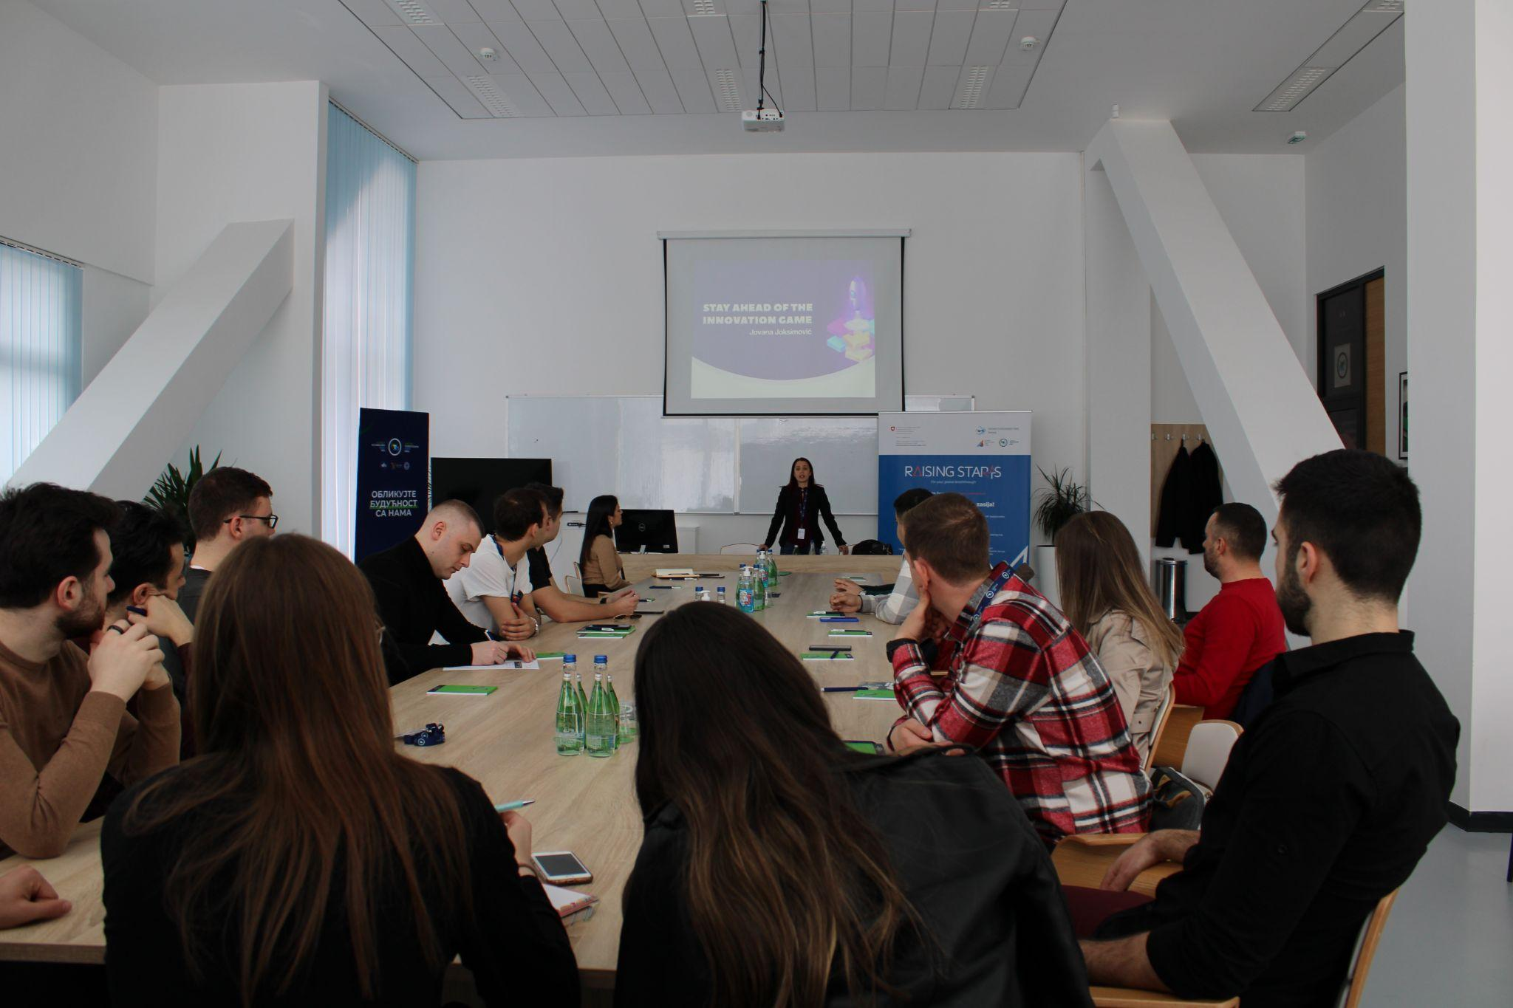
Intelectual Property - successful collaboration with Swiss IPI
IP fully integrated in all steps of the program!
IP support includes:
- awareness raising activities
- trainings and workshops
- IP analysis
- dedicated IP officer
- IP funding (international protection of IP rights)
- capacity building for Serbian IPO
- capacity building of STPs
Results:
3 startups received IP funding; 10+ workshops; 40+ supported companies

Slide 6
FIRST 2 BATCHES THROUGH NUMBERS
506
APPLICATIONS
117
TEAMS IN
STAGE 1
36 (+20)
STARTUPS IN
STAGE 2
60 MENTORS
700+(300) MENTORSHIP
session
17
STARTUPS RAISED ADDITIONAL INVESTMENTS
1 mil EUR
RAISED
INVESTMENTS

Slide 7
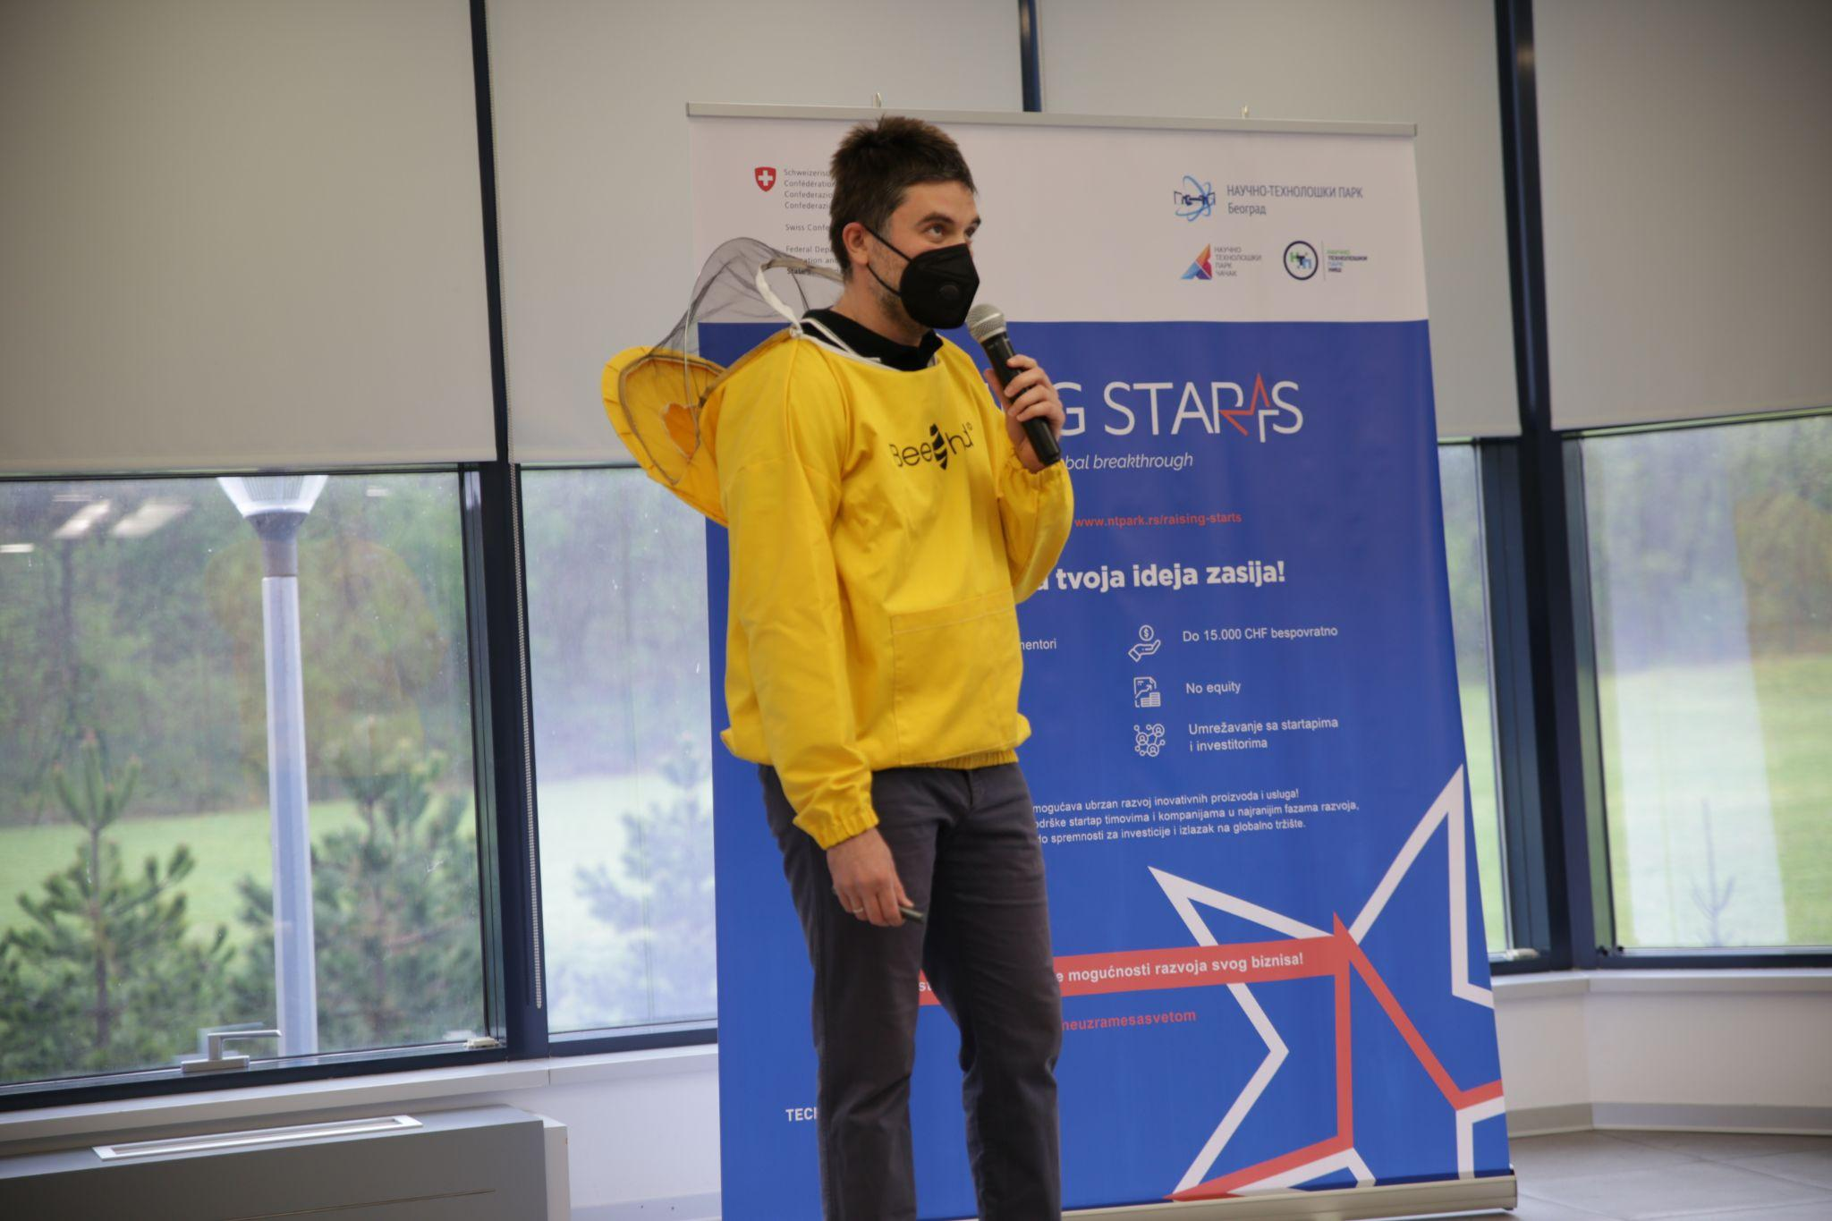
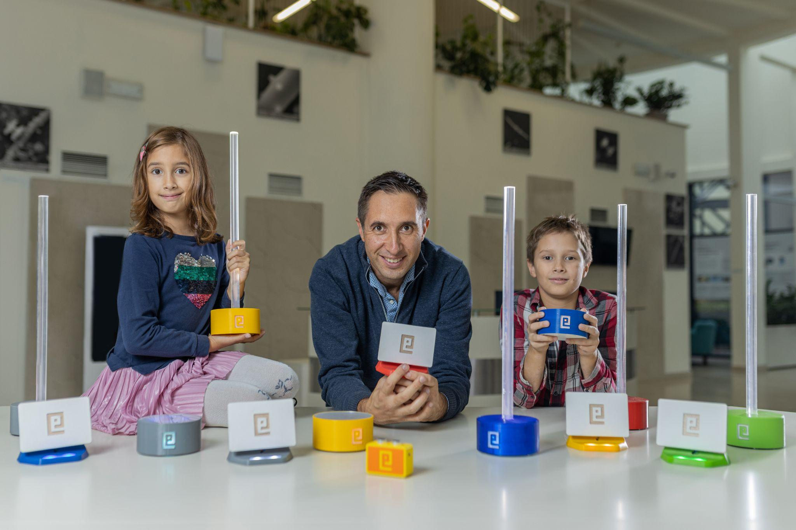

Slide 8
A Guide to the Intellectual property
for Serbian Startups
The first document of this type for startups in Serbia is an adaptation of the World Intellectual Property Organization (WIPO) publication "Enterprising Ideas: A Guide to the Intellectual property for Startups", adjusted to the local ecosystem and procedures for the IP rights protection in the Republic of Serbia, with examples of the use of intellectual property rights in business at five domestic startups.

Slide 9
STUDY TOUR TO SWITZERLAND
27-29 March, 2023
Transfer of knowledge from Switzerland Innovation Ecosystem organizations for capacity building and learning on the best-practice examples
Organised by Swiss Intelectual Property Institute (IPO) and STP Belgrade
Participants:
DATE | ACTIVITY
Day 1 – 27.03.2023. Bern Day 2 – 28.03.2023. Lausanne / Genève Day 3 – 29.03.2023. Zürich | Swiss Federal Institute for Intellectual Property/ State Secretariat for Economic Affairs SERI / SWITT (Swiss Technology Transfer Association) EPFL Innovation Park / Technology Transfer Office BioAlps Geneva Technopark Zurich Blue Lion Incubator
Ministry of Science, Innovation and Technological Development
STPs Belgrade, Nis and Cacak
Office for Intellectual Property of Serbia
University of Belgrade

