Slide 1
SCIENCE TECHNOLOGY PARK BELGRADE Serbian Successful Example
Gordana Danilovic Grkovic

Slide 2
INCUBATION
BUSINESS TECHNOLOGY INCUBATOR OF TECHNICAL FACULTIES BELGRADE (BITF)
First technology incubator in Serbia
2008
Supports enthusiastic and ambitious young enrepreneurs, who use new technology to solve problems globally.
.
BITF encourages young and technically educated people in starting up their own businesses and keep the talent in Serbia
45 startup companies
Founders:

Slide 3
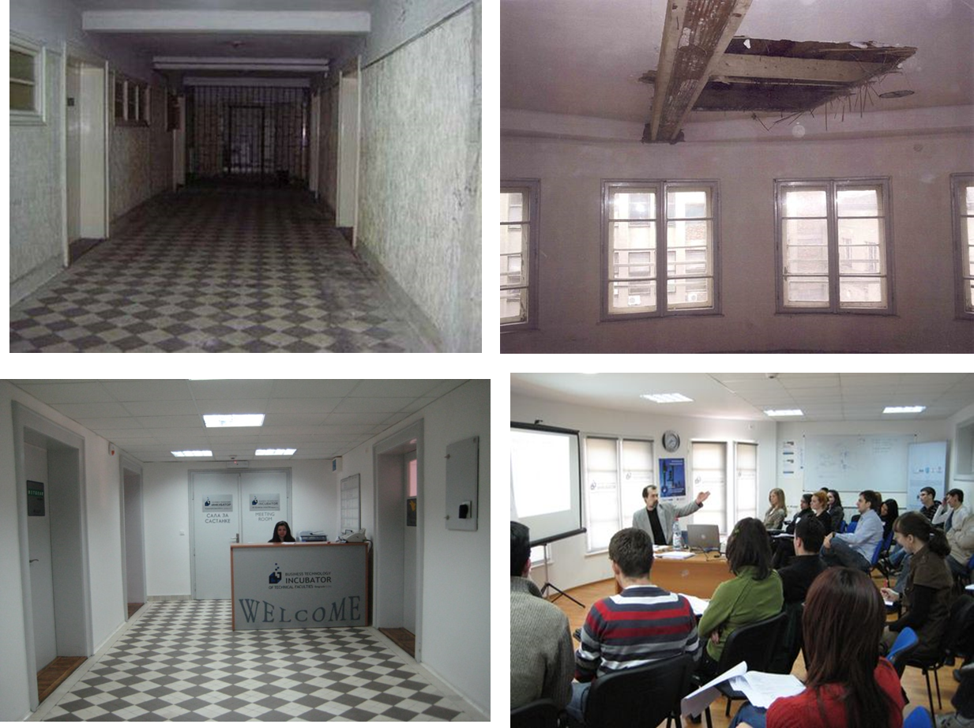
INCUBATION
BUSINESS TECHNOLOGY INCUBATOR OF TECHNICAL FACULTIES BELGRADE (BITF)

Slide 4
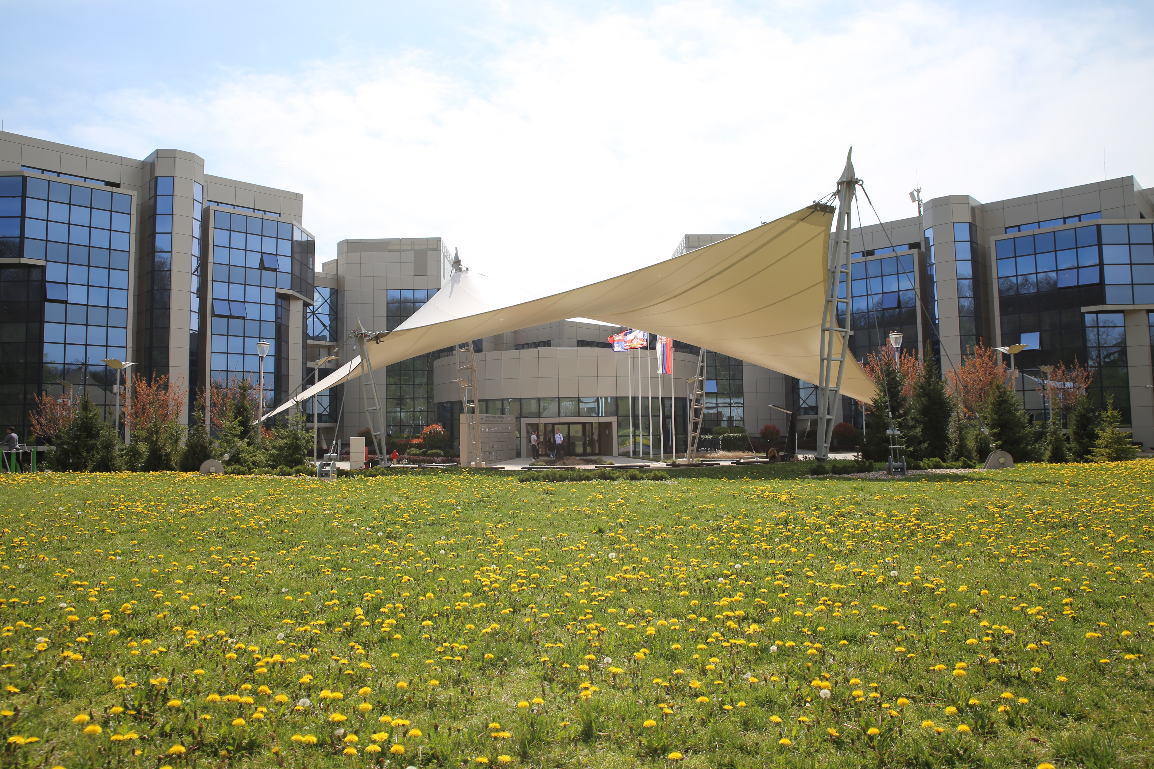

Slide 5
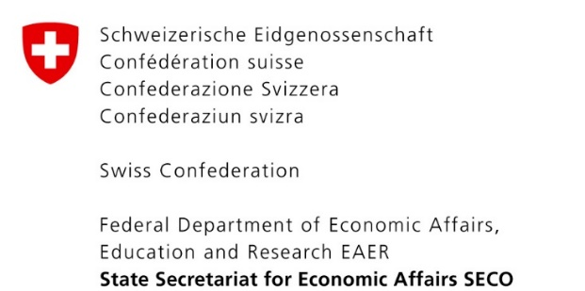
WHERE TECH
MEETS BUSINESS
Founders:
With support of:
Notes:
TREBAJU MI NEGDE LOGOTIPI OSNIVACA

Slide 6
KNOWLEDGE IS POWER!
Startups
Development of high-tech sector
Development of innovative products and services
Employment of young highly educated people
Export growth instead of brain drain
Business networking and globalization
STP Belgrade plays a key role in Serbian innovation ecosystem by connecting all relevant Stakeholders and boosting knowledge based economy.
University
Venture funds
Corporate
Government
Market

Slide 7
WE SUPPORT
... where fresh starters meet valuable experience ...
STARTUP COMPANIES AND TEAMS
young entrepreneurs coming from technical faculties
GROWING TECH COMPANIES SMEs and R&D of large domestic and foreign companies
...and drive changes for better future togehter!

Slide 8
OUR ECOSYSTEM
STARTUPS
GROWING COMPANIES
Notes:
UBACITI NOVE CLANICE IZBACITI ON KOJI SU IZASLI

Slide 9
OUR RESULTS IN 7 YEARS:
7
developed support programs
180+
Supported companies
1000+
potential entrepreneurs trained
5000+
students encouraged for technological entrepreneurship
20000+
visitors
STP Belgrade companies currently:
1500+
employees
50+
exporting countries

Slide 10
57,6
GROWTH OF INCOME AND EXPORTS
48,1
*In millions of euros
34,6
40.3
income
export
30.2
26,5
19.3
23.3
16.6
17.2
14.9
10.5
5.2
4.2
3.9
3.5
3.2
2.5
2.6
1.9
1.8
0.7
1.0
1.2
0.2
0.4
0.5
0.1
2008
2009
2010
2011
2012
2013
2014
2015
2016
2017
2018
2019
2020
2021*

Slide 11
Grow
Generate
Key programs:
Accelerate
Growth program
Educate
Incubation program
Raising starts
For specific industries:
Pre-seed program for early stage startups
Imagine IF! (Innovation Forum Cambridge, UK)
Colosseum Sports Tech Serbia (Israel)
ParkUP!

Slide 12
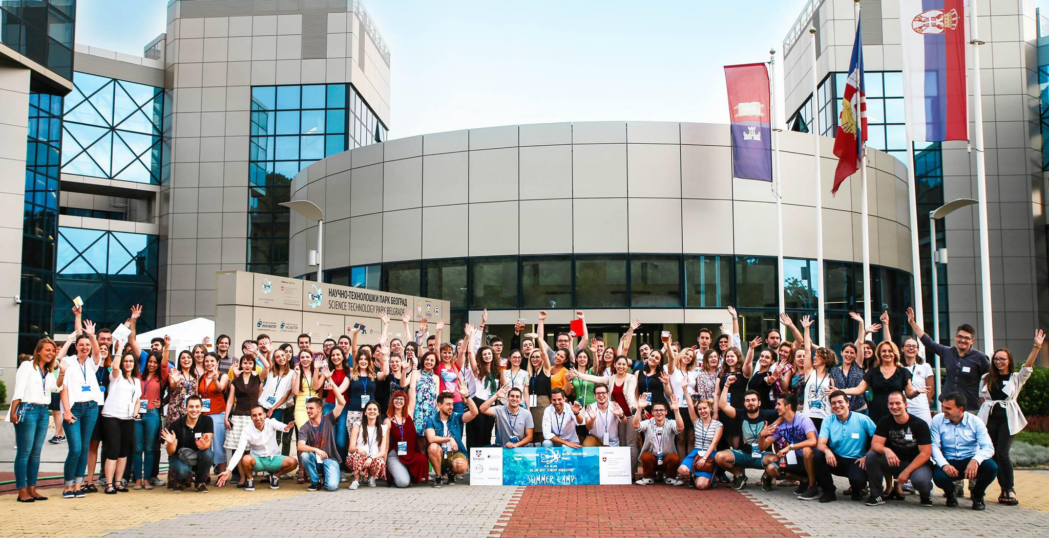
An intensive one week program of learning, working and networking with the goal of encouraging students interested in the startup world, with benefit of gaining knowledge and skills on how to create ideas / spot problems worth solving, form a team and learn about the steps in developing a successful startup.
60 +
WORKSHOPS
350+ participants from 15 faculties
1000+ interested students
7 DAYS

Slide 13
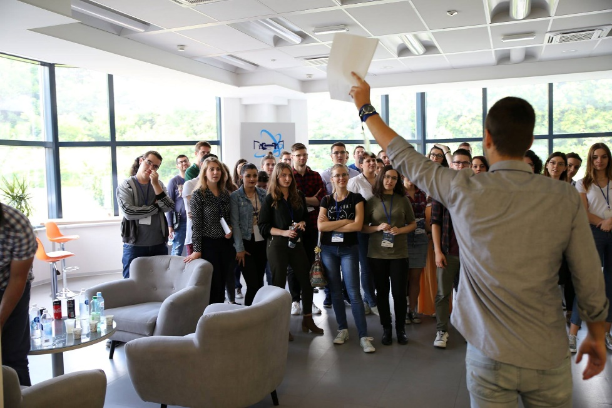
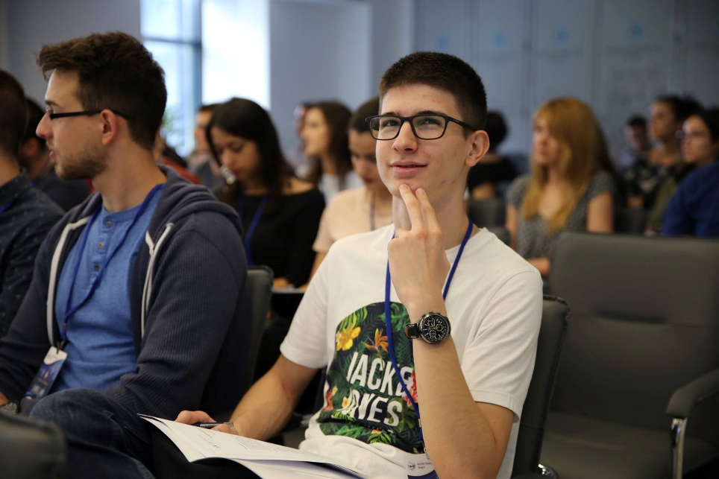
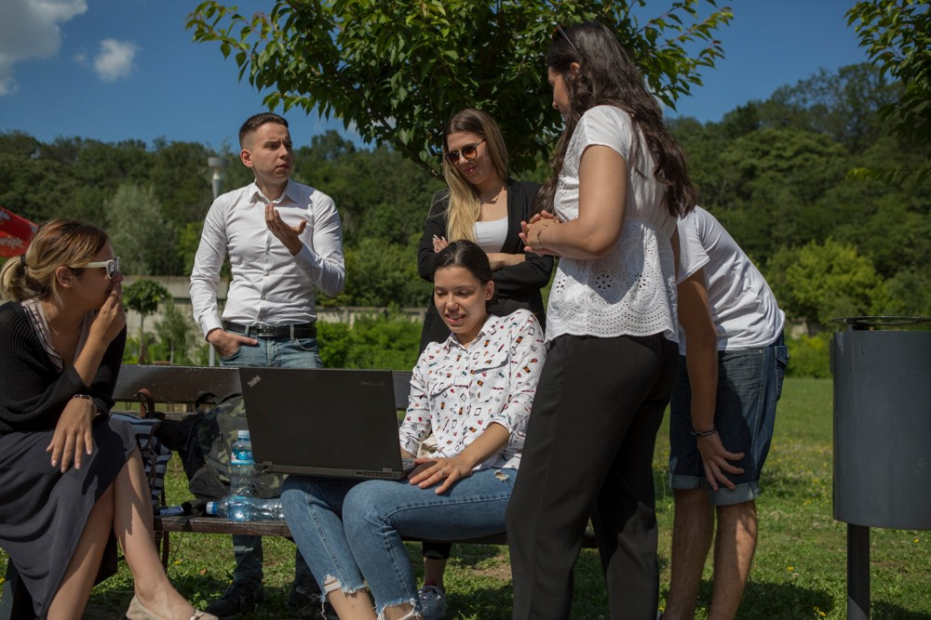
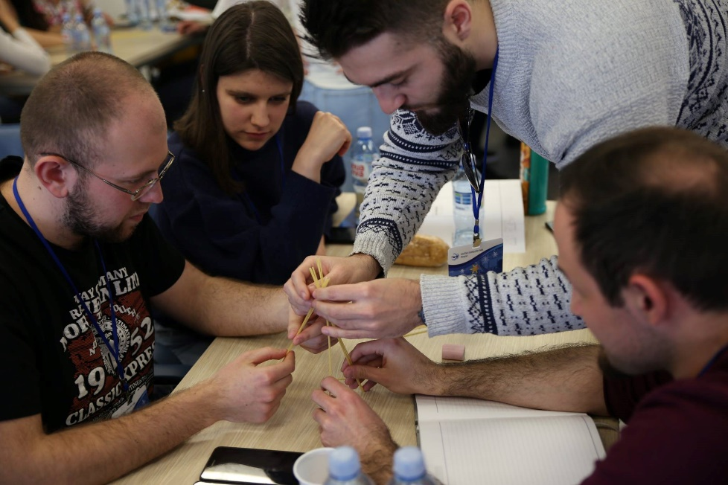
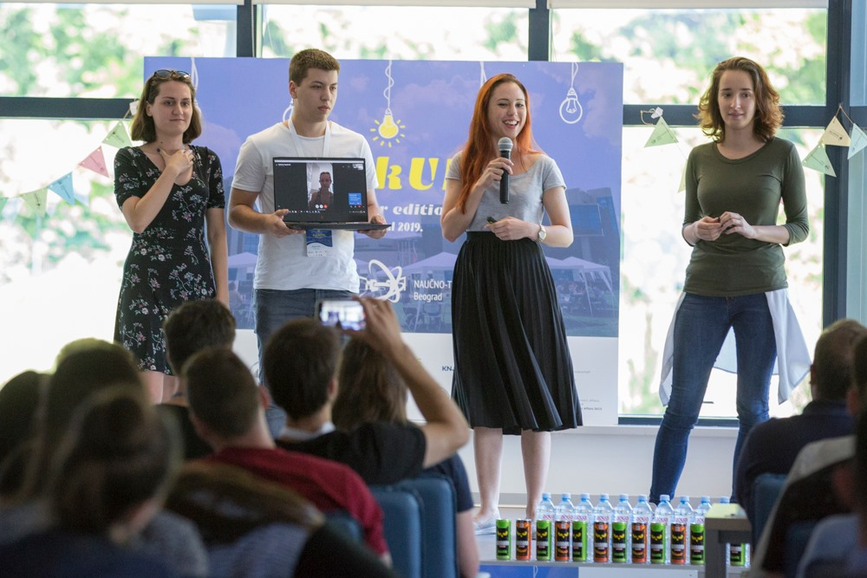
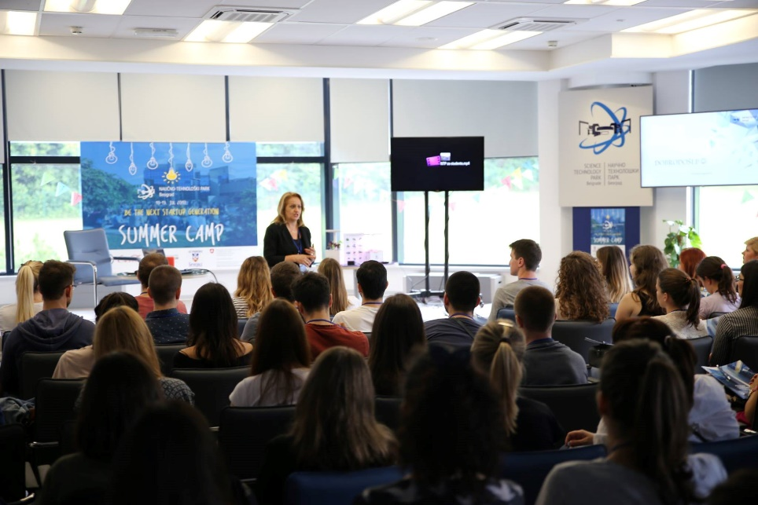
15 FACULTIES

Slide 14
We strive to create an environment where startup founders can focus on idea validation and building amazing products.
With support of:

Slide 15
We will expand your know-how and support you in turning your idea into successful business.
With Raising starts program you will benefit from:
- financial support up to CHF 20,000 with no equity!
- trainings and mentors
- networking and modern maker space
It's time for your idea to shine!
up to100
COMPANIES
3
CITIES
With support of:

Slide 16
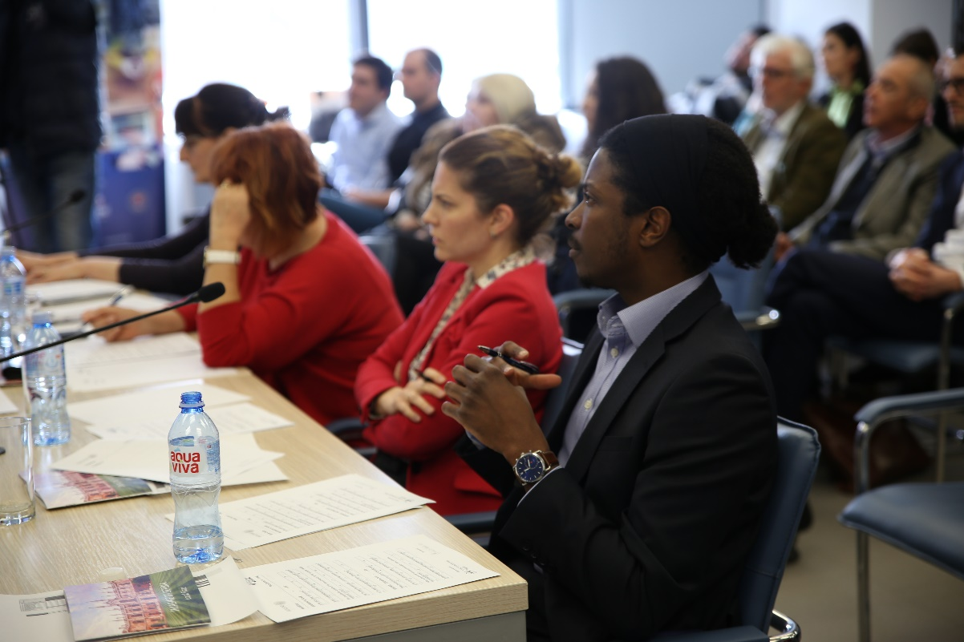
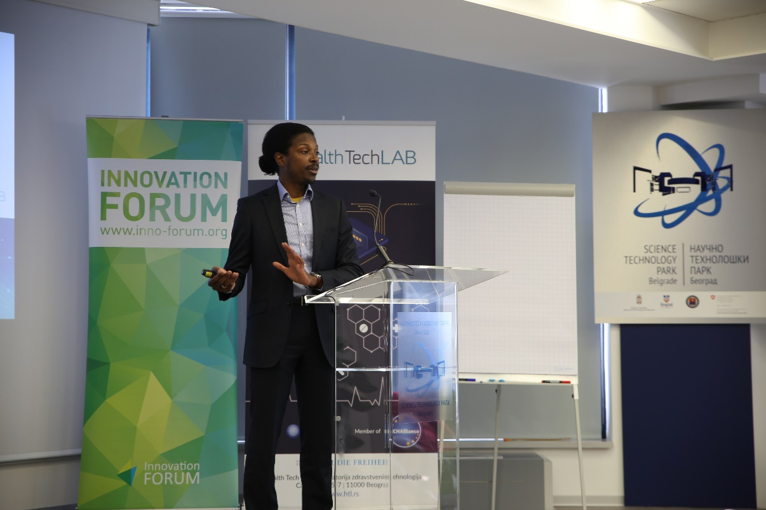
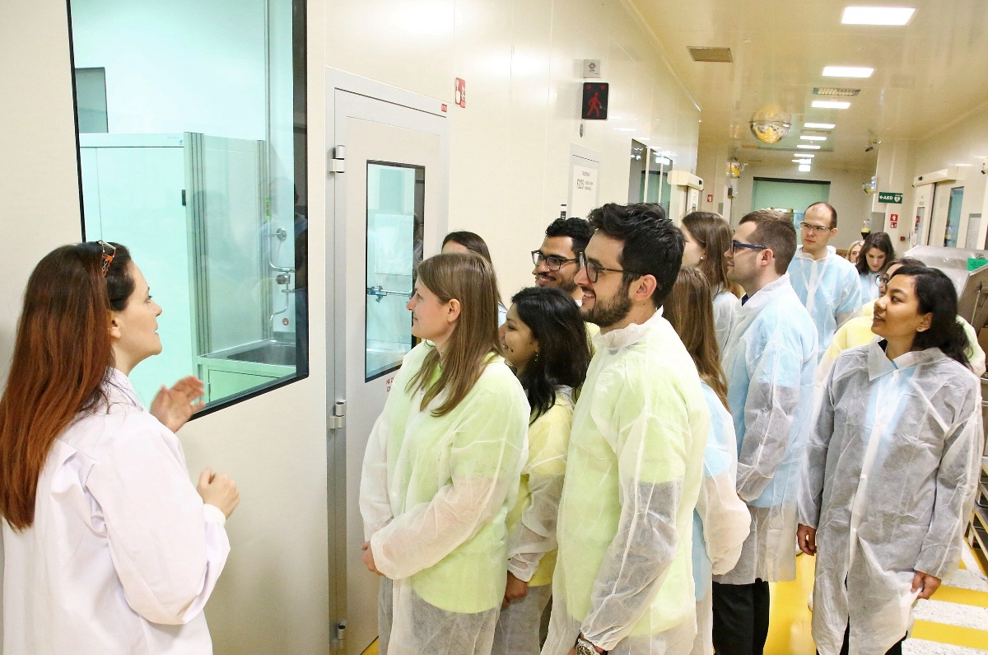
IMAGINE IF! is the first truly global competition and pre-accelerator program for healthcare science-based ventures. The Program provides to early-stage science startups extensive opportunities: mentorship, the potential to secure non-dilutive capital, free advice from leading professional services companies and rapid networking across the Innovation Forum platform.
*in 2 Years n Serbia
In partnership with
2
batches
15+
Workshops
25
startups
100+
mentors
450+
Participants

Slide 17
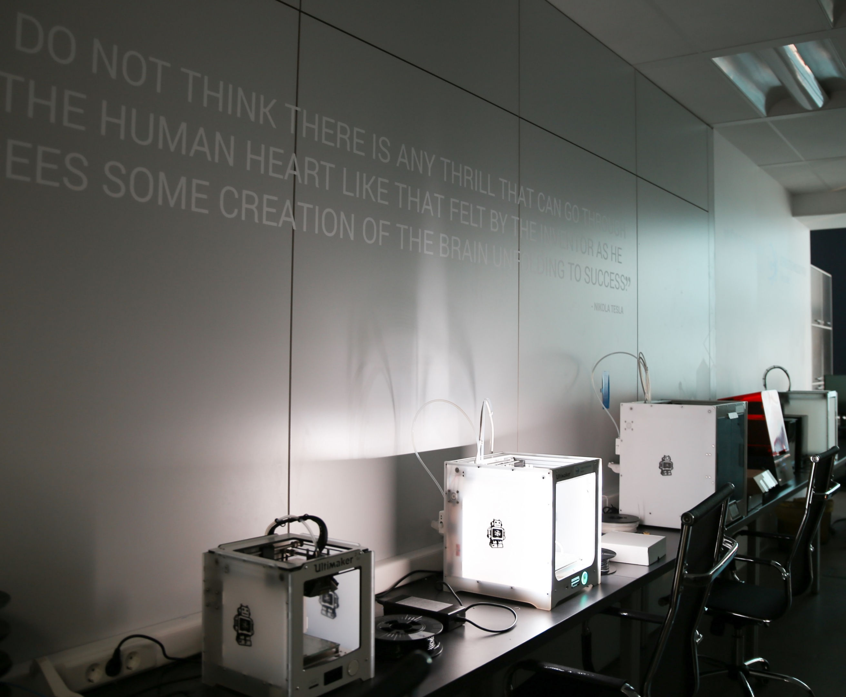
FROM THE IDEA TO THE PRODUCT REALIZATION
3D Innolab
Laser & UV Innolab
CNC Innolab

Slide 18
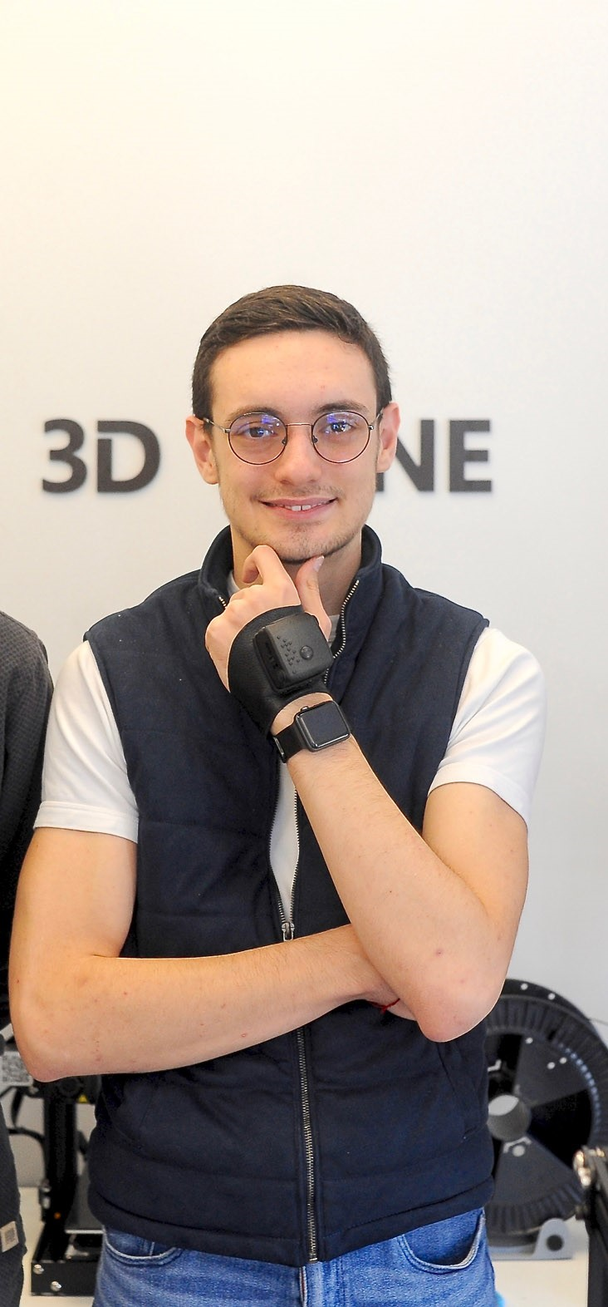
INCUBATION
The Social Formula with their own, specially designed and coded targeting tools for enhancing companies’ online presence by finding the ideal customers online, aiming to create unique advertising and digital marketing strategies.
UrbiGo produces smart vertical gardens that allow urban residents to grow plants or spices in their apartments all year around.
A young startup that develops a smart glove for blind and visually impaired people. The glove works according to the principle of guiding a similar white stick, changes it and complements it.

Slide 19
GROWTH PROGRAM
We support SMEs and R&D of large domestic and foreign companies who dare to disrupt the ordinary
How to establish business in Serbia
Access to talents
Access to our network
Visibility and promotion
Innovative environment
Conference space
Curently, we are home to more than 10 foreign R&D centers, including companies from Switzerland, Germany, Italy, etc.

Slide 20
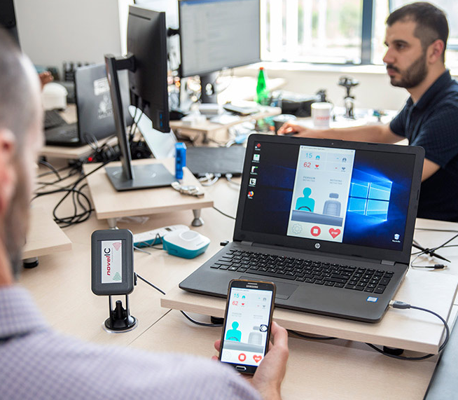
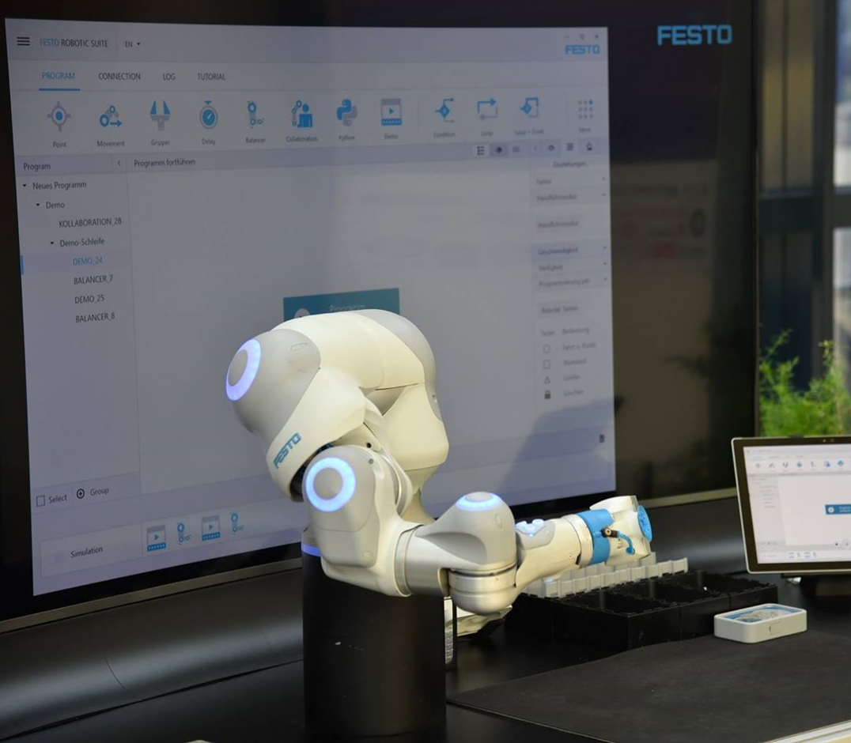
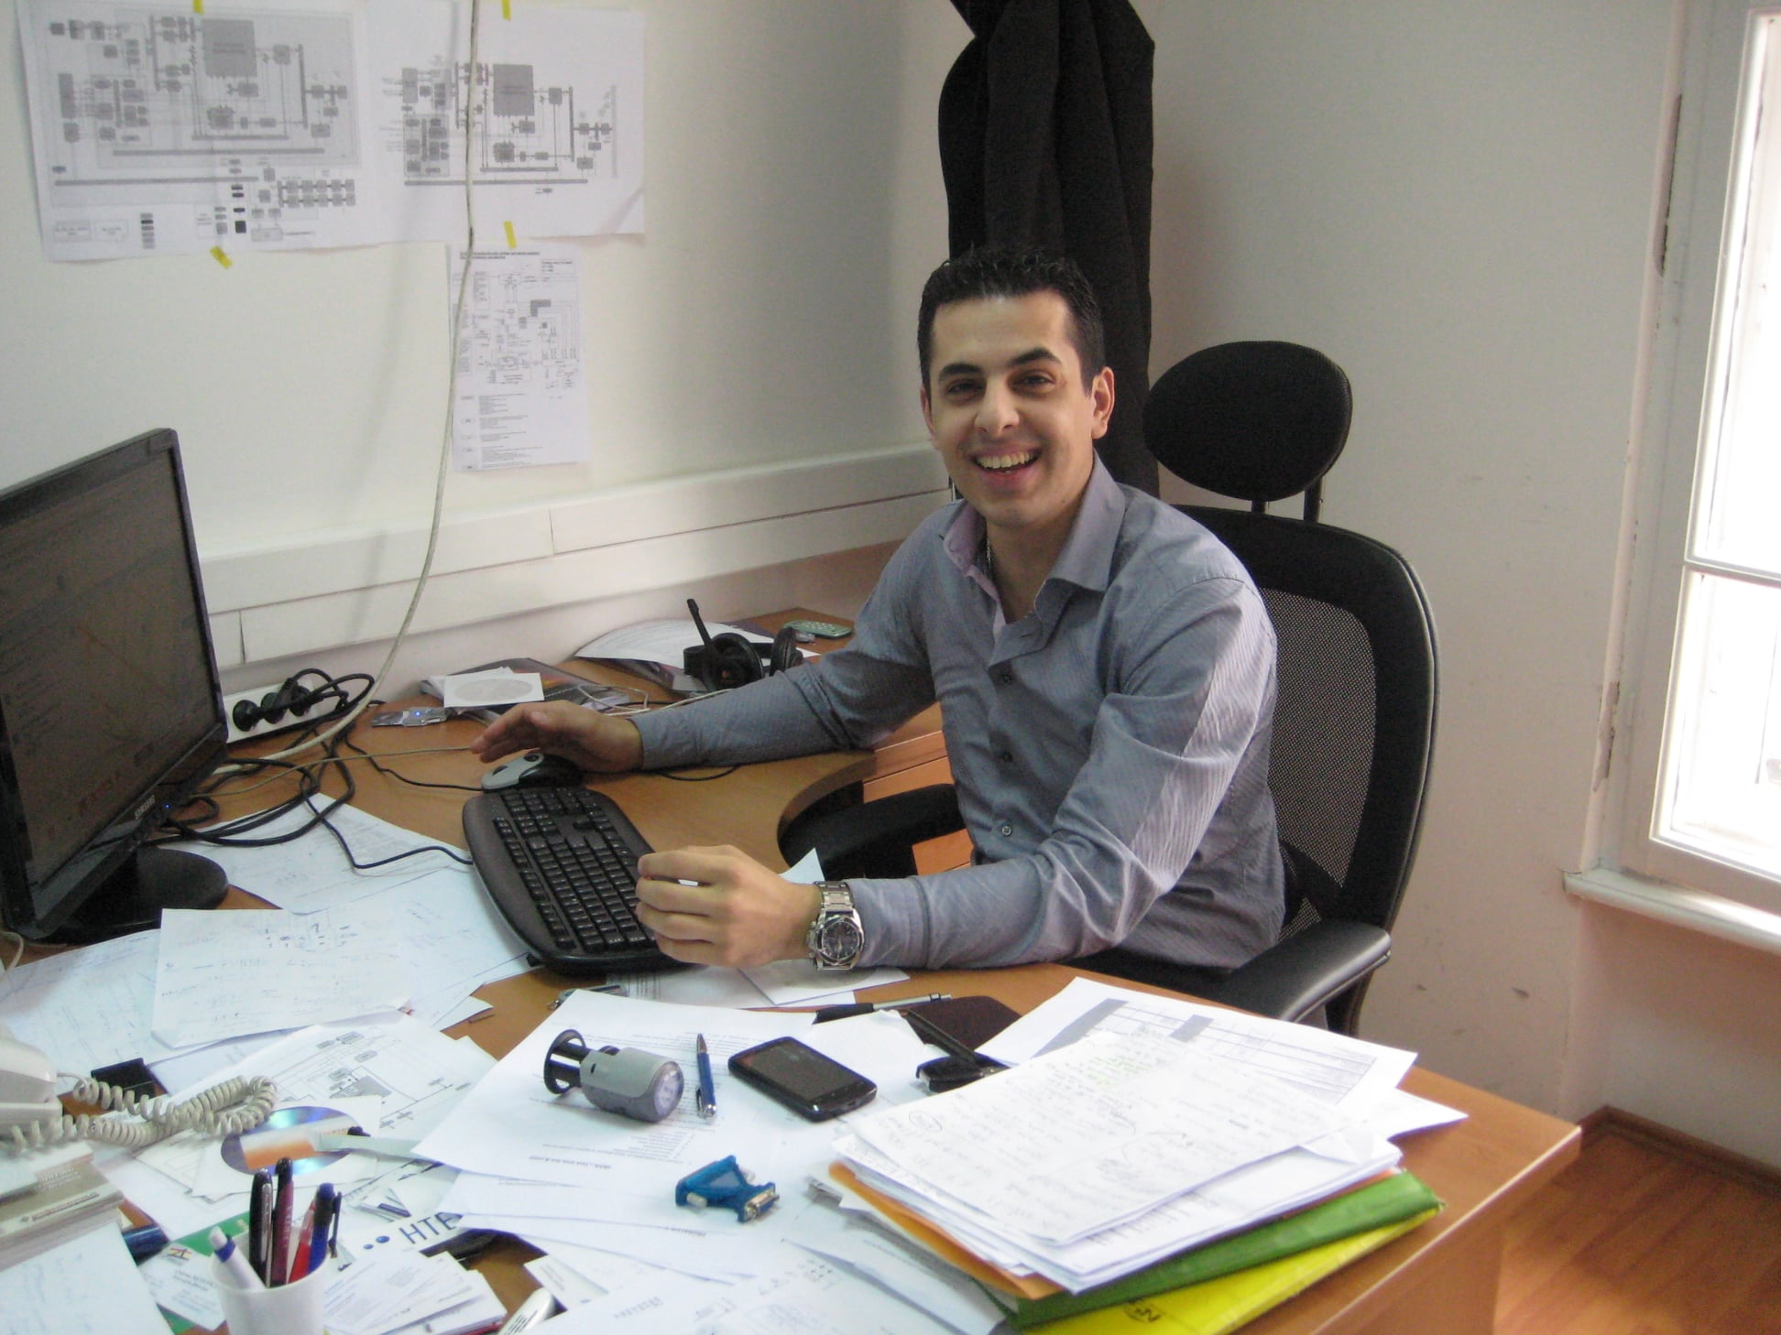
GROWING COMPANIES
HTEC is an engineering and technology company that has been developing various digital products in different industries such as robotics, green-tech, energy, fin-tech, med & health-tech. The company has grown from 250 to more than 2.000 employees in just two years. They have raised more than 150 million EUR of external capital
NovelIc Microsystems develops its own patented radar sensor and software hardware (radar-on-chip) for various applications: contactless detection of vital signs and presence of humans within cars and smart homes of the future.
Festo Serbia, the Serbian branch of Festo Company founded in Germany established Festo Didactic, the education and application center, which offers services ranging from educational equipment and consulting

Slide 21
HOW TO BECOME A MEMBER
MEMBERSHIP
EVALUATION
PUBLIC CALL
Full member
Virtual membership
Committee evalutes if the company fits criteria
Application process

Slide 22
KNOWLEDGE TRANSFER
OUR EXPERTISE:
Business model for establishment & development of tech parks & incubators
Development of business support programs for start-ups
Connecting local stakeholders in generating the change in the ecosystem
BY IMPLEMENTING THIS BUSINESS MODEL, STP IS CAPABLE TO GENERATE EACH YEAR MORE:
INNOVATION, JOBS, EXPORT, STARTUPS!

Slide 23
WE CONNECT YOU TO THE WORLD AND BRING THE WORLD TO OUR COUNTRY
MEMBER OF

Slide 24
STP BELGRADE
ANY TIME IS A GOOD TIME TO START A COMPANY
LET’S CONNECT
Founders:
With support of:

