Slide 1
WIPO Existing Tools and Programs to Support Techno-Parks in Defining their Institutional IP Policies
Alejandro Roca Campana
Senior Director
IP for Innovators Department (IPID)
IP & Innovation Ecosystems Sector

Slide 2
Video about Technology Transfer on IP and TT webpage

Slide 3
Support Academic Institutions to create an interconected Innovation Ecosystem
Global Challenges & Trends
Research results
Linkages
Legal Framework
Government
IP
Your University’s Ecosystem
Education
Challenges
Outcomes
Incentives
IP Policy
Collaborations
Infrastructure
Research
Strategic University Goals
TTO/TISC
Dissemination
Businesses
Venture Capital
People
Technology Transfer
Technology Transfer
Funding
IP Market
Education & Skilled People
IP Commercialization
Commercia-lization
Funding
New Products & Services
Climate Change, Pandemics, Cyber Issues

Slide 4
WIPO – Assisting Technology Transfer Structures to Create an Institutional Innovation Ecosystem
Legal Framework - Institutional IP Policy
TT Structures
Professional Human Capital
Funding for technology transfer services

Slide 5
Technology Transfer Legal Framework
National Level
Support for development and improvement of national legislation with focus on specific technology transfer regulations and guidelines
National Projects on the Assessment of Technology Transfer Systems with Recommendations for Improvements – in order to facilitate development of enabling innovation eco system.
Institutional Level
Assistance for Development of the National Model of IP Policy for academic institutions – National IP Policy Template;
Expert coaching services for professionals working on definition of Institutional IP Policies based on WIPO IP Toolkit for Universities and R&D Institutions.
Contribution to the national IP Strategy – technology transfer regulations;
Launching in 2023 - Technology Transfer Provisions database

Slide 6
IP Policy Resources
WIPO IP Policy Toolkit
The IP Toolkit helps universities and research institutions deal with key issues such as ownership of IP and rights of use, IP disclosure, IP management, commercialization of IP, incentives for researchers, recording and accounting, and conflicts of interest.
IP Policy Writer’s Checklist
IP Policy Template for Academic and Research Institutions
Guidelines for Customization of the IP Policy Template
https://www.wipo.int/technology-transfer/en/ip-policies.html

Slide 7
1. Policy Writers’ Checklist
Step-by-step information on the different stages
Guidance on policy choices
Notes:
IP Policies exist in a variety of forms, scope, length, and degree of specificity. There is no perfect template, superior to others. What matters is that the Policy works and is owned by its users – the institution and its personnel.
The aim of this Checklist is to set a consistent basis for institutions willing to draft their IP Policy, by providing
step by step information on the different stages the process of creating or improving an IP Policy usually involves, and
guidance on Policy choices

Slide 8
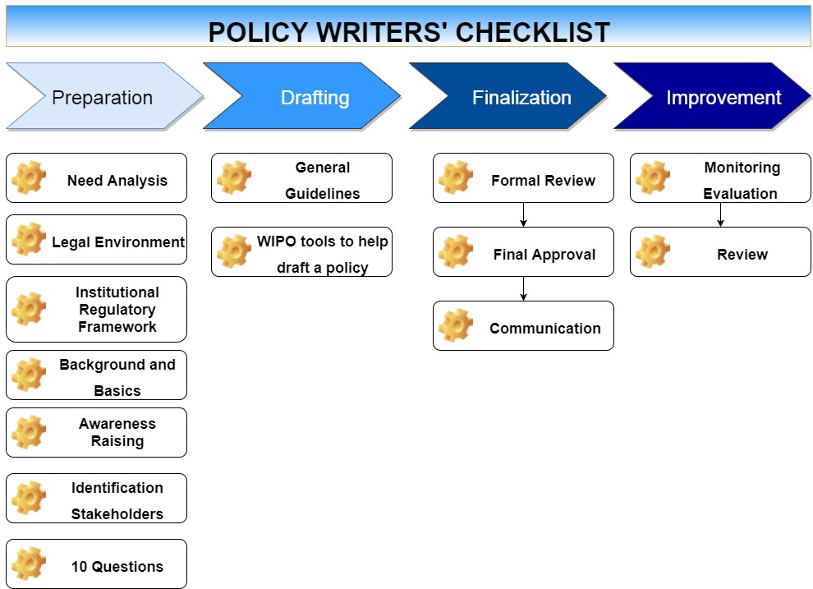

Slide 9
Example
2.2 analyzing the legal FRAMEWORK
An Institution’s IP Policy must be consistent with national employment and IP legislation and any exemptions that may exist for public researchers or for universities and their faculty.
Unfortunately, it is not always straightforward to find out what are the national rules on the ownership and commercialization of IP emerging from universities and research institutions. The help of an IP lawyer may be needed to help clarify the key legal issues. Furthermore, the Institution should consider the international IP environment if it intends to consider the global implications of its IP.
Notes:
The checklist warns the reader that the policy must be in line with national law.
So, one of the first steps is to assess the national legal framework.

Slide 10
Checklist – Key Legal Framework Issues
Does your country have any laws, regulations, or policies that focus on:
Default legal regime for employee’s inventions/creative output;
Ownership of research results in publicly sponsored research;
Specific ownership rules for public research organizations and possibility to modify them contractually;
Specific ownership regime for students/visiting researchers/doctoral students and possibility to modify it contractually;
Specific regime for commercialization procedures;
Requirements regarding transfer of IP and licensing;
Creation of spin-offs;
Specific regulation on organization and support of commercialization processes within the Institution (e.g. technology transfer office);
Rules of apportionment of expenses and revenues from R&D activities and the subsequent exploitation of the results;
Exemptions for research use;
Specific rules regarding publication of scientific results financed by public bodies;

Slide 11
Biodiversity laws regarding the possession, use and transfer of biological materials;
Traditional Knowledge laws that may impact Institution research and creative activity;
Non-disclosure and non-compete clauses in research contracts;
Incentives provided by law (e.g., legal requirements for researchers to disclose; royalty sharing or equity participation in start-ups; tax reduction for incomes from IP commercialization, number of inventions filed or patented as one of criteria for academic achievements’ assessment);
National guidelines concerning conflicts of interests involving research staff and IP activities;
Mandatory IP licensing requirements.

Slide 12
2. IP Policy Template 3. Guidelines for Customization
Template
A “model”, but customizable.
Compendium of key issues to be regulated in an IP Policy.
Guidelines
Explain the contents and describe the background of each proposed article in the Template.
The aim is not to give absolute directions, but to present and explain different available options, leaving to individual institutions the choice of solutions best applicable to their needs.
Notes:
This Intellectual Property Policy Template for Universities and Research Institutions (IP Policy Template) aims to provide a compendium of key issues that are essential in an IP policy, including ownership, benefit sharing and incentives, confidentiality and publication, IP management and commercialization, recording and maintenance of IP, and IP-related conflicts of interest.
The Template provides a coherent set of clauses that comprise an effective IP Policy. The clauses may be used as is. However, there are a variety of policy choices and clauses that may be used instead of those provided in the Template.
The Guidelines for Customization of the IP Policy Template provide these alternatives and describe options through different country examples, and an analysis of pros and cons of various approaches.

Slide 13
WIPO Template and Guidelines: Content
Art.1 – Preface
Art.2 – Definitions
Art.3 – Scope
Art.4 – Governance and Operation
Art.5 – Ownership of IP and Rights of Use
Art.6 – Publication, Confidentiality, Non-Disclosure, Trade Secrets
Art.7 – Research Contracts
Art.8 – IP Disclosure and Determination of IP Ownership
Art.9 – Commercialization of IP
Art.10 – Incentives and Distribution of Revenues
Art.11 – Recording and Maintenance of IP
Art.12 – Traditional Knowledge and Genetic Resources
Art.13 – Conflicts of Interest
Art.14 – Miscellaneous
Notes:
Template 24 pages
Guidelines 80 pages

Slide 14
How it works
IP Policy
Guidelines
Explanations
Options
Template Policy
Individual Policy
Notes:
The Template provides a coherent set of clauses that comprise an effective IP Policy. The clauses may be used as is.
However, there are a variety of policy choices and clauses that may be used instead of those provided in the Template. The Guidelines provide these alternatives and describe options through different country examples, and an analysis of pros and cons of various approaches.
The institutions are encouraged to create their individual policy, and to customize the Template policy toward their own needs and characteristics.

Slide 15
Template
Guidelines
4.2.The IP Management Office (IPMO)
Terminology. Common names for offices responsible for day-to-day management of IP, technology transfer and commercialization differ (see page XX Guidelines).
In deciding on the term, it is important to (1) use the official terms that were already established in any existing university regulations, local practices or national regulations; (2) in the absence thereof, chose a term that reflects the main duties of the unit.
Examples of common names include: Technology Transfer Office (TTO), Technology Licensing Office (TLO), Technology Management Office, Research Contracts and Intellectual Property Services Office, Office of Technology Transfer, Office of Technology Development, Technology Transfer Interface, and Industry Liaisons Office.
4.2.The IP Management Office (IPMO)
4.2.1. The Institution shall establish an IP Management Office (IPMO) or designate a function within the Institution or another organisation to act as such, to assist the Institution in managing its IP in a form that will most effectively promote its development and use for economic and social benefit.

Slide 16
Template
Guidelines
4.2.The IP Management Office (IPMO)
4.2.1. The Institution shall establish an IP Management Office (IPMO) or designate a function within the Institution or another organisation to act as such, to assist the Institution in managing its IP in a form that will most effectively promote its development and use for economic and social benefit.
Article 4.2.1, shall establish: Taking the decision to establish a new IPMO is a significant undertaking, and the decision to create one should be made in the context of a long-term plan that takes into consideration the following :
Does “IP commercialization” align with your institution’s mission?
Do the quality and quantity of research within the institution warrant the establishment of an IPMO?
Is the institution willing to make a long-term commitment to necessary institutional changes and to adequately invest in resources and people?
In some countries, national law or government has required that an IPMO (or similar unit) exists before allowing an Institution the right to exploit IP.
Example: South Africa’s IPRs from Publicly Financed Research and Development Act, 2008 requires that institutions establish an office for technology transfer or designate this function to an existing structure within the institution. See wording of section 6 of the South African Act:
“Establishment of office of technology transfer at institutions
6. (1) Unless determined otherwise by the Minister in consultation with the Minister responsible for higher education, or any other Cabinet minister to which an institution reports, any institution must, within 12 months of the coming into effect of this Act—
(a) establish and maintain an office of technology transfer; or
(b) designate persons or an existing structure within the institution to undertake the responsibilities of the office of technology transfer.
(2) An office of technology transfer is responsible for undertaking the obligations of the institution in terms of this Act.
(3) Two or more institutions may with the concurrence of NIPMO establish a regional office of technology transfer.”

Slide 17
Template
Guidelines
4.2.The IP Management Office (IPMO)
4.2.1. The Institution shall establish an IP Management Office (IPMO) or designate a function within the Institution or another organisation to act as such, to assist the Institution in managing its IP in a form that will most effectively promote its development and use for economic and social benefit.
Article 4.2.1, or designate a function within the Institution or another organisation : There is no single “right” way to set up an IPMO, but success requires considering some specific issues.
Internal Office. Currently the most widely used form is an internal IPMO. Decades of experience has demonstrated that having an organizational unit or specialized department embedded within the institution is best to win the confidence of the researchers, and to be able to recognize new opportunities. [….].
Separate Wholly Owned Company. This structure offers the added advantage of shielding the university from direct risks associated with IP commercialisation in that it can be sued and can sue in its own name, whereas an internal office structure IPMO does not have separate legal persona.
Private IP service provider. The main alternative to creating an in-house IPMO is to outsource some or all of the IPMO functions to specialists from the private sector. Often in long-term arrangements, there are a number of types of private sector service providers who can be employed in the development or exploitation of IP. These can be loosely labelled as advisers, managers and scouts. [….].
An IP Management consortium is a group of institutions cooperating to establish and operate a communal IPMO. This may be a viable option for some institutions who can find other institution, in a similar situation, willing to pool resources. [….].
Example: Consortium - Northern Technology Exchange Market, China
The Chinese Northern Technology Exchange Market (NTEM), as a state-level standing technology market jointly constructed by the Ministry of Science and Technology and the Tianjin Municipal Government in March of 1995, is one of the most important regional technology transfer institutions, the distributing centre of technological achievements and information and the technology trading centre. See: http://www.ntem.com.cn/english1/

Slide 18
IP Toolkit for Academic Institutions - Volume II
Models of Technology Transfer Agreements
Hypothetical case studies – for training purposes

Slide 19
WIPO Models of Agreements
Exclusive IP License with Company
Inter – Institutional Licensing Agreement
Exclusive IP and Technology License Agreement
suitable for any exclusive patent and technology license agreement, where the university licenses its patents and associated unpatented technology to a commercial partner to be commercialised.
It is suitable where the subject matter of the license is:
1. a patent, patent application, or intellectual property intended to be patented
2. software, whether or not patented or intended to be patented
3. know how
4. any combination of the above.
Exclusive Technology License on Know How and Trade Secret
suitable for any exclusive technology license agreement, where the university licenses its unpatented technology to a commercial partner to be commercialised. No patent license is included.
It is suitable where the subject matter of the license is:
know how, trade secrets or other unpatented information
Technology License on Copyright
This template is suitable for use when licensing any works in which copyright subsists.

Slide 20
Examples of Issues Addressed – How to Manage Sublicenses
Terms of Sublicense
Each such sublicense (i) must be in writing and a signed copy thereof must be delivered to University within 30 days after it is signed, (ii) may not grant rights that are greater than or impose obligations that are less than those granted to Licensee in this Agreement, (iii) must identify the University as an intended beneficiary with the right to enforce its rights if Licensee does not, (iv) must permit University to audit the accounts of Sublicense relevant to the sublicense if Licensee does not, (v) must provide for its automatic termination coincident with termination of this Agreement, (vi) may not grant the right to grant further sublicenses, and (vii) may not combine consideration for the sublicense with consideration for other benefits conveyed by Licensee.

Slide 21
How to Audit Accounts of Licensees – Big Challenge
Inspection of Accounts by the University
Upon 7 days notice;
Inspect and copy accounts
Only once in every 12 months
If because of any inspection the University discovers any underpayment of the amounts required to be paid by the Licensee to the University pursuant to this Agreement and the underpayment exceeds five percent (5%) of the amount that should have been paid, the Licensee shall reimburse the University for all reasonable costs incurred in relation to that inspection.
If Licensee elects to inspect the accounts of any Sublicense, Licensee will provide with advance written notice of such inspection, which notice will identify the reasons for such inspection. Licensee will give University a copy of any report of the results of such inspection.

Slide 22
Licensing Insurance
INSURANCE
11.1 The Licensee to Take Out Insurance
(a) Before the Licensee Commercialises Licensed IP or sells any Licensed Product, the Licensee must take out a product liability policy of insurance covering all usual risks covered by such policies, including any loss or damage or injury of any kind whatsoever and howsoever caused to any person or property, and special, direct, indirect or consequential, including consequential financial loss suffered by any person, arising out of the Commercialisation of the Licensed IP or the use of the Licensed Products, for an amount not less than $10,000,000.00 per claim or such other reasonable amount as the University shall from time to time notify the Licensee.
(b) Before any Sublicensee Commercialises any Licensed IP or sells any Licensee Product, the Licensee must ensure that the Sublicensee takes out a product liability policy of insurance of the same scope as required by clause 11.1(a).
The University May Insure if the Licensee Fails to Insure - and Licensee must reimburse the University for all costs incurred by doing so.

Slide 23
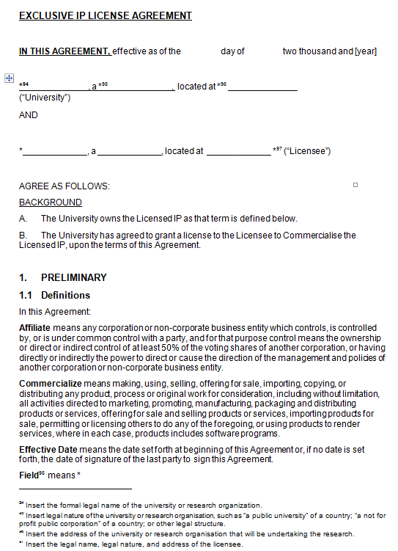
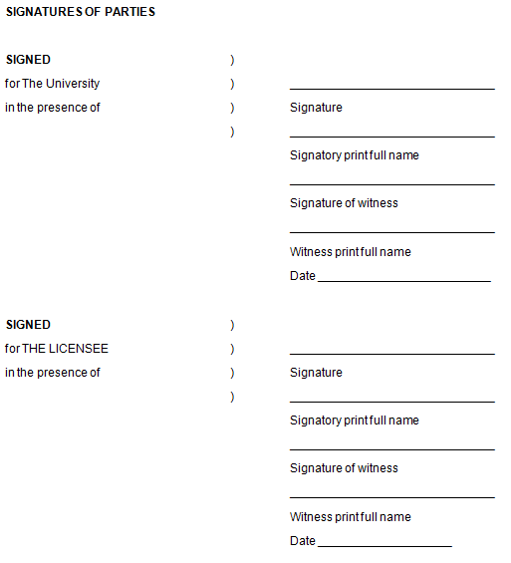
Model Agreement vs. Guidelines (1/2) Exclusive IP License Agreement
Notes:
Introductory Note
This template is suitable for any exclusive patent license agreement, where the university licenses patents to a commercial partner to be commercialised.
It is suitable where the subject matter of the license is a patent, patent application, or intellectual property intended to be patented, or a copyrighted work such as software, whether or not patented or intended to be patented.
This template assumes no confidential information will be exchanged and the Licensee will have no control over publications.
This template is not suitable to license software to an end user.

Slide 24
Model Agreement vs. Guidelines (2/2) Exclusive IP License Agreement
Model Agreement
Guidelines
1. PRELIMINARY
2. TERM
3. GRANT OF LICENSE
4. GRANT OF SUB-LICENSES
5. FINANCIAL TERMS
6. ACCOUNTS
7. DILIGENCE OBLIGATIONS
8. GENERAL OBLIGATIONS OF LICENSEE
9. INTELLECTUAL PROPERTY
10. PATENTS
11. INSURANCE
12. WARRANTIES
13. RELEASE AND INDEMNITY
14. DISPUTE RESOLUTION
15. TERMINATION
16. SERVICE OF NOTICES
SIGNATURES OF PARTIES
1. INTRODUCTION
2. WHAT IS A LICENSE ?
3. WHAT IS LICENSED
4. EXCLUSIVITY
5. FIELD
6. TERRITORY
7. TERM
8. SUBLICENSING
9. DILIGENCE OBLIGATIONS
10. PATENT APPLICATIONS
11. WARRANTIES
12. CONFIDENTIAL INFORMATION
13. PUBLICATIONS
14. STUDENTS
15. INFRINGEMENT
16. INSURANCE
17. RELEASE
18. INDEMNITY
19. TERMINATION
20. GOVERNING LAW
Notes:
Model agreement – under 1. PRELIMINARY incl. definitions: Affiliate, Commercialize, Effective Date, Field, Intellectual Property or IP, Licensed IP, Licensed Product, Net Sales Price, Patents, Royalty Period, Sublicense Fees, Sublicensee, Technology, Territory, Third Party

Slide 25
Model Agreement vs. Guidelines How it works (ex. Exclusive IP License Agreement)
Model Agreement
Guidelines
Explanations
Options
Model Agreement
Individual Agreement
Notes:
The Template provides a coherent set of clauses that comprise an effective IP Policy. The clauses may be used as is.
However, there are a variety of policy choices and clauses that may be used instead of those provided in the Template. The Guidelines provide these alternatives and describe options through different country examples, and an analysis of pros and cons of various approaches.
The institutions are encouraged to create their individual policy, and to customize the Template policy toward their own needs and characteristics.

Slide 26
Template
Guidelines
4. GRANT OF SUB-LICENSES
4.1 Grant
The University grants to Licensee the right to grant a sub-license to any Affiliate or Third Party (Sublicensee) to Commercialise Licensed Technology.
[…]
8. SUBLICENSING
Most exclusive licenses grant the licensee the right to grant sublicenses. Because the IP owner, by granting an exclusive license, agrees not to grant any more licenses, without a sublicense right neither party would be able to grant further rights without amending the contract. It is good practice, therefore, to give the licensee a right to grant sublicenses.
8.1 With or Without Consent
The right to grant sublicenses may be conditioned on the prior approval of the IP owner-licensor. Where the IP owner is a commercial entity, prior approval is usually objectionable because it introduces questions of competitive motive for approval or not. Where the IP owner is a university, however, competition is usually not an issue, and a university may have a legitimate interest in insuring the sublicenses are qualified to commercialize the IP. Normally, where the university has the right of prior approval, it cannot unreasonably withhold, delay or condition approval. This general limit of the university’s right of approval is undefined but often more acceptable than specific criteria for sublicensees.
A prior consent requirement is often of concern to a company licensee because a sublicense may be only part of or broader deal with another company under confidential terms. By law, a licensee cannot grant greater rights or lesser restrictions to a sublicensee than those in the licensee agreement. The company will contend prior approval risks disclosure of confidential information, the scope of a sublicense is limited by law, and license has the same interest as the IP owner in granting sublicensees to qualified companies.
The Exclusive License Agreement templates include sublicense provisions but do not require prior approval. Such a restriction can be added without difficulty.

Slide 27
Template
Guidelines
[…] 4.2 Terms of Sublicense
Each such sublicense (i) must be in writing and a signed copy thereof must be delivered to University within 30 days after it is signed, (ii) may not grant rights that are greater than or impose obligations that are less than those granted to Licensee in this Agreement, (iii) must identify the University as an intended beneficiary with the right to enforce its rights if Licensee does not, (iv) must permit University to audit the accounts of Sublicensee relevant to the sublicense if Licensee does not, (v) must provide for its automatic termination coincident with termination of this Agreement, […]
8.2 Other Sublicense Terms
The provisions in the templates do address other issues arising from the grant of a sublicense.
The sublicense should be in writing and copy delivered to the university. Like any license, a sublicense could be granted orally. Companies often direct their affiliates to practice IP without bothering with formal paperwork. Requiring sublicenses to be in writing and copied to the licensor means the licensor will know who is sublicensed and on what terms. While it may not be prior approval, the university is entitled to know how its IP is sublicensed. If the sublicense is part of a larger confidential deal, the licensee may be permitted to redact terms that are not part of the sublicense.
The sublicense should identify the university or licensor as an intended beneficiary. In some countries, this would permit the licensor or university to enforce the sublicense if the licensee fails to do so. Also, permitting the university to audit the sublicensee’s records if the licensee does not, will aid the university in enforcing its rights to revenue based on the sublicensee’s sales.
Normally, if the license agreement is terminated early, before it otherwise would expire, the sublicense could continue in effect with the sublicensee reporting to the licensor. If the licensor wishes sublicensees to terminate with the license agreement, this must be specified. The templates provide for automatic termination with the license agreement.
Consideration for the sublicense—royalties, upfront fees, milestone payments—should not be combined with payments for other benefits conveyed to the sublicensee as part of a broader deal. If the sublicensee were to pay a combined payment, it would be hard to determine if it was paying for the sublicense or for something else.

Slide 28
Template
Guidelines
[…] (vi) may not grant the right to grant further sublicenses, and (vii) may not combine consideration for the sublicense with consideration for other benefits conveyed by Licensee.
If University requires prior approval of sublicenses, add at end of clause “, subject to prior written consent of University which consent will not be unreasonably withheld, delayed or conditioned.”
Because the licensee may grant all rights it received to a sublicensee and must impose all restrictions on a sublicensee, the license agreement should be clear about what rights cannot be sublicensed or what restrictions need not be imposed. In the templates, it provides that the licensee cannot grant a sublicensee the right grant further sublicenses. The university also may wish to prevent grant of exclusive sublicenses without associated diligence requirements or may wish to waive the requirement of an upfront fee from sublicensees.
Finally, a sublicense will require consideration like that in the license agreement. There may be upfront payments, milestone payments and royalties of the same type required by the license, but nothing prevents a licensee from obtaining more of these payments or additional payments. The templates require a licensee to pay to the licensor not only the royalties on sublicensee sales (clause 5.3(a)), but also a percentage of any other fees received from a sublicensee (clause 5.3(b)).
In some situations where broad sublicensing would be beneficial to spread the use of the IP, a university can agree to share sublicense revenue with the licensee. Thus, a license that permits the licensee to retain 20% of the royalties paid by sublicensees may be a financial incentive to grant many sublicenses.

Slide 29
Guidelines on Joint Ownership
Research Agreement
The first type of agreement where joint ownership of intellectual property can arise is under a research agreement. In each form of research agreement—Contract Research, Sponsored Research, Collaborative Research—each party contributes to the result. Even where one party just pays for research conducted by the other party, the paying party has an expectation which may be ownership or joint ownership of intellectual property arising from the research.
The parties are often drawn to joint ownership of the intellectual property because it sounds equitable. The parties, however, rarely appreciate the complex legal consequences of joint ownership of intellectual property.
2.2 Material Transfer Agreement
The second type of agreement where joint ownership of intellectual property can arise is under a material transfer agreement. One party may provide biological (or non-biological) material to the other for a research purpose. That one party believes the other party’s research would not have been possible without the transferred material. The one party, therefore, has an expectation of return, often in the form of joint ownership of any intellectual property arising from the research.
2.3 When There is No Agreement
Joint ownership arises by law where two or more parties contribute to an invention or an original work of authorship. Under patent law, for example, joint inventors, absent some assignment by them, will be joint owners of the patent. Where such inventors are employed by the same employer, the employer may be the sole owner of the patent, but if the joint inventors are employed by different employers, the latter would be joint owners.

Slide 30
Implications of Joint Ownership

Slide 31
Hypothetical Case Studies – Base for Educational and Capacity Building Programs
Based on real experiences of the experts developing the Toolkit;
Each case study begins with a background story followed by several focused questions arising from it, and finally proposing ( not imposing!!) solutions;
Corresponds and make reference to several of the Model Agreements.
HYPOTHETICAL CASE STUDIES
MATERIAL TRANSFER AGREEMENT (COMMERCIAL);
EXCLUSIVE LICENSE;
CONTRACT RESEARCH AGREEMENT;
COLLABORATIVE RESEARCH WITH COMPANY;
OWNERSHIP OF IP.

Slide 32
WIPO Technology Transfer and IP Commercialization Capacity Building Programs
Based on the specialized resources, such as IP and TT web site, containing information, tools, databases and case studies related to TT: https://www.wipo.int/technology-transfer/en/index.html
Following programs are offered to innovation stakeholders:
Fundamentals of TT
IPR Management:
https://www.wipo.int/technology-transfer/en/academic-assets-management.html
Institutional IP Policy training: https://www.wipo.int/technology-transfer/en/ip-policies.html
WIPO IP Marketing Program
Successful Technology Licensing:
https://www.wipo.int/publications/en/details.jsp?id=296.
NEW (2022 – 2023): STL02 and Licensing of GR
WIPO Model Technology Transfer Agreements (https://www.wipo.int/technology-transfer/en/agreements.html) and Negotiation Skills
IP Valuation – Training Program, Guides and video Webinar: A Practical Guide
for Valuing Intangible Assets in Research and Development Institutions (https://www.wipo.int/meetings/en/doc_details.jsp?doc_id=331542) and Intellectual Property Valuation Manual for Academic Institutions (https://www.wipo.int/meetings/en/doc_details.jsp?doc_id=332588).
NEW (2022 – 2023): IP Valuation Guide and separate publications on IP Valuation in Biotechnology Sector, SMEs, Litigation and Valuing Equities
NEW (2022 – 2023): WIPO Incentive Guide

Slide 33
Successful Technology Licensing (STL)
Standardized Training Kit
Program
Understanding key terms of licensing agreement
Preparation for negotiations
Simulation of licensing negotiation
Practical application of knowledge acquired on a real cases – coaching sessions
Standard presentations – to be used by stakeholders and experts
Translated in 10 languages
Hypothetical stories
Adaptable program – on line and in situ
Basic and Advanced
Often in combination with IP valuation program for advanced audience
Outcome – capacity of participants to identify risk and opportunities in licensing negotiation
NEW:
1. STL02
2. Licensing of Genetic Resources.

Slide 34
Transferring Technology from Lab to Market
WIPO IP Marketing Program
How to develop technology brief in a collaboration with researchers
Using patent information - Patent landscape - as a source of information regarding potential partners and competitors
Approaching “big companies” – practical advises – “do” and “don’t do”.
IP Valuation – Training Program, Guides and video Webinars
A Practical Guide for Valuing Intangible Assets in Research and Development Institutions;
Intellectual Property Valuation Manual for Academic Institutions;
NEW (2022 – 2023) – IP Valuation Guide and separate publications on IP Valuation in Biotechnology Sector, SMEs, Litigation and Valuing Equities
https://www.wipo.int/technology-transfer/en/access-market.html

Slide 35
IP Valuation – Resources
A Practical Guide for Valuing Intangible Assets in Research and Development Institutions;
Intellectual Property Valuation Manual for Academic Institutions;
IP Valuation Primer for SMEs – developed by LESI for WIPO training needs
https://www.wipo.int/technology-transfer/en/access-market.html

Slide 36
Creating NEW Resources - IP Valuation General Booklet
Oxentia

Slide 37
Booklet content
Abbreviations
What is IP valuation?
1.1. About the purpose, scope and objective of WIPO project
1.2. When is IP valuation used?
1.3. Context in which IP valuation is done
1.4. Existing rules – accounting and international standards
1.4.1. IP value on balance sheets
1.4.2. Other existing international standards on IP valuation
1.5. IP valuation in the knowledge economy
1.6. Complexity of IP valuation – new trends
1.6.1.Blockchain for IP management
1.6.2.Evaluation – Qualitative valuation
1.7. Volatile nature of IP value
2. IP valuation methods
2.1Cost Method
2.1.1. Advantages and disadvantages of the cost method
2.1.2. When the Cost method may be used
2.1.3. Calculating the reproduction cost
2.1.4. Case study - Cost based valuation
2.1.5. Challenges to cost-based valuation in negotiations
2.2. Comparables Method
2.2.1. Advantages and disadvantages of the market method
2.2.2. Estimating a value of IP using the market method
2.2.3. Considerations when using the market method
2.2.4. Case Study - Using the market approach in practice
2.3. Income Approach – Discounted Cash Flow (DCF)
2.3.1. Advantages and disadvantages of the DCF approach
2.3.2. Finding relevant data to populate DCF models
2.3.3. Developing a Discounted Cash Flow template
2.3.4. Case study – DCF based valuation
2.4. Real options (RO) method
2.4.1. Advantages and disadvantages of the Real Options method
2.4.2. When Real Options method can be used
2.4.3. Case study – applying the real options method
2.5. Monte Carlo Simulations
2.5.1. Advantages and disadvantages
2.5.2. Simulating scenarios
3. Conclusions
Notes:
Can explain the format and structure of the workshop:
Aim is to create a plan to develop the technology towards commercialising it
Each sprint builds upon the other

Slide 38
IP Valuation in Biotech and Pharma
Oxentia

Slide 39
Booklet content
Abbreviations
1. Introduction
1.1 How the biotech sector different from others
1.2 IP valuation in the biotechnology sector
2. Income based approaches
2.1 Discounted Cash Flows (DCF) and Net Present Value (NPV)
2.1.1.Risk-adjusted Net Present Value (rNPV)
2.1.2.Case Study – Valuing a Phase 1 drug candidate
2.2 Real-Options Valuation (ROV)
2.2.1.Modelling and resolving decision trees
2.2.2.Considerations when using ROV
3. Comparables Method
3.1 Sourcing relevant data
3.2 Considerations when using the comparables method
4. Conclusions
Notes:
Can explain the format and structure of the workshop:
Aim is to create a plan to develop the technology towards commercialising it
Each sprint builds upon the other

Slide 40
Licensing in the area of Biotechnology and Genetic Resources
WIPO Covid Package
Reference documents
TT Primer for Biotechnology Sector
IP Policies for Universities
Models of capacity building programs customized for the needs of biotech or pharma stakeholders
Licensing of Genetic Resources
Text Box
Bridge – data base of licensing agreements and real business cases
Inter – active tool

Slide 41
New IP and Technology Transfer webpage – Reference on the Google

Slide 42
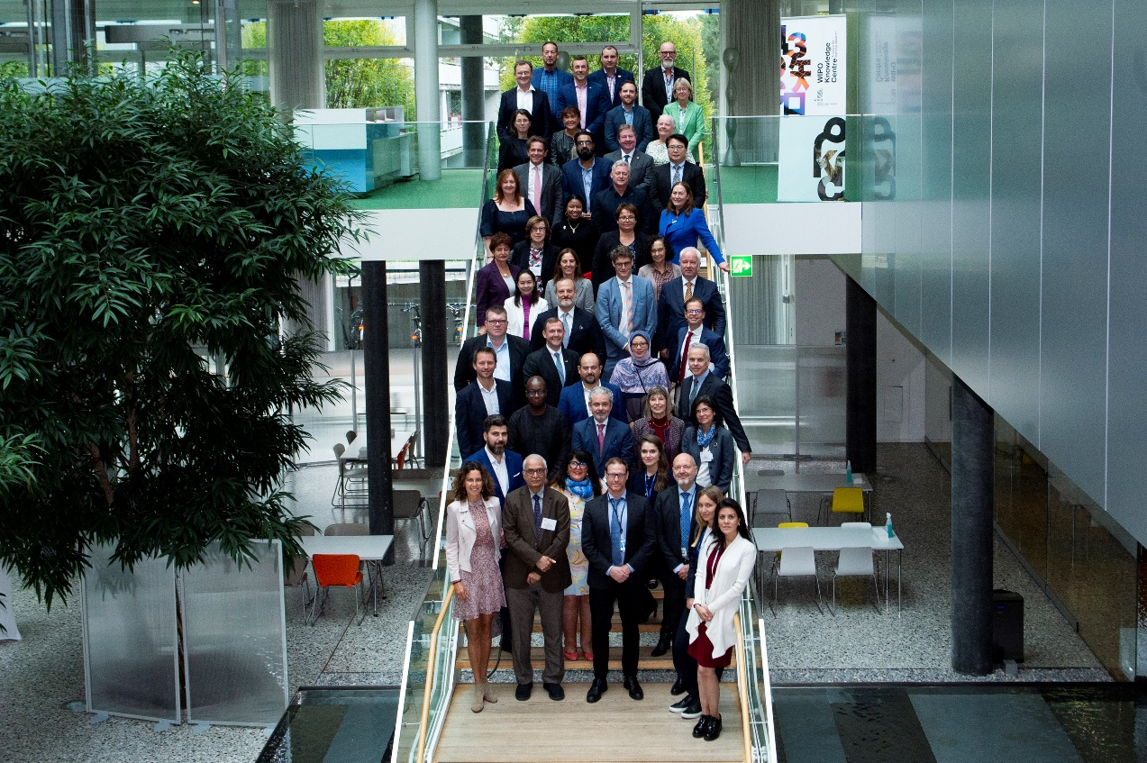
WIPO – AUTM International Knowledge and Technology Transfer Leadership Summit 2022
The first WIPO / AUTM International Knowledge and Technology Transfer Leadership Summit;
WIPO vision to facilitate global technology transfer inclusive dialogue;
TT leaders worldwide discussed future of TT system and discussed “hot topics”, diversity and inclusion in innovation eco systems and government funding.

Slide 43
Digital Support Tools and Platforms
WIPO INSPIRE Platform
Database Reports
Patent Register Portal
eTISC Platform
TISC Project and Performance Management Platform (TPPM)

Slide 44
WIPO INSPIRE
https://inspire.wipo.int/

Slide 45
Thank you!

